Slide 1




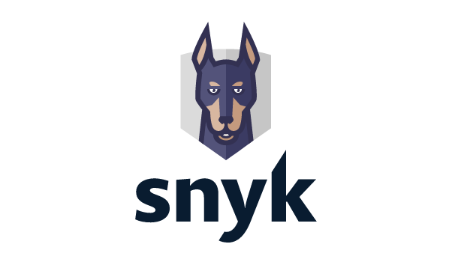
Full integration option
AWS Lambda integration option
Amazon ECR integration option
AWS Cloud
AWS Cloud
AWS Cloud
AWS Lambda
Amazon Elastic Container Registry
AWS Lambda
Amazon Elastic Container Registry
Cross-account IAM role
Cross-account IAM role
Cross-account IAM role
Snyk integration

