Slide 1





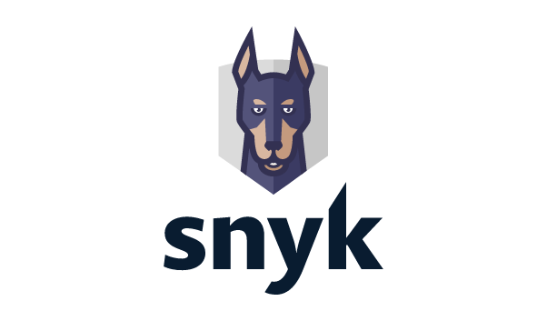
Full integration option
Snyk Cloud integration option
Snyk Container integration option
Snyk Container “auto” integration option
AWS Cloud
AWS Cloud
AWS Cloud
AWS Cloud
Amazon Elastic Container Registry
Resources
Resources
Amazon Elastic Container Registry
Amazon Elastic Container Registry
AWS Lambda
Create Snyk organization; install ECR integration
Cross-account IAM roles
Cross-account IAM role
Cross-account IAM role
Cross-account IAM role
Snyk integration

