Slide 1




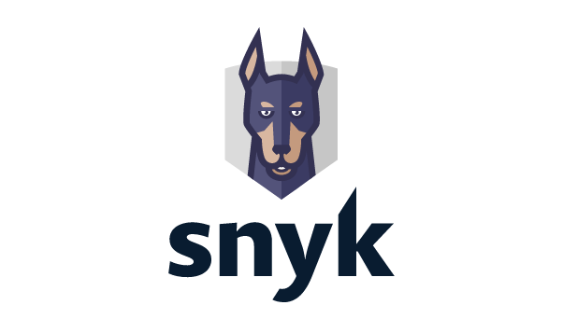
AWS Lambda integration option
Amazon ECR integration option 2 (automated Snyk connection)
Full integration option
Amazon ECR integration option
AWS Cloud
AWS Cloud
AWS Cloud
AWS Cloud
AWS Lambda
Amazon Elastic Container Registry
AWS Lambda
Amazon Elastic Container Registry
Amazon Elastic Container Registry
Cross-account IAM role
Cross-account IAM role
Cross-account IAM role
Cross-account IAM role
Snyk integration

