Slide 1





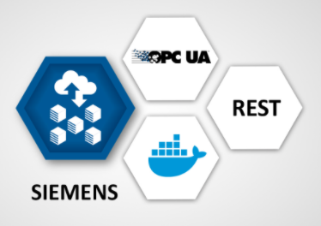
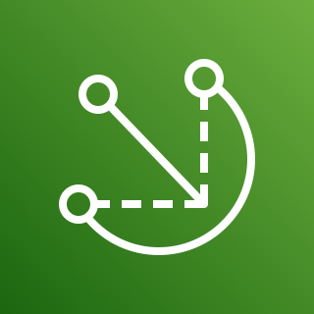







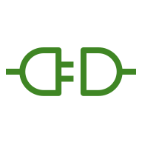
AWS Cloud
Availability Zone 1
Availability Zone 2
VPC
Public subnet
Public subnet
Lambda function
Classic
Load Balancer
Auto Scaling group
Softing dataFEED edgeConnector Siemens in PLC simulation mode
NAT gateway
Amazon EC2 instance
NAT gateway
AWS IoT Greengrass
AWS IoT Core
AWS IAM
Amazon ECS
AWS IoT SiteWise
AWS IoT SiteWise connector

