Slide 1





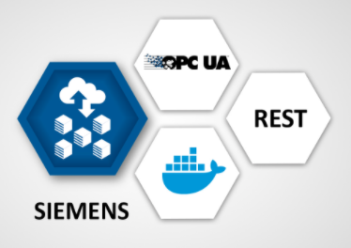








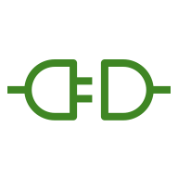

AWS Cloud
Availability Zone 1
Availability Zone 2
VPC
Public subnet
Public subnet
Classic
Load Balancer
AWS IoT Greengrass
Auto Scaling group
Softing dataFEED edgeConnector Siemens in PLC simulation mode
NAT gateway
Amazon EC2 instance
NAT gateway
AWS IoT Core
Amazon Elastic Compute Cloud (Amazon EC2)
AWS Identity and Access Management (IAM)
Amazon Elastic Container Service (Amazon ECS)
AWS IoT SiteWise
AWS IoT SiteWise connector
Lambda function

