Slide 1













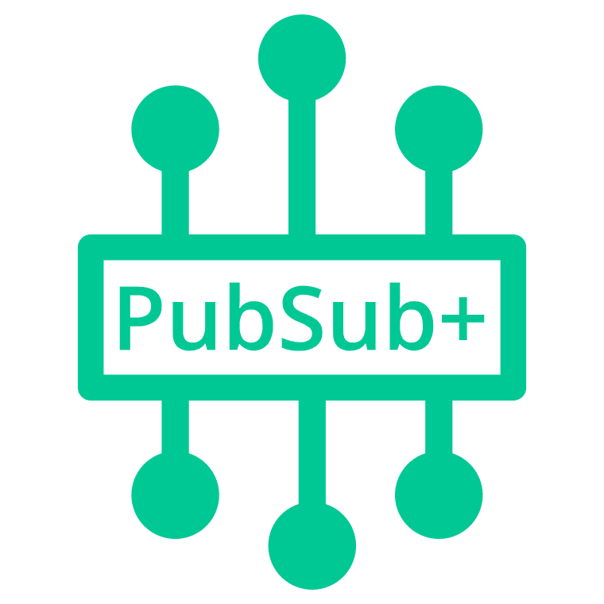


AWS Cloud
Client Access
Solace SMF, REST, WebSocket, MQTT, AMQP etc.
Open standard protocols and APIs
Availability Zone 1
Availability Zone 2
Availability Zone 3
VPC
Messaging client
Public subnet
Public subnet
Public subnet
10.0.128.0/26
10.0.129.0/26
10.0.130.0/26
HTTPS
NAT gateway
NAT gateway
NAT gateway
Internet gateway
Linux Bastion Auto Scaling group
PubSub+ Manager in Browser
Bastion host
SSH traffic
Bastion host
SSH traffic
Admin
Management client
Solace SEMP,
SSH (for CLI)
Private subnet
Private subnet
Private subnet
10.0.128.64/26
10.0.129.64/26
10.0.130.64/26
S3 Template Storage
Elastic Load Balancing (ELB)
Monitoring Node
Primary Broker Node
Backup Broker Node
Cloud Initialization logs
10.0.128.0/22

Slide 2


AWS Cloud
Availability Zone 1
Availability Zone 2
Availability Zone 3
VPC
Public subnet
Internet gateway
Public subnet
Public subnet
HTTPS
Messaging client
NAT gateway
NAT gateway
NAT gateway
Auto Scaling
group
Amazon S3
Linux bastion host
Linux bastion host
Administrator
Logs
Private subnet
Private subnet
Private subnet
Solace SEMP,
SSH (for CLI)
Classic Load Balancer
Primary broker node
Backup broker node
Monitoring node

