Slide 1







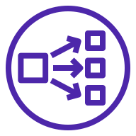




AWS Cloud
VPC
Availability Zone
Availability Zone
Public subnet
Public subnet
Auto Scaling group
NAT gateway
Bastion
NAT gateway
Amazon Simple Storage Service (Amazon S3)
Private subnet
Network Load Balancer
Private subnet
Auto Scaling group
Dnodes
Dnodes
AWS Identity and Access Management (IAM)
ElastiCache
for Redis
ElastiCache
for Redis

