Slide 1









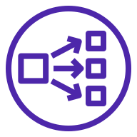


AWS Cloud
VPC
Availability Zone 1
Availability Zone 2
Public subnet
Public subnet
Amazon Simple Storage Service (Amazon S3)
Auto Scaling group
NAT gateway
Bastion
NAT gateway
AWS Identity and Access Management (IAM)
Private subnet
Private subnet
Network Load Balancer
Auto Scaling group
Dnodes
Dnodes
ElastiCache for Redis
ElastiCache for Redis

