Slide 1









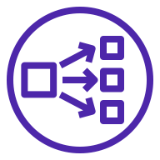


AWS Cloud
Availability Zone 1
Availability Zone 2
VPC
Public subnet
Public subnet
Amazon S3
NAT gateway
NAT gateway
Auto Scaling group
Bastion host
IAM
Private subnet
Private subnet
Network Load Balancer
Auto Scaling group
Data nodes
Data nodes
ElastiCache for Redis
ElastiCache for Redis

