Slide 1


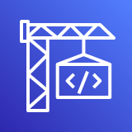



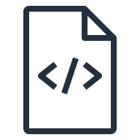
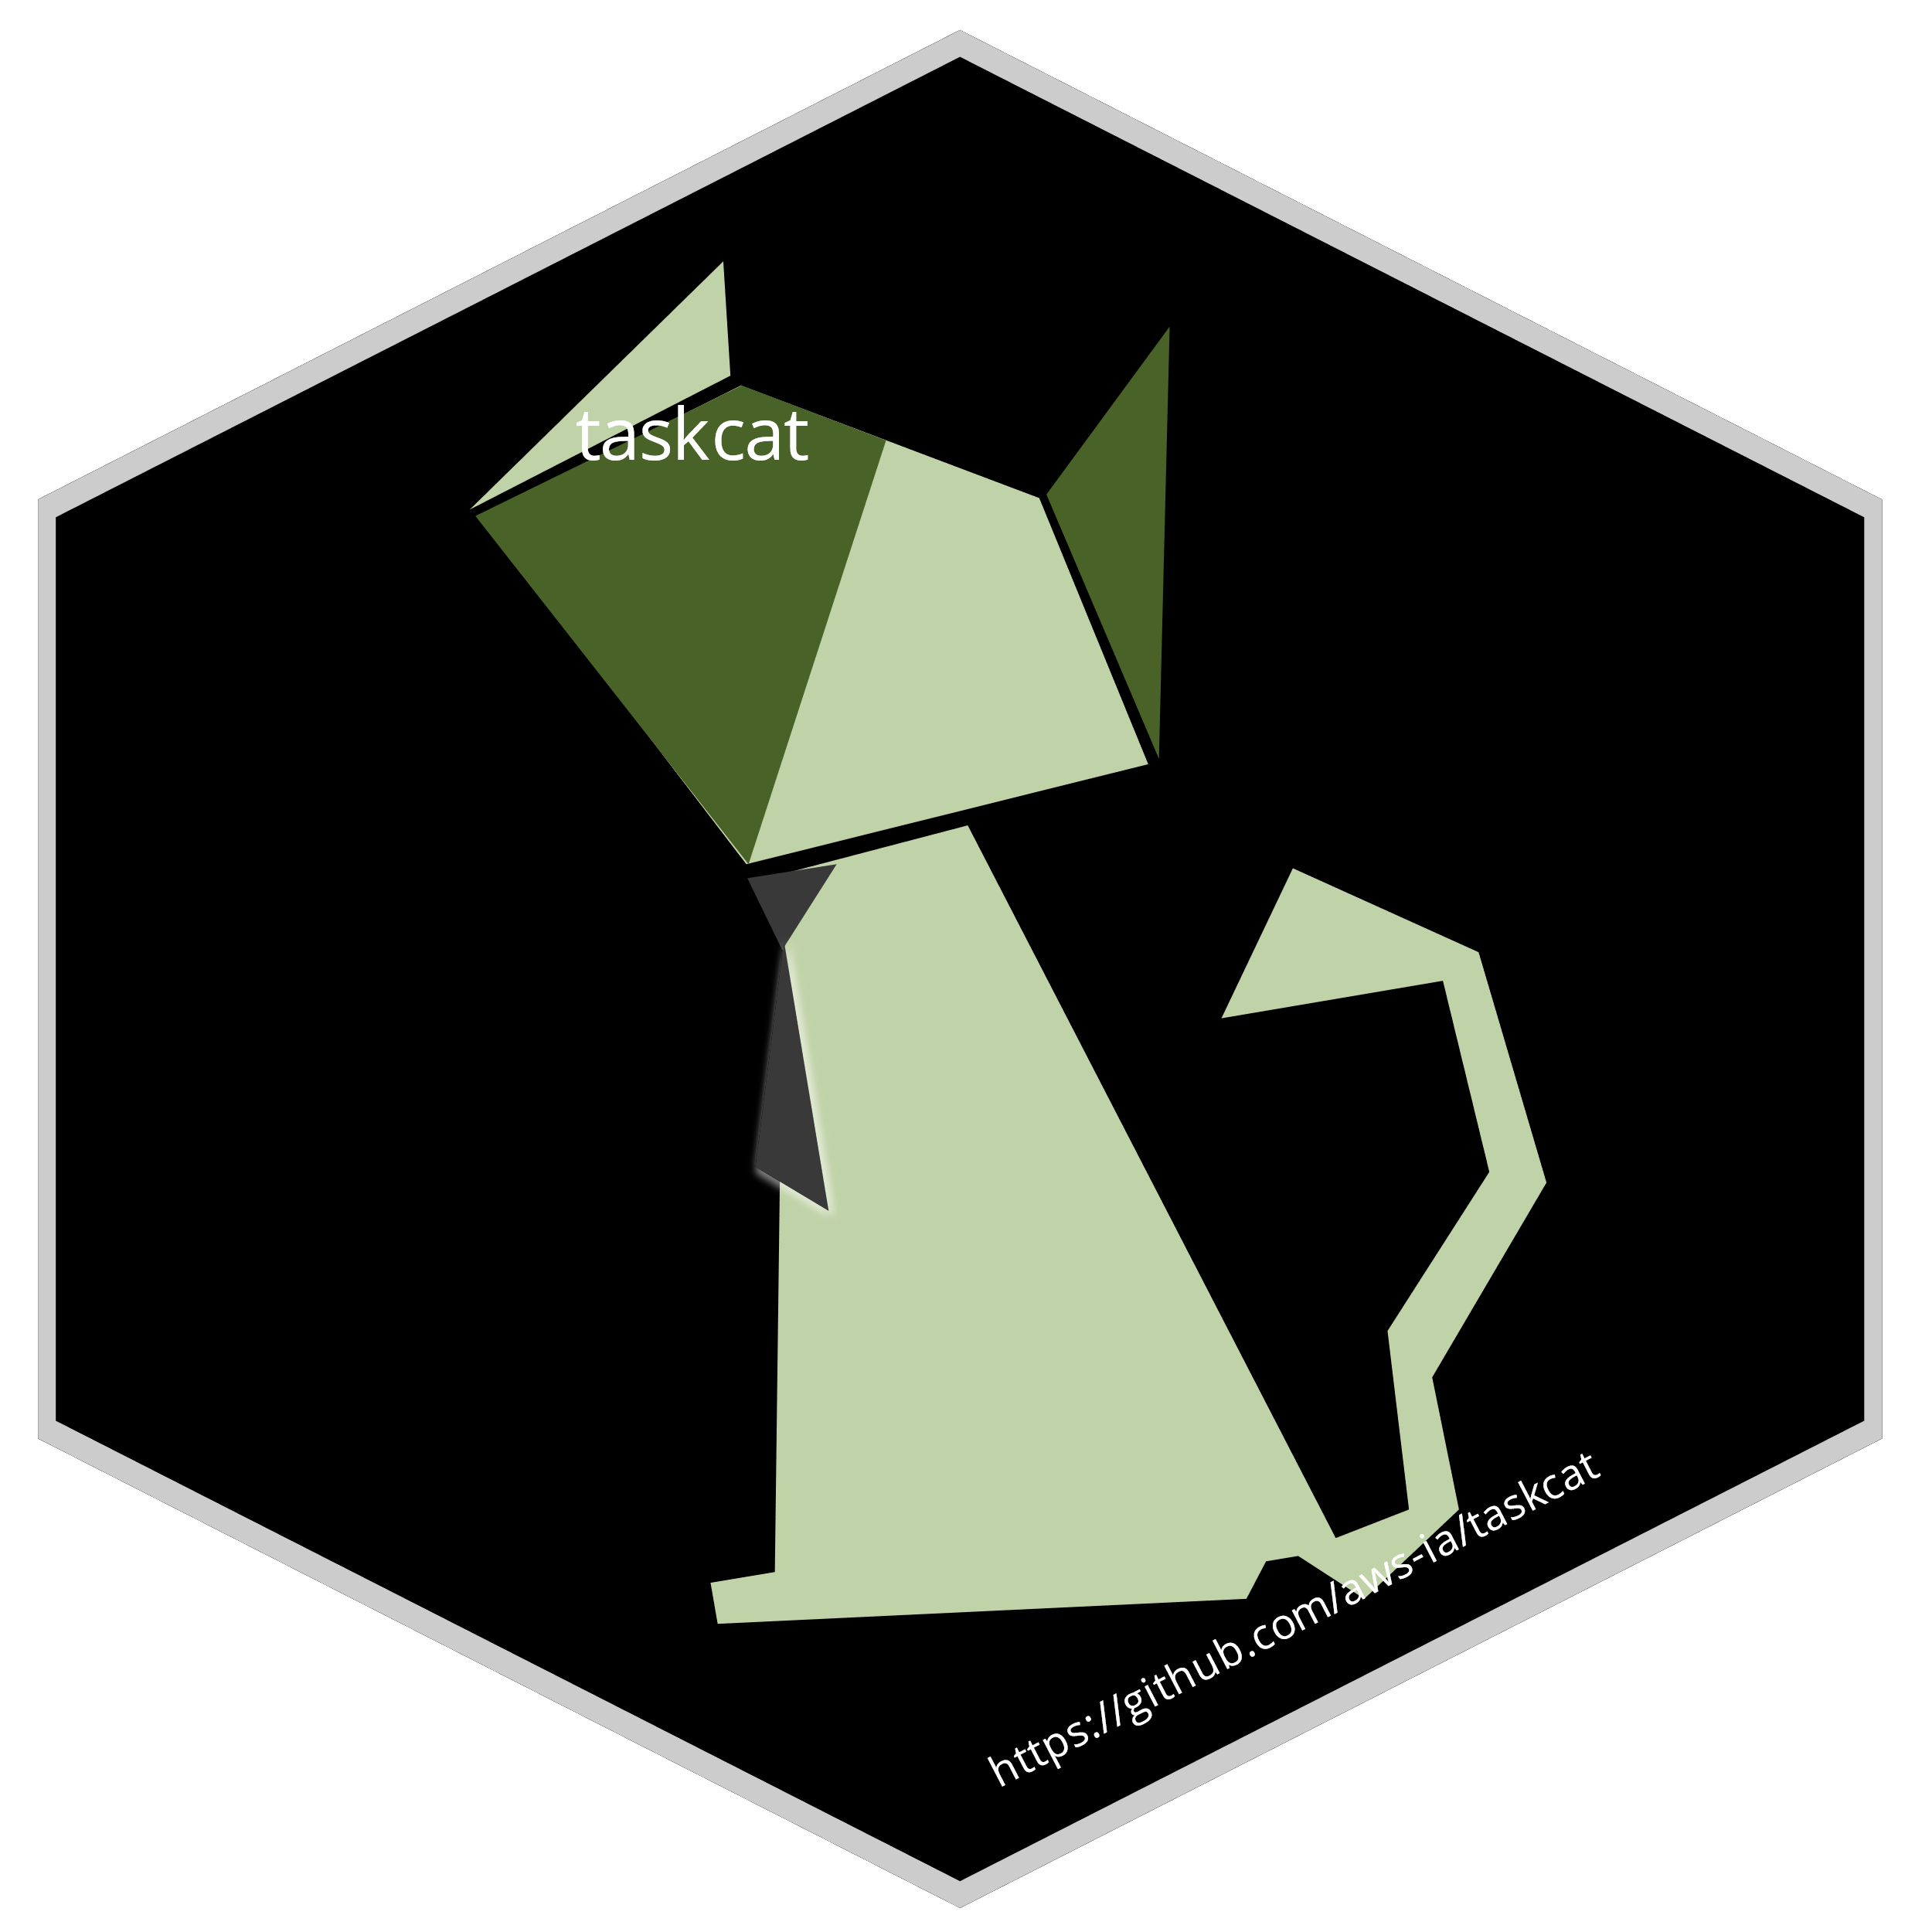



AWS Cloud
AWS CodePipeline pipeline
Source stage
Build/test stage
Deploy stage
AWS CodeBuild project
AWS Secrets Manager
Amazon S3 template bucket
Git push
Git webhook
Git users
Source code
TaskCat
AWS Lambda
GitHub
repository
AWS CloudFormation stack
Amazon S3 artifact bucket
Git merge

Slide 2


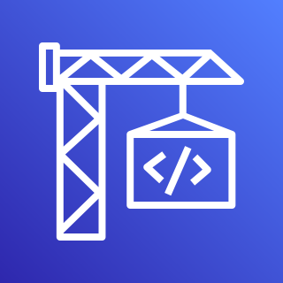


AWS Cloud
AWS CodePipeline pipeline
Source stage
Build/test stage
Deploy stage
AWS Secrets Manager
Templates
Git push
Git webhook
Git users
GitHub
repository
Source code
Lambda function
AWS CodeBuild
TaskCat
Artifacts
Reports
Git merge

Slide 3
AWS Cloud
AWS CodePipeline
Source stage
Build/test stage
Deploy stage
AWS Secrets Manager
Templates
Git push
Git webhook
Git users
GitHub
repository
Source code
Lambda function
AWS CodeBuild
TaskCat
Artifacts
Reports
Git merge

Slide 4
AWS Cloud
AWS CodePipeline
CI/CD pipeline
Source stage
Build/test stage
Deploy stage
AWS Secrets Manager
Templates
Git push
Git webhook
Git users
GitHub
repository
Source code
Artifacts
AWS CodeBuild
TaskCat
Lambda function
Reports
Git merge

