Slide 1





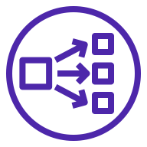


AWS Cloud
VPC
Public subnet
Public subnet
Public subnet
NAT gateway
NAT gateway
NAT gateway
Bastion Host
Private subnet
Private subnet
Private subnet
Network Load Balancer
OLAP & Virtualization Service
Explorer, Dashboard, Plato, etc…
Graph Service
Graphd0
Graphd1
Graphd2
Storage Service
Storaged0
Storaged1
Storaged2
EBS Volume
EBS Volume
EBS Volume

