Slide 1
RIS Recruitment Portal
Standardizing candidate intake, operational vacancy control, and structured Excel reporting
Executive Briefing • Solutions & System Walkthrough

Slide 2
The Legacy Challenge: The Data & Roster Bottleneck
THE RECRUITMENT BOTTLENECK
Data Scrawl & Manual Review
• Multiple degrees and research works clumped into single cells with commas, blocking automated analysis.
• Spreadsheets stretching infinitely to the right with redundant columns, causing horizontal scrolling fatigue.
• Manual resume downloads and alignment causing long hiring delays.
THE INTEGRATED PORTAL APPROACH
Structured Intake to Clean Output
• Standardized Intake: Candidates input individual degrees, scores, and timelines dynamically at source. Uses a custom-made database for the backend.
• HR Control Centers: Instantly filter active roles, review metrics, and open dossier profile views.
• Candidate details are now properly displayed in spreadsheets, making filtration and screening easier.

Slide 3
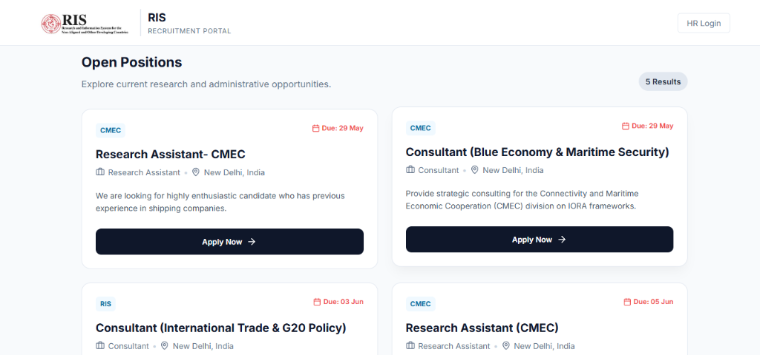
Candidate Interface: Structured Job Board
• Applicants access a clean web interface listing open opportunities at RIS.
• Provides concise public descriptions to inform prospective applicants prior to starting an application.
• Direct redirection to a structured application form to ensure candidate details are captured correctly.

Slide 4
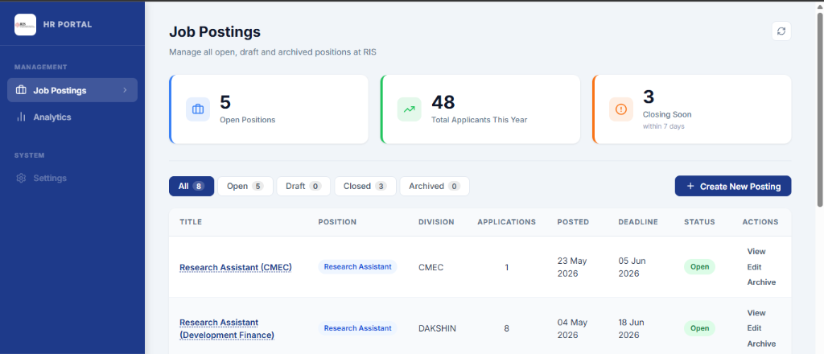
HR Dashboard: Central Roster Management
• HR administrators get a comprehensive overview of active vacancies and applicant volumes.
• Top-level summary cards display Open Positions, Total Applicants (this year), and roles Closing Soon.
• Central table showing active vacancies, divisions, applicant numbers, posted dates, and deadlines.
• Quick access links to view applicants, edit job listings, or archive roles.

Slide 5
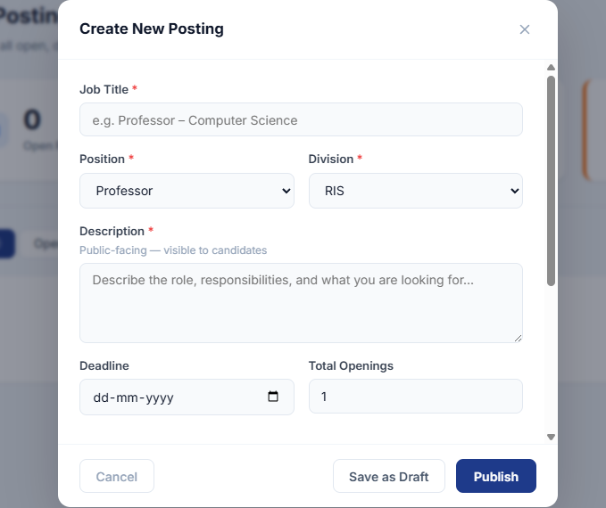
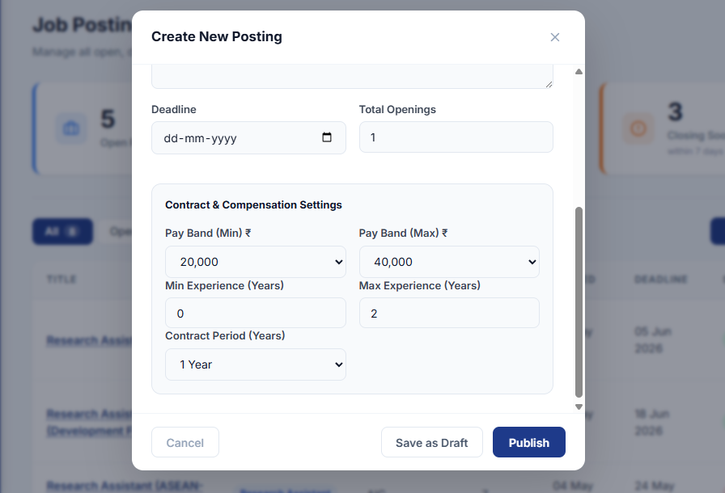
HR Operations: Easy Job Posting Creation

Slide 6
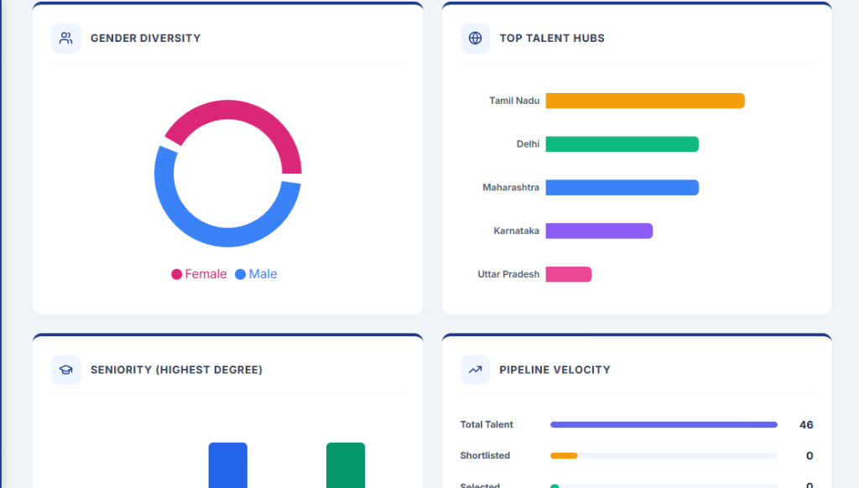
HR Dashboard: Global Analytics
• Presents visual candidate demographics across the system automatically.
• A donut chart maps the gender balance of the active applicant pool. A bar chart visualizes geographic distribution, showing top applicant states at a glance.
• Hiring Pipeline Velocity: Tracks total applications against shortlists and selections dynamically.

Slide 7
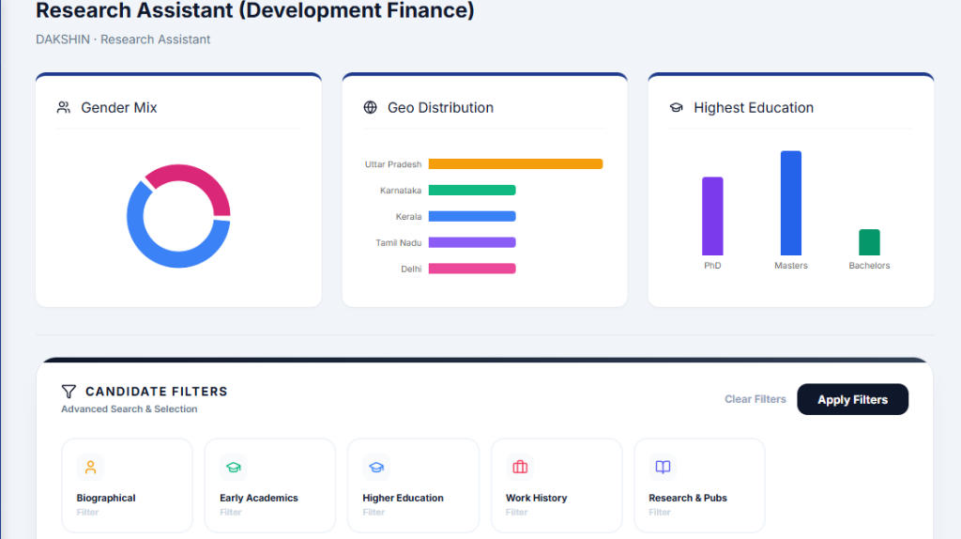
Roster Analytics & Multivariate Filters
• Displays demographic and seniority distributions tailored to the selected job posting.
• Advanced Filters: Isolate candidate subsets instantly using biographical, academic, experience, and publication filters.
• No Decision Lag: Enables HR to search through hundreds of profiles in seconds without opening individual resumes.

Slide 8
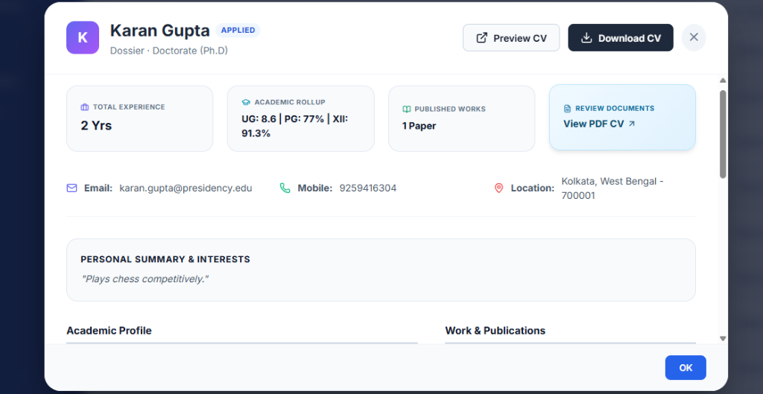
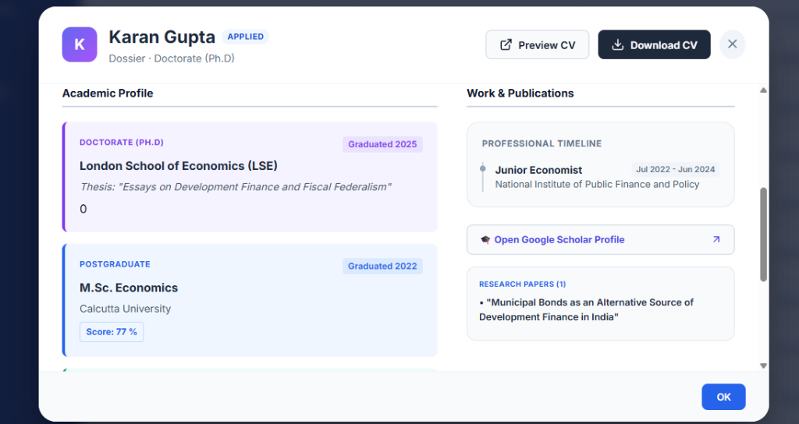
Candidate Dossier: 360-Degree Profile View
Review candidate profiles instantly in a modular, color-coded dossier modal without opening separate files.
• Quick Profile Rollups • Color-Coded Academic Levels • Timeline Experience Views • Clean Close Layout

Slide 9
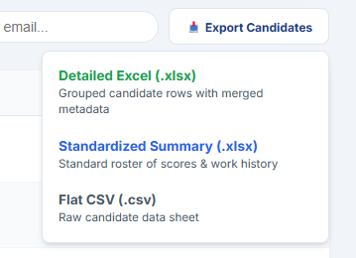
Clean Report Generation
• Download candidate data tailored to the requirements of the review committee.

Slide 10
Operational Impact
Time Saved in Review: Managers can now review candidates directly from the portal, eliminating manual CV tracking and administrative overhead.
Standardized Candidate Data: Dynamic form validations ensure applicant details are clean and complete on submission.
Advanced Roster Exports: Generates presentation-ready spreadsheets with organized layouts.

