Slide 1








Medium & Large-Scale Deployments
CFN
Template
AWS
Marketplace
AWS Cloud
CFN Stack To Launch Remote Desktop with Vivado
Availability Zone
VPC
Remote Desktop
Xilinx Vivado Design Suite and NICE DCV

Slide 2

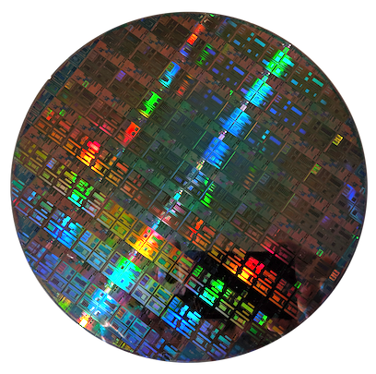
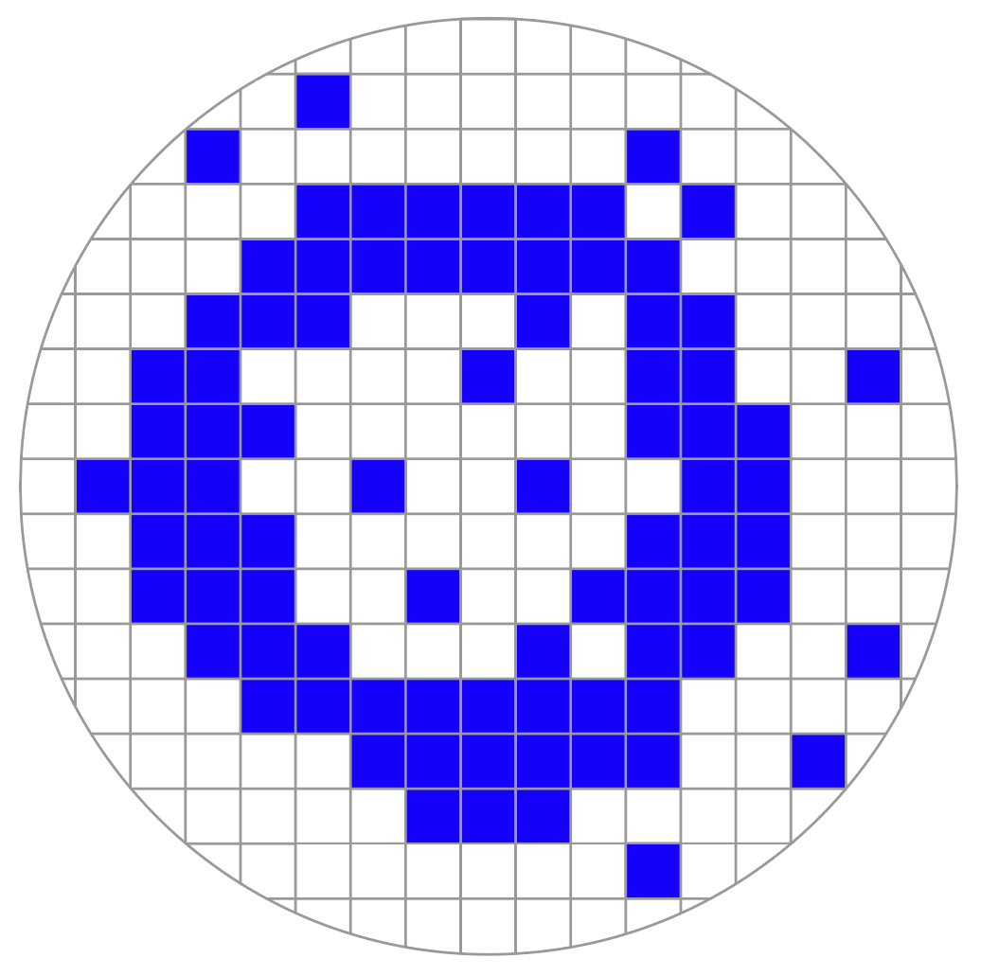
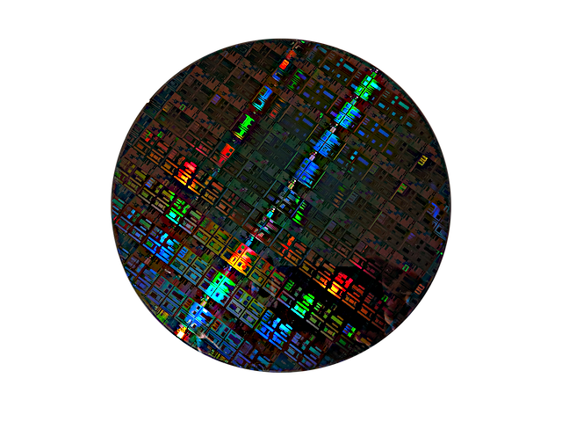

Fabrication Facility
AWS IoT Greengrass
Image production and defect map sent for real time inference
Inspection and Probe Station
Real Time Inference

