Slide 1

Amazon Lex
Conversational Interfaces

Slide 2
ML @ AWS: Our mission
“Put machine learning in the hands of every developer and data scientist ”

Slide 3
AWS AI/ML stack
Application Services
API-driven services: Vision & Language Services, Conversational Chatbots
Platform Services
Deploy machine learning models with high-performance machine learning algorithms, broad framework support, and one-click training, tuning, and inference.
Frameworks & Infrastructure
Develop sophisticated models with any framework, create managed, auto-scaling clusters of GPUs for large scale training, or run inference on trained models.

Slide 4
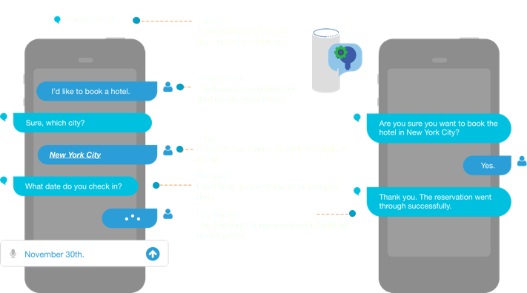
Amazon Lex

Slide 5
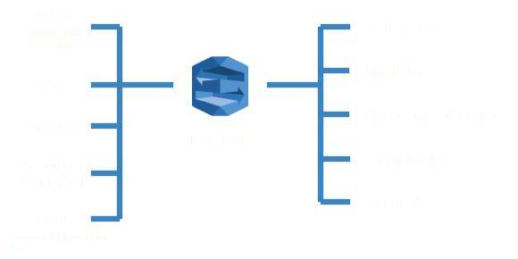
Conversational Chatbots
https://aws.amazon.com/blogs/machine-learning/deploy-a-web-ui-for-your-chatbot/

Slide 6
Additional Resources
https://aws.amazon.com/documentation/lex/
https://docs.aws.amazon.com/lex/latest/dg/what-is.html
https://docs.aws.amazon.com/lex/latest/dg/examples.html

Slide 7
Go Build
https://github.com/drandrewkane/AI_ML_Workshops/tree/master/lab-2-Building_Chat_Bots_With_Lex

