Slide 1


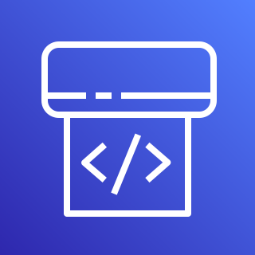
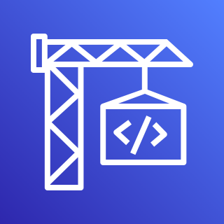
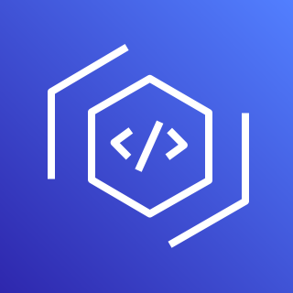
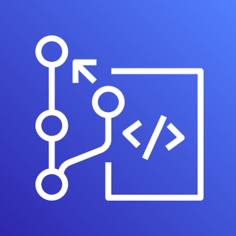

Devops Account
CA-Central-1
US-West-2
Upstream CodePipeline
CodeArtifact
CodeCommit
CodeBuild
Shared Package
Build Package
Push Package to CodeArtifact
Shared Domain and Repo
Application Account
CA-Central-1
Downstream CodePipeline
CodeCommit
CodeBuild
Application Code
Build & Package Lambda
Pull Package to build layer
Lambda Function
Lambda Layer

