Slide 1

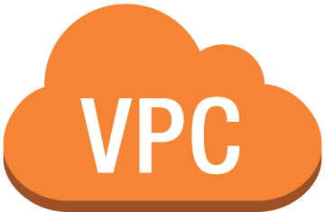
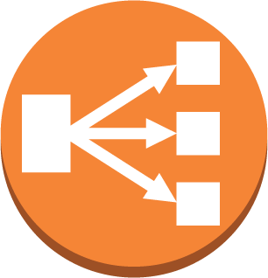

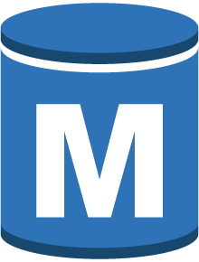

Route53
Elastic Load Balancing
Public Subnet
Public Subnet
App Security Group
App
Server
App
Server
App
Server
App
Server
Auto Scaling group
Private Subnet
Private Subnet
DB Security Group
R/W workload
Synchronous Replication
Availability Zone 1
Availability Zone 2
virtual private cloud
AWS region

Slide 2
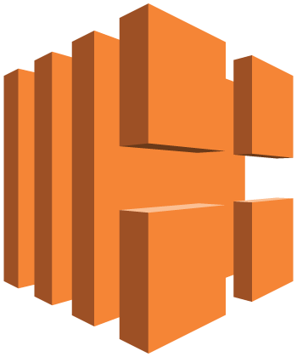
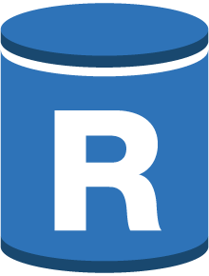
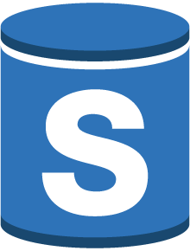
Elastic Load Balancing
App
Server
App
Server
App
Server
App
Server
App security group
Public Subnet
Public Subnet
Auto Scaling Group
Route53 Domain
Read Requests
DB security group
Route53 Record Set(CNAME)
Private Subnet
Private Subnet
Availability Zone 1
Availability Zone 2
AWS region

Slide 3
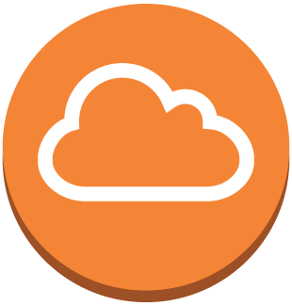
Aurora Read Replicas
Public Subnet
Public Subnet
Public Subnet
Application Security Group
Internet Gateway
Application Server
Application Server
Application Server
Application Server
Application Server
Application Server
Private Subnet
Private Subnet
Private Subnet
Database Security Group
Cluster Subnet Group
Aurora DB Instance
Aurora Read Replica
Aurora Read Replica
Availability Zone
Availability Zone
Availability Zone
Region

Slide 4
RDS Cross Region Replication
Public Subnet
Public Subnet
Public Subnet
Application Security Group
Application Security Group
Internet Gateway
Application Server
Application Server
Application Server
Application Server
Application Server
Application Server
Internet Gateway
Private Subnet
Private Subnet
Private Subnet
Database Security Group
Database Security Group
Cluster Subnet Group
RDS DB Instance
RDS DB Instance Standby
RDS DB Instance Read Replica
Availability Zone
Availability Zone
Availability Zone
Region
Region

Slide 5
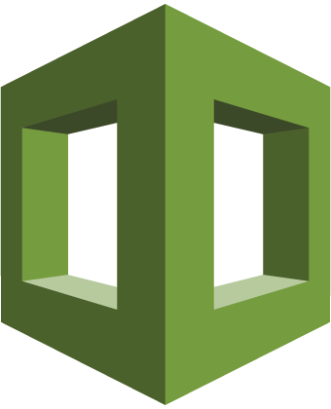
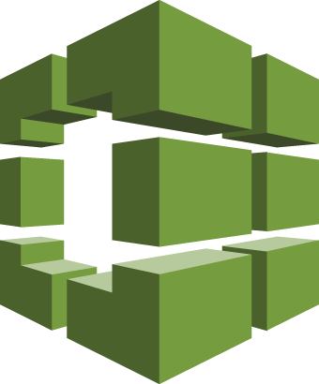
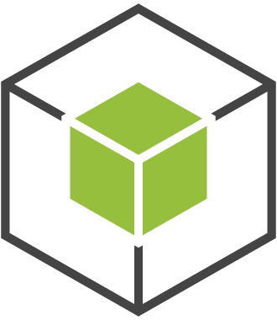

2
3
rds::restoreDBClusterToPointInTime(
restoreType=‘copy-on-write’
)
rds::backtrackDBCluster(
backtrackTo= <date>
)
AWS CloudFormation
1
5
Production VPC
Integration Test VPC
Production App Subnets
Production Subnet Group
Integration Test
Subnet Group
AWS CodeBuild
6
Aurora
Primary
Aurora
Clone
4
Your Application
Shared storage volume
4
Notes:
1. In this architecture, your application uses Amazon Aurora, and has configured the database for Backtrack. This typically resides in a Production Virtual Private Cloud (VPC) network.
2. Your integration test is scheduled to run in whatever manner suits your application. This schedule can run a CloudFormation template (or any other type of provisioning tool) to create the entire integration testing cloud environment, including the network, databases, and testing applications.
3. This integration testing template will call the RDS [restoreDBClusterToPointInTime](https://docs.aws.amazon.com/AmazonRDS/latest/APIReference/API_RestoreDBClusterToPointInTime.html) API to provision a clone database. When doing so, the API call provides the argument `RestoreType` with value `copy-on-write`, which will cause the new database to be a clone of the primary without duplicating the underlying data. This operation completes in only a few minutes.
4. The new clone database is provisioned, and has it's own unique DNS endpoint. This can reside in a separate VPC to keep network isolation from the production environment. It attaches to the same underlying shared Aurora storage as the primary database, and sees the data as of the `RestoreToTime` value supplied in the request to restore the database.
5. You may choose to use Aurora Backtrack to rewind the database to a previous point in time by using the [BacktrackDBCluster](https://docs.aws.amazon.com/AmazonRDS/latest/APIReference/API_BacktrackDBCluster.html) API, and at this phase may install changes to the database to simulate an 'release' to production.
6. Your integration testing framework can then run against this cloned database, to determine the correctness of your release. Once completed, the CloudFormation stack can be terminated, which will tear down all of the created resources automatically.

Slide 6
2
3
1
5
4
5

