Slide 1








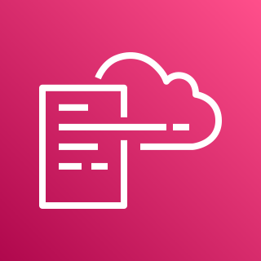




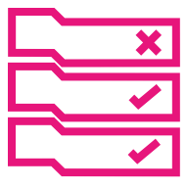



AWS Cloud
Organization Management Account
All Bedrock Accounts
Home Region
Global Region
1.0
1.6
1.7
1.8
1.11
2.0
1.1
KMS
Key
2.1
2.7
DLQ
CloudWatch Filters
CloudWatch Alarms
1.5
CloudWatch Sharing Role
Rule Lambda
Roles
1.4
1.9
AWS CloudFormation
1.3
1.10
CloudWatch Log Group
Bedrock Lambda Function
CloudWatch Link
SNS Topic
SNS Topic
Region n
Global Region
Region 2
1.2
Region 1
CloudWatch Lambda Role
2.2
2.3
2.8
Audit (Security Tooling) Account
CloudWatch Filters
CloudWatch Alarms
Config Rules
3.0
Home Region
2.5
2.4
2.9
3.1
3.2
3.3
CloudWatch Link
SNS Topic
Config
Lambdas
2.6
Resource
Table
CloudWatch Dashboard
CloudWatch Sink
KMS
Key

