Slide 1





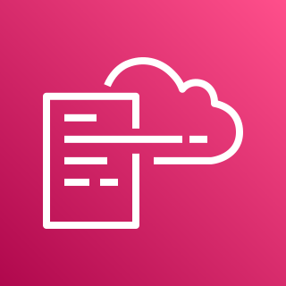
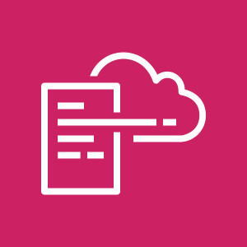






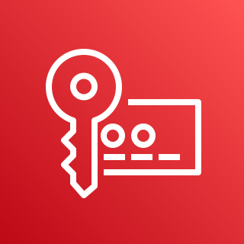
AWS Cloud
Organization Management Account
Log Archive Account
Home Region
1.0
1.6
1.7
1.8
2.0
Home Region
1.1
SNS Topic
DLQ
Alarm Topic
2.1
Region 1
1.4
Region 1
AWS CloudFormation
1.9
AWS CloudFormation
Region 2
Region 2
Regional Event Rules
Region n
Lambda Function
Region n
2.2
2.3
1.10
2.4
1.2
1.3
1.5
Delivery S3 Bucket
Configuration Role
AWS Config
AWS Config
Lambda
Role
Configuration Role
CloudWatch Log Group
All Existing and Future Organization Member Accounts
Audit (Security Tooling) Account
4.0
Home Region
Home Region
3.0
3.1
3.2
3.3
Region 1
4.1
Region 1
Region 2
Region 2
AWS CloudFormation
Delivery KMS Key
Config
Aggregator
Region n
AWS CloudFormation
Region n
3.4
3.5
3.6
3.7
3.8
4.2
4.3
Configuration Role
Config
Aggregator Role
Config Topic
SNS KMS
Key
AWS
Config
Configuration Role
AWS Config

