Slide 1









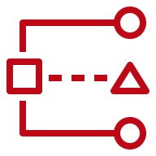





1
3
5
Setup Environment
Choose Deployment Method
Deploy Solutions
AWS Control Tower
AWS CloudFormation
2
4
Deploy Common
Prerequisites Solution
Deploy Common
CFCT Setup Solution
Customizations for AWS Control Tower
(CFCT)

Slide 2

1
2
4
Setup Environment
Choose Deployment Method
Deploy Solutions
AWS Control Tower
AWS CloudFormation
Customizations for AWS Control Tower
(CFCT)
3
Deploy Execution
Role

Slide 3
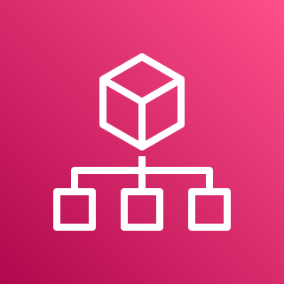



1
2
3
Setup Environment
Deploy Using CloudFormation
Deploy Solutions
Root OU
AWS Organizations
Management Account
AWS CloudFormation
Security OU
Security Tooling Account
Common Prerequisites Solution
Log Archive Account

Slide 4

1
2
3
Setup Environment
Deploy Using
Terraform
Deploy Solutions
AWS Control Tower
Hashicorp
Terraform
Common Prerequisites Solution

Slide 5
1
2
3
Setup Environment
Deploy Using
Terraform
Deploy Solutions
Root OU
AWS Organizations
Management Account
Hashicorp
Terraform
Security OU
Security Tooling Account
Common Prerequisites Solution
Log Archive Account

