Slide 1



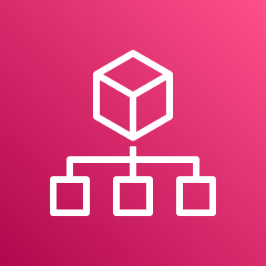





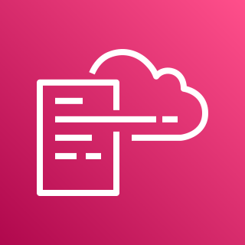

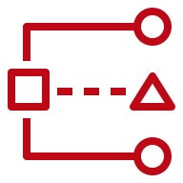

AWS Cloud
Organization Management Account
1.0
1.4
Lambda Role
Home-region
1.2
1.5
1.1
Lambda Function
AWS Organizations
AWS CloudFormation
1.3
CloudWatch Log Group
Delegated Administrator Account (e.g. Audit)
OU: Security
2.0
2.1
Services

Slide 2
AWS Cloud
Organization Management Account
1.0
1.3
Lambda Role
Home-region
1.1
1.4
Lambda Function
AWS Organizations
1.2
CloudWatch Log Group
Delegated Administrator Account (e.g. Audit)
OU: Security
2.0
2.1
Services

