Slide 1







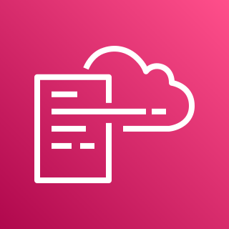





AWS Cloud
Audit Account
Organization Management Account
2.0
Home Region
1.0
Home Region
Global Region
2.5
1.6
1.9
2.1
Recorder Event Rule
Region n
1.1
1.5
DLQ
Alarm Topic
2.2
Region 2
AWS CloudFormation
SNS Topic
Configuration
Role
Region 1
AWS CloudFormation
Region n
1.3
1.7
2.6
2.3
Region Aggregator
2.4
Lambda
Function
Region 2
Region 1
EventBridge
Role
Security Hub
Security Hub
Regional Event Rule
1.10
1.12
1.8
All Existing and Future Organization Member Accounts
1.13
CloudWatch Log Group
Security Hub
3.0
Home Region
Scheduled Event Rule
Recorder Event Rule
Global Region
3.1
Global Region
Region n
1.4
1.2
1.11
1.14
3.2
AWS CloudFormation
Region 2
Global Event Rule
Lambda
Role
Configuration
Role
EventBridge
Role
Configuration
Role
Region 1
3.4
3.5
3.3
EventBridge
Role
Recorder Event Rule
Security Hub

Slide 2




AWS Cloud
Audit Account
Organization Management Account
2.0
Home Region
1.0
Home Region
Global Region
1.5
1.8
2.4
Region n
1.4
DLQ
Alarm Topic
2.1
Region 2
Recorder Event Rule
SNS Topic
Configuration
Role
Region 1
1.6
Region n
2.5
2.2
2.3
1.2
Lambda
Function
Region Aggregator
Region 2
Region 1
EventBridge
Role
Security Hub
Security Hub
Regional Event Rule
1.9
1.11
1.7
All Existing and Future Organization Member Accounts
1.12
CloudWatch Log Group
Security Hub
3.0
Home Region
Scheduled Event Rule
Recorder Event Rule
Global Region
Global Region
Region n
1.3
1.1
1.10
1.13
3.1
Region 2
Global Event Rule
Lambda
Role
Configuration
Role
EventBridge
Role
3.3
Configuration
Role
Region 1
Recorder Event Rule
3.2
3.4
EventBridge
Role
Security Hub

