Slide 1





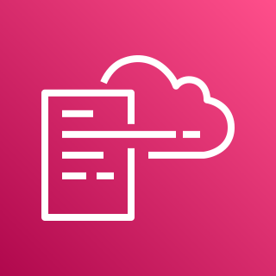








AWS Cloud
Organization Management Account
Audit Account
1.0
Home Region
2.0
Home Region
1.5
1.6
1.1
DLQ
Alarm Topic
2.1
Region 1
Region 2
AWS CloudFormation
Region 1
AWS CloudFormation
Region n
Region 2
1.3
1.7
Region n
2.2
2.3
1.10
Configuration
Role
Detective
Regional Event Rules
Lambda Function
Detective
All Existing and Future Organization Member Accounts
1.8
1.9
1.2
3.0
Home Region
Lambda
Layer
CloudWatch Log Group
IAM Roles
3.1
Region 1
Global Region
Region 2
AWS CloudFormation
Region n
1.4
3.2
3.3
Global Event Rules
Configuration
Role
Detective

Slide 2
AWS Cloud
Organization Management Account
Audit Account
1.0
2.0
Home Region
2.1
Region 1
Home Region
1.4
1.5
Region 2
1.1
AWS CloudFormation
Region n
DLQ
Alarm Topic
2.2
2.3
AWS CloudFormation
Region 1
Region 2
Configuration
Role
Detective
1.3
1.6
Region n
Compliance Event Rule
Lambda Function
1.9
All Existing and Future Organization Member Accounts
3.0
Home Region
Detective
1.7
1.8
3.1
Region 1
1.2
Region 2
Lambda
Layer
CloudWatch Log Group
IAM Roles
AWS CloudFormation
Region n
3.2
3.3
Configuration
Role
Detective

