Slide 1



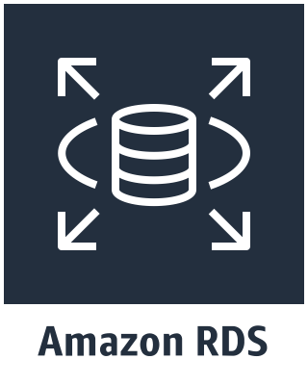

VPC
Public subnet
Public subnet
Microsoft SQL Server 2008 R2
Simulating On-Prem Server
ONPREM
(10.0.128.100)
Private subnet
Private subnet
Microsoft SQL Server 2017
Always On on EC2
WSFCNode1
(10.0.0.100)
WSFCNode1
(10.0.32.100)
Amazon RDS Multi-AZ
SQL Server 2017
Amazon Directory Services
Microsoft AD

