Slide 1
SQL Server on AWS Cloud

Slide 2
Agenda
Selecting the Right Service
Selecting the Right Storage
  TempDB Considerations
Selecting the Right Instance
High Availability and Disaster Recovery Options
Migrating to the AWS Cloud
Refactoring to the AWS Cloud
Reference Architecture
Licensing
Q&A

Slide 3
Selecting the Right Service

Slide 4


Where can I run my SQL Server workloads on AWS?
Amazon Relational Database Service
(Amazon RDS)
Managed service with up to 64 vCPU, 488-GB RAM, and 16-TB storage
Express, WEB, Standard, and Enterprise Editions
Available Instance Types depend upon the edition
Standard or Provisioned IO
Amazon Elastic Compute Cloud
(Amazon EC2)
Self-managed SQL Server installation on virtual machine with up to 128 vCPU, 4-TB RAM, and 400-TB storage (up to 448 vCPU, 12-TB RAM for High-memory instances)
Any available Instance Type
Multiple storage options
Notes:
Let’s talk about the options available for running SQL Server on AWS

Slide 5


Options for Deploying SQL Server on AWS
Amazon RDS for SQL Server
SQL Server on Amazon EC2
Consider RDS first!
Focus on:
Business value tasks
High-level tuning tasks
Schema optimization
No in-house database management expertise
Push-button Scaling
Consider SQL Server on EC2 if:
Need full control over:
DB instance & OS
Backups
Replication
Clustering
Require options that are not available in RDS
Scaling
High Availability
High Availability
Database Backups
Database Backups
DBMS Patching
DBMS Patching
DBMS Install/Maintenance
DBMS Install/Maintenance
OS Patching
OS Patching
OS Install
OS Install
Power, HVAC, net
Power, HVAC, net
AWS managed
Customer managed
Notes:
Push-Button Scaling
DB Instance Class – Using a few clicks of the AWS Management Console, you can scale the compute and memory resources powering your deployment up or down. Scaling operations typically complete within a few minutes.
Storage and IOPS – As your storage requirements grow you can provision additional storage on-the-fly with zero downtime.

Slide 6



Multi-AZ SQL Server on Amazon RDS
Amazon
RDS
Primary
Amazon
RDS
Secondary
Synchronous Commit
Automatic Failover
Private Subnet
Private Subnet
Availability Zone 1
Availability Zone 2
AWS Region

Slide 7
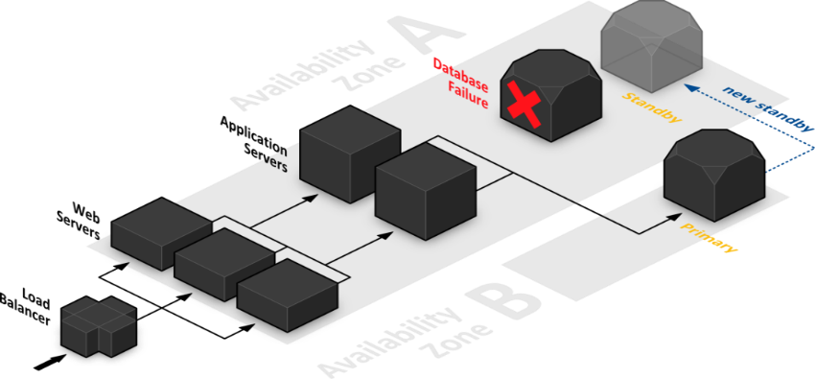
Multi-AZ SQL Server on Amazon RDS – Managed Solution
Failure scenarios mitigated:
Loss of availability in primary AZ
Loss of network connectivity to principal DB node
Compute unit or storage failure on principal DB node
Failover process:
Automatic Failover
Synchronous replication
Inexpensive & enabled with a few clicks

Slide 8
SQL Server Features at a Glance
Amazon RDS
Amazon EC2
Versions Supported:
2012, 2014, 2016, 2017
All**
Editions Supported:
Express, Web, Standard, Enterprise
All**
High Availability:
AWS-managed (Mirroring, Always-On AG)
Self-managed (Always-On, FCI, Mirroring…)
Encryption:
Encrypted Storage using AWS KMS (all editions); TDE Support (Enterprise edition)
Authentication:
Windows (MAD) & SQL Authentication
Windows & SQL Authentication
Backups:
Managed Automated Backups
Maintenance Plans & 3rd Party Tools
Maintenance:
Automated Software Patching
Self-managed
Notes:
We have an exhaustive user-guide, here are some highlights
EC2 is supported with either bring your own software or pre-configured AMIs (virtual machines). The pre-configured options will not have as many versions or editions supported as a custom-built solution that you build yourself.
How many of you have struggled, either because of expense or just the technical challenges, in setting up a multi-site high availability option for your SQL Server instance?
With Amazon RDS for SQL Server it is a simple as checking a checkbox when you launch an Amazon RDS instance, to setup a multi-AZ SQL Server cluster, that leverages synchronous replication between to AZs using database mirroring.
If you need a different HA solution like AlwaysOn, or log shipping, then choose SQL Server on Amazon EC2 and manage that yourself.
Both platforms support storage encryption for all editions using KMS. And for those of you running enterprise edition, you can use transparent data encryption on both platforms.
If you need to install 3rd party tools or run specific database maintenance plans, then run SQL Server on Amazon EC2, otherwise we take care of all of that for you.
If you want to take advantage of automated software patching, then choose Amazon RDS for SQL Server otherwise you need to manage these tedious maintenance tasks yourself with SQL Server on Amazon EC2.

Slide 9
What about the rest of SQL Server?
SQL Agent*
Integration Services (SSIS) – 4 to 12 months on RDS SQL Server
  In private preview
Reporting Services (SSRS) – 4 to 12 months on RDS SQL Server
Analysis Services (SSAS) – 4 to 12 months on RDS SQL Server
Database Mail
Service Broker
Data Quality Service
Master Data Service
https://docs.aws.amazon.com/AmazonRDS/latest/UserGuide/CHAP_SQLServer.html#SQLServer.Concepts.General.FeatureNonSupport
Notes:
Integration Services (SSIS), Reporting Services (SSRS), and Analysis Services (SSAS) CANNOT be installed on RDS Instance
SQL Agent: Running replication jobs and running command-line scripts by using ActiveX, Windows command shell, or Windows PowerShell are not supported.

Slide 10
SQL Server EC2 vs. RDS: Which should I use?
 | EC2 | RDS
License included | ✓ | ✓
BYOL | ✓
Full control over the instance | ✓
Automated backups |  | ✓
Self-managed Always-On Availability Groups / Failover Cluster Instance | ✓
AWS-managed Multi-AZ deployment |  | ✓
Integrated Security | ✓ | ✓ (MAD)
Co-hosting additional SQL Server components* | ✓
Auditable centralized engine parameter tuning |  | ✓
Automated backups and point in time restore |  | ✓
No direct instance or file system access |  | ✓
*Special considerations for HA/DR environments
Notes:
This is a “decision matrix” to assist you in selecting appropriate service.

Slide 11
RDS SQL Server Pace of Innovation – 2018
February – Differential Backups (limited)
February – CDC Support
February – Max IOPS increased to 32,000
March – SQL Server 2017 RTM CU3, SQL Server 2016 SP1 CU7
May – More regions support SQL Server High Availability
August – AWS Secrets Manager Support
September – Database Deletion Protection
October – Backup and Restore Enhancements (Family_GUID)
October – Backup and Restore for Multi-AZ DBs
November – Always On Availability Groups for SQL Server 2016 EE
December – M5 Support

Slide 12
RDS SQL Server Pace of Innovation – 2019
March – Performance Insights
May – Increased database limit per database instance (up to 100)
May – Always On Availability Groups for SQL Server 2017
May – SQL Server Auditing
June – Multi-file native restores
August – Change server-level collation
September – T3 and R5 families and the 8xl and 16xl sizes
September – Support for X1 and X1e instance types (up to 4 TB memory)
November – Support for differential restores and log restores
November – Updated linked servers to support cross VPC connections
November – Publish Agent and Error log files to Amazon CloudWatch

Slide 13
Selecting the Right Service – RDS Recent Releases
Performance Insights on Amazon RDS for SQL Server(03/04/2019)
Allows experts as well non-experts to detect performance problems with an easy-to-understand dashboard that visualizes database load.
You can get started by logging into the Amazon RDS Management Console, enabling Performance Insights for a new or existing database instance, and viewing the Performance Insights dashboard.
The Amazon Web Services API and SDK make it easy to integrate Performance Insights data into on-premises and third-party monitoring tools.
Priced at per vCPU/month (https://aws.amazon.com/rds/performance-insights/pricing/)
https://docs.aws.amazon.com/AmazonRDS/latest/UserGuide/USER_PerfInsights.html

Slide 14
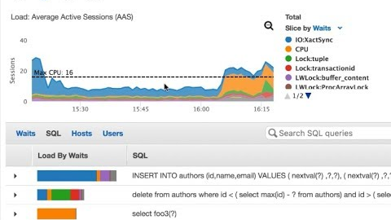
Selecting the Right Service – RDS Recent Releases
Performance Insights for SQL RDS

Slide 15
Selecting the Right Service – RDS Roadmap (2020)
Integration Services (SSIS) on RDS Host
Reporting Services (SSRS) on RDS Host
Analysis Services (SSAS) on RDS Host
Read Replicas with AlwaysOn for Enterprise Edition
Cross-Region Read Replicas
Enable DBMail
Z1 Instance Type

Slide 16
Selecting the Right Service – RDS Backlog
M5/R5D with Temp DB on Local Storage
Multi-AZ AO-AG on SQL Server 2016, 2017 Standard Edition
Further AWS Integration (SNS, SQS, Lambda, SES)
SQL Server on Linux
Automated Cross Region Backups
Semi-Managed / Amazon Flex
  Host Level Access Provided, Full Database Permissions
  Automation for Provisioning, Backups, HA, and others

Slide 17
Selecting the Right Storage

Slide 18

Amazon Elastic Block Storage
What is Amazon Elastic Block Storage (EBS)?
Network-attached block storage
Available for all instance types
Many instance types support EBS optimization – dedicated channel for network storage I/O, eliminating contention with regular I/O
Some instance types are EBS optimized, others offer it as an option

Slide 19


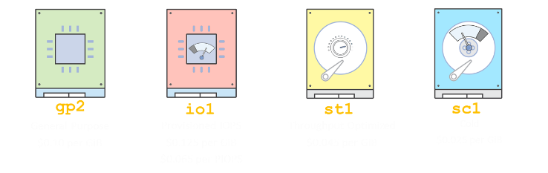
Amazon EBS Volume Types (Cost)
SSD
HDD
* All prices are per month, prorated to the second, for the us-east-1 Region as of September 2018

Slide 20
Amazon EBS Volume Types (Performance)
Volume Type | General Purpose: GP2 | Provisioned IOPS: PIOPS/IO1 | Throughput Optimized: ST1 | Cold HDD: SC1
Technology: | SSD | SSD | Magnetic | Magnetic
Sizes: | 1 GiB – 16 TiB | 4 GiB – 16 TiB | 500 GiB – 16TiB | 500 GiB – 16 TiB
Max. IOPS: | 10,000 @ 16KiB | 64,000 @ 16KiB | 500 @ 1MiB | 250 @ 1MiB
Max. Throughput: | 160 MiB/sec | 1,000 MiB/sec | 500 MiB/sec | 250 MiB/sec
Max. IOPS/Instance | 80,000 | 80,000 | 80,000 | 80,000
Max. Throughput /Instance | 1,750 MiB/s | 1,750 MiB/s | 1,750 MiB/s | 1,750 MiB/s
Properties: | 3 IOPS/GB, burstable up to 3000 IOPS for max 1 TiB volumes | Consistent provisioned performance, up to 50 IOPS/GB | Optimized for throughput, and sequential read/write workloads, baseline per TiB throughput, with burst capability

Slide 21

Amazon EC2 Instance Storage
Some instance types come with direct attached storage
  disk-based local storage (H1/D2)
  NVMe SSD (I3/C5d/M5d/R5d/Z1d)
Fast disk I/O without going over the network
Size depends on the instance, Included in the hourly cost
Data on instance storage does not persist instance stop/start or hardware failure
Must be allocated at launch

Slide 22








Choosing an Amazon Storage Volume type
IOPS
Throughput
is more important
is more important
> 80,000
≤ 80,000
Small, random I/O
Large, sequential I/O
Latency?
Aggregate throughput?
< 1 ms
Single-digit ms
≤ 1,750 MiB/s
> 1,750 MiB/s
Which is more important?
Which is more important?
Cost
Performance
Cost
Performance
I3/C5d/…
H1/D2
gp2
io1
sc1
st1

Slide 23
Storage Considerations and Sample Layout for SQL Server on EC2
Consider IOPS and throughput needed by your workload
Enable EBS optimization on instance
Create a volume for data (random access)
Create a volume for log (sequential access)
Format with 64K allocation unit size
Stripe EBS PIOPS volumes for higher IOPS
Match total EBS IOPS and throughput to instance type
Example volume layout:
C:\ Boot on General Purpose SSD (gp2)
D:\ Data files on PIOPS (single or striped)
E:\ Log file on st1 or PIOPS
F:\ Backups on st1 or sc1
Z:\ Tempdb on instance storage (if available)
*Consider Using multiple tempdb files (1:1 mapping with CPUs, up to 8)
Notes:
TempDB on Instance storage is not encrypted!

Slide 24
tempdb on Instance Storage
Consider:
Scripting/automating configuration on instance boot
Changing SQL Server service startup to Automatic (Delayed Start) to allow instance storage to provision
Striping multiple instance storage disks together for higher I/O

Slide 25


SQL Server Instant File Initialization
What is database file initialization?
Normally, database files are initialized zeroing out leftover disk data
File initialization causes some DB operations to take longer
Instant database file initialization reclaims unused disk space without zeroing it out
Notes:
Useful for the case when we need to allocate tempdb files on Instance Storage or when DB/Log configured with AutoGrowth.

Slide 26
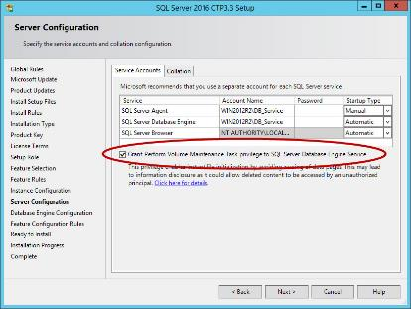
Enabling Instant Database File Initialization
SQL Server 2016+ Install Time
Post-Install or Other Versions
Grant Perform volume maintenance tasks to SQL Server service account
Open the Local Security Policy app,
From Local Policy, choose User Rights Assignment.
Double-click Perform volume maintenance tasks.
Choose Add User or Group.
https://msdn.microsoft.com/en-us/library/ms175935.aspx

Slide 27
Selecting the Right Instance

Slide 28



SQL Server Instance Type Selection Criteria
Compute
Capabilities
vCPUs
Memory
Capabilities
GB of RAM
Network
Performance
MB/s (Throughput)
Storage
Performance
I/O Throughput
Notes:
Instance types differ in:
Range of available memory
Range of available storage
Types of available storage (Instance Storage vs. EBS)
Number of CPUs
Amount of RAM

Slide 29
Amazon EC2: Flexible Compute Options
Current Instance Families and Generation | Family/Usage
M5, M4 | General Purpose Compute
T3, T2 | Burstable Performance
C5, C4 | Compute Optimized
P3, P2, G3, F1 | Accelerated Computing
X1, X1E, R5, R4, R3 | Memory Optimized
I3, M5D, C5D, R5D | Storage Optimized (I/O)
D2 | Storage Optimized (Density)
Notes:
Instance types differ in:
Range of available memory
Range of available storage
Types of available storage (Instance Storage vs. EBS)
Number of CPUs
Amount of RAM

Slide 30
High Availability and Disaster Recovery Options

Slide 31
SQL Server HA/DR on EC2
Basic Always On Availability Groups (Standard Edition, 2016+)
Always On Availability Groups (Enterprise Edition)
Failover Cluster Instance*
Transaction Log Shipping (DR solution)
Mirroring
  This feature is in maintenance mode and may be removed in a future version of Microsoft SQL Server. Avoid using this feature in new development work, and plan to modify applications that currently use this feature. Use Always On availability groups instead.
  Basic Always On Availability Groups replace the deprecated Database Mirroring feature and provides a similar level of feature support.
* Some configurations may require third-party tools.
Notes:
Full customization (and administration) of failover and disaster recovery for EC2
Multi-region: cross-region peering
FCI: SIOS DataKeeper or SoftNAS – EBS block storage replication simulates shared storage

Slide 32
SQL Server 2016+ Enterprise vs. Standard Edition
 | AO AG | Basic AG
Always On Failover Cluster Instances (FCI) | ✓ | ✓
Clusterless Availability Group | ✓ | ✓
Domain Independent Availability Group | ✓ | ✓
Log shipping | ✓ | ✓
Multiple Secondary Replicas | ✓
Read Access to Secondary Replica | ✓
Backup from Secondary Replica | ✓
Multiple Databases in Availability Group | ✓
Page integrity checks on secondary replicas | ✓
Participation in Distributed Availability Group | ✓
Notes:
Many businesses have chosen SQL Server Enterprise Edition because of their HA requirements
Enterprise Edition could cost as much as 10x of Standard Edition
SQL Server 2016+ provide HA options for Standard Edition that previously used to be exclusive to Enterprise Edition
These features can potentially be leveraged to reduce costs

Slide 33
Basic Availability Group (SQL Server Standard)
In many practical cases, Basic AG suffices for business needs
Can deliver high performance and resiliency
Basic Availability Group contains only one DB (but you may have multiple BAGs!)
With Asynchronous Commit across regions can deliver DR solution (requires VPC peering)
Primary Replica
Secondary Replica
Synchronous or
Asynchronous
commit
Subnet a
Subnet b
Availability Zone 1
Availability Zone 2
AWS Region
AWS Region

Slide 34
Always On Availability Group (SQL Server Enterprise)
Primary Replica
Secondary Replica
Secondary Replica
Synchronous
commit
Asynchronous
commit
Subnet a
Subnet b
Subnet c
Availability Zone 1
Availability Zone 2
VPC
peering
Availability Zone 3
AWS Region
AWS Region
AWS Region
HA/DR Solution
Read Scale-out
Offload backup
Synchronous commit – supports automatic failover
Asynchronous commit – only manual failover
Notes:
Contrary to Basic AG, replicas could be made readable:
Read Scale-out AG with multiple read replicas
Backup from replica
Synchronous – automatic failover available
Asynchronous – ONLY manual failover

Slide 35
Always On Failover Cluster Instance
HA at instance level
Relies upon a shared storage available to all nodes
Only one instance of SQL Server active
No read access to standby instance
Standard Edition supports 2 nodes in AO FCI
Shared Storage options in Windows:
Storage Spaces Direct (S2D)
FSx (as of re:Invent 2019)
SIOS Datakeeper*
SoftNAS*
*Third-party solutions
Active
Standby
Subnet a
Subnet b
Availability Zone 1
Availability Zone 2
DB files on virtual shared storage
DB files on virtual shared storage
AWS Region

Slide 36
Always On FCI in Availability Group
Active
Standby
Secondary Replica
NO Automatic
Failover!
Subnet a
Subnet b
Subnet c
Availability Zone 1
Availability Zone 2
VPC
peering
Availability Zone 3
DB files on virtual shared storage
DB files on virtual shared storage
AWS Region
AWS Region
Notes:
Many other configurations available (starting with SQL 2016/Windows 2016):
Multiple Availability groups across same set of servers
Distributed Availability Groups
Domain Independent Availability Group (based on Workgroup WSFC)
Clusterless Availability Group (not really and HA option – no automatic failover!)

Slide 37
Always On Availability Group Special Configurations
(starting with SQL 2016/Windows 2016)
Multiple Availability Groups across same set of servers
Distributed Availability Groups
Domain-Independent Availability Group (based on Workgroup WSFC)
Clusterless Availability Group*
* Not an HA solution – no automatic failover

Slide 38
Always On Availability Group Issues of Concern
SQL Server Logins
Server-level objects (linked servers, triggers, etc.)
SQL Server Agent jobs
Integration Services
Reporting Services
Analyses Services
Notes:
Database Logins
Risk of Orphan DB Users
SQL Server logins should be manually propagated preserving SID preferably before establishing the AG;
Does not affect Windows logins
SQL Server Agent jobs
Require manual migration
Special configuration to identify whether they are running on Primary replica
Integration Services
Requires latest version and some special configuration!
GUI has been enhanced to allow the user to add the database master key
SSIS jobs in SQL Server Agent need to be modified
Reporting Services
Benefit from HA of Reporting Services DB
Reporting Services is not cluster-aware and will not fail over
Configure load balancing for the Web servers that host the report servers
Analyses Services
Benefit from HA of AG - it can both retrieve and process data from Always On relational databases
You cannot configure an Analysis Services instance to run in an Always On availability group

Slide 39
Migrating to the AWS Cloud

Slide 40


DB Migration Options
Extending Availability Group to the Cloud
SQL Server Backup/Restore
AWS Database Migration Service (DMS)
SQL Server Replication*
Scripting DB and Data*
SQL Server Mirroring (must be the same version)
Notes:
Replication
Merge replication adds the column rowguid to every table, unless the table already has a column of data type uniqueidentifier with the ROWGUIDCOL property set
If a transactional publication supports queued updating subscriptions, replication adds the column msrepl_tran_version to every table.
The NOT FOR REPLICATION option is specified by default for foreign key constraints and check constraints
Limit use of some statement, like Truncate Table

Slide 41








SQL Server Backup/Restore (with log shipping)
On-Premises
AWS Cloud
AWS Storage Gateway
Domain controller
VPN/DX
Share
(SMB)
Local
cache
SQL Server
(native SQL agent)
Internet
SQL Server
Amazon
EC2
Backup bucket
Corporate data center
Notes:
AWS Storage Gateway is a hybrid storage service that enables your on-premises applications to seamlessly use AWS cloud storage. You can use the service for backup and archiving, disaster recovery, cloud data processing, storage tiering, and migration. Your applications connect to the service through a virtual machine or hardware gateway appliance using standard storage protocols, such as NFS, SMB and iSCSI.
In this scenario, your SQL Serer backups would be stored in Storage Gateway, Volume Gateway, which exposes the storage from the Storage Gateway appliance via file shale. Once the backup files are in Storage Gateway, the service automatically copies the files and puts as objects in S3, which can then be downloaded and restored to SQL Server on EC2 or RDS for SQL Server.

Slide 42


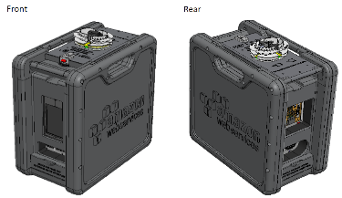






SQL Server Backup/Restore
AWS Cloud
AWS Cloud
Amazon S3
Amazon S3
Glacier
MS SQL instance
SQL Server
Cloud Migration
Notes:
AWS Snowball addresses common challenges with large-scale data transfers including high network costs, long transfer times, and security concerns. Customers today use Snowball to migrate analytics data, video libraries, image repositories, backups, and to archive part of data center shutdowns, tape replacement or application migration projects.
Cloud Migration
If you have large quantities of data you need to migrate into AWS – as part of an application server, file server, database, or backup/archive migration – AWS Snowball is often much faster and more cost-effective than transferring that data over the Internet.
Disaster Recovery
In the event that you need to quickly retrieve a large quantity of data stored in Amazon S3, AWS Snowball appliances can help retrieve the data much quicker than high-bandwidth Internet.
Datacenter Decommission
There are many steps involved to decommissioning a datacenter to ensure valuable data is not lost. AWS Snowball can help ensure that your data is securely and cost-effectively transferred to AWS during this process.
Content Distribution
Use AWS Snowball appliances if you regularly receive or need to share large amounts of data with clients, customers, or business associates. Appliances can be sent directly from AWS to client or customer locations.

Slide 43


AWS Database Migration Service
AWS Database Migration Service helps you migrate databases to AWS quickly, securely, and reliably
The source database remains fully operational during the migration, minimizing downtime to applications that rely on the database.
Start your first migration in 10 minutes or less
AWS Database Migration Service
(AWS DMS)
Notes:
Reliable
The AWS Database Migration Service is highly resilient and self–healing.
It continually monitors source and target databases, network connectivity, and the replication instance.
In case of interruption, it automatically restarts the process and continues the migration from where it was halted.

Slide 44
Initial Data Load (table by table)
Source
Target
Replication instance
Notes:
Creates tables at target database
Sets up metadata required at target
Populates data from source
Each process loads one entire table
Can use multiple processes
Can be paused
When restarted will continue from where it was stopped
Will reload any tables that were currently in progress

Slide 45
Change Data Capture (CDC) and Apply to Target
Update
Apply Change after bulk load
Replication instance
Transactions
t1
t2
t1
t2
Source
Target
Notes:
Oracle supplemental logging
MySQL row-level bin logging
SQL Server bulk logged/full recovery
Postgres WAL
No agent
Uses recovery log
Native change data capture API

Slide 46

Keep your apps running during the migration
Customer
premises
AWS
DMS
Replication
Instance
VPN,
Direct Connect
Start DMS replication instance
Connect to source and target databases
Select tables, schemas, or databases
Let AWS DMS create tables, load data, and keep them in sync
Application users
Notes:
Initial Load is table-by-table
DMS RI need to be properly scaled for the amount of work

Slide 47
Keep your apps running during the migration
AWS
Start DMS replication instance
Connect to source and target databases
Select tables, schemas, or databases
Let AWS DMS create tables, load data, and keep them in sync
Switch applications over to the target at your convenience
Dismantle migration infrastructure
Application users

Slide 48
What else can DMS do? – Take it all, or Not
Source
Target
Replication instance
Notes:
Some organizations have many years of historical data, and for those that are willing to make the leap, filtering can be done during a migration so that only newer information is kept. Filtering can be done on any field in the source database–not just dates.

Slide 49
What else can DMS do? – Consolidate DBs
Source
Source
Target
Replication instance
Source
Notes:
So by now it should be pretty obvious that data can move from A to B, and many have used DMS to do just that. Some customers have been pretty ingenious with DMS and have fanned in, or consolidated systems. DMS will put data where you ask it to, so if you want to merge data from a number of legacy systems into a single repository, DMS can help with this. And remember, DMS can just as easily move data between like databases and unlike databases, so you can take information from a number of different platforms and consolidate it in a single, cloud database.

Slide 50
What else can DMS do? – Split DB
Target
Source
Target
Replication instance
Target
Notes:
In addition to “fanning-in” or consolidating, we’ve had a customer who has taken their database and “fanned-out” different portions to different targets. For example, from their ERP system they replicate they customer list out to the CRM system and also take some of the general ledger transactions and funnel them over to a BI system.
We’ve also had a customer who, for legacy reasons, used a single database for three different applications. With DMS you can split this information out to different databases. One could be PostgreSQL, one SQL Server, and one Aurora

Slide 51
Summary of Migration Considerations
SQL Server version and edition features
Authentication requirements
Amount of data being migrated
Connectivity to AWS
Migration method
AWS Professional Services or Partner help
Well Architected Framework
Optimize after migration
Notes:
SQL Server version – The migration approach should be lift and shift and then upgrade SQL Server version.
Amount of data – If you have a large quantity of data, leverage things like multi-part uploads to S3 or Snowball.
Connectivity to AWS – Connectivity to AWS will impact the amount of time it takes to migrate your data.
Migration Method – Will you have a hybrid configuration, staged migration, or cutover migration? Something important to identify.
Authentication – Do you need Windows or SQL authentication for your application? If it is Windows authentication, what is your Active Directory Domain strategy?
AWS Service Integrations – As we have seen in this presentation, one can integrate SQL Server with many AWS Services. Identify which services will add the most value to your solution and organization.

Slide 52
Refactoring to AWS Cloud

Slide 53







Modernize with Amazon Aurora RDS
AWS Cloud
Fully managed
Performance & scalability
On-Premises
Highly secure
Availability & durability
Amazon Aurora
Notes:
5x throughput of standard MySQL and 3x of standard PostgreSQL; scale-out up to 15 read replicas
Fault-tolerant, self-healing storage; six copies of data across three AZs; continuous backup to S3
Network isolation, encryption at rest/transit
Managed by RDS: no hardware provisioning, software patching, setup, configuration or backups

Slide 54
Amazon Aurora RDS Features
Aurora is open source and flexible; Aurora licensing fees are way cheaper; Aurora has been proven to cost about 70% less than on-prem SQL server deployments
Aurora backups happen continuously; Less than an hour to restore from backup
Fault-tolerant with self-healing storage - 6 copies of your database across 3 AZs provided automatically
Aurora is optimized for multiple, concurrent read requests to the database – 5x throughput of standard MySQL and 3x of standard PostgreSQL
Low-latency Multi-AZ Aurora read-replicas (up to 15) with shared underlying storage eliminates replication delay.

Slide 55
Amazon Aurora RDS Features (cont’d)
Storage Auto-Scaling in 10 GB increments up to 64 TB
Push-button compute scaling scales CPU and Memory
Cross-region replication (Global DB feature) with latencies below 1 sec
Up to 16 database replicas per region
Cross-region Disaster Recovery promotes one of the secondary regions to take read/write responsibilities in less than 1 min.
Network isolation, encryption at rest/transit

Slide 56
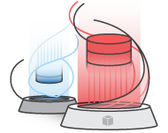
AWS Schema Conversion Tool (SCT)
The AWS Schema Conversion Tool helps automate many database schema and code conversion tasks when migrating between database engines or data warehouse engines
Integrates with AWS DMS to implement schema conversion during migration
Features
Microsoft SQL Server schema conversion to Amazon Aurora, MySQL, MariaDB, and PostgreSQL
Database Migration Assessment report for choosing the best target engine
Code browser that highlights places where manual edits are required
Secure connections to your databases with SSL

Slide 57
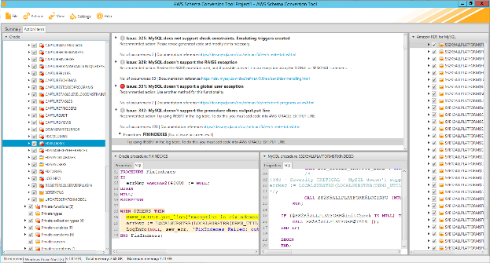
SCT helps with converting Tables, Views, and Code
Sequences
User-defined types
Synonyms
Packages
Stored procedures
Functions
Triggers
Schemas
Tables
Indexes
Views

Slide 58
Reference Architecture

Slide 59
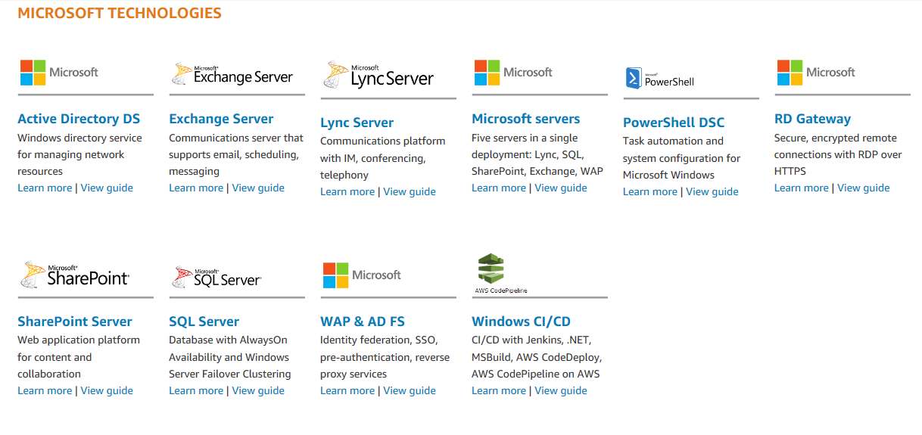
Microsoft based AWS Quick Starts
Notes:
AWS Quick Starts provide Automated, gold-standard deployments in the AWS Cloud
https://aws.amazon.com/quickstart/

Slide 60
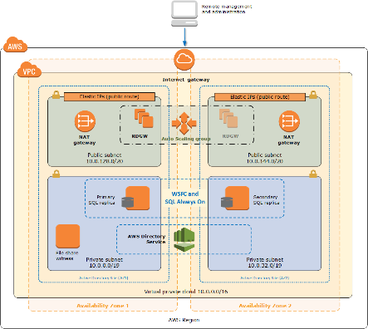
Always On Availability Group Quick Start
Sets up VPC with public and private subnets (2 AZs)
Sets up Internet Gateway
Sets up RDGW in public subnet for administration
Sets up NAT for internet access with Elastic IP
Sets up Domain Controllers *
Sets up WSFC nodes
Install and configure SQL Server Enterprise Edition with AlwaysOn Availability Group
Configures Security Groups

Slide 61
Licensing

Slide 62
Flexible Licensing Options for SQL Server Deployment in the AWS Cloud
Flexible pay-as-you-go licensing choices (RDS and AWS AMI)
Bring your license mobility benefits to AWS
Bring your legacy licenses to AWS without paying software assurance
Licensing Option in AWS
Buy license-included options
Bring licenses to AWS
Deploy RDS
Rent license-included instances from AWS (Windows Server, SQL Server)
Default tenancy for
License Mobility eligible products with
Software Assurance
Dedicated options for
licenses not eligible for
License Mobility
Notes:
No other cloud platform offers flexible cost optimization choices for customers than AWS. We’ll dive into each option that best fits your needs.
Bring your own licenses
If you have already purchased Microsoft licenses, you can bring your own licenses (BYOL) to AWS. The BYOL approach allows you to capitalize on both your existing license investments and all the benefits of running Microsoft workloads on AWS. There are two ways to bring your licenses to AWS: by running your Windows workloads on Amazon EC2 Dedicated Infrastructure (EC2 Dedicated Hosts and EC2 Dedicated Instances), or by using Microsoft License Mobility through Software Assurance on shared or default tenant EC2. It is important to note that if you choose to bring your own licenses to AWS, you are responsible for ensuring you follow the stipulations of your licensing agreement with Microsoft. If you have questions about your licensing or rights to Microsoft software, please consult your legal team, Microsoft (including the Microsoft product terms), or your Microsoft reseller.
License Mobility through Software Assurance
If you have active Software Assurance for eligible Microsoft software, you can take advantage of your existing Microsoft license investments to move to shared or default tenant EC2. You can use AWS VM Import to bring virtual machine images from your on-premises environment to AWS, including both Microsoft software licenses and virtual machine configurations. Customers who wish to use license mobility can purchase Amazon EC2 instances with licensed Microsoft Windows Server pre-installed and bring existing licenses for products like Microsoft SQL Server, Microsoft SharePoint, and more.
Dedicated Options for licenses not eligible for License Mobility
Amazon EC2 Dedicated Hosts and EC2 Dedicated Instances give you access to hardware that's fully dedicated for your use. This allows you to use your own licensed Microsoft software, including Microsoft Windows Server, on dedicated infrastructure, even without Software Assurance. Amazon EC2 Dedicated Hosts and Dedicated Instances may also enable you to use an active MSDN subscription on AWS for development and testing.
Microsoft@amazon.com – for all licensing questions

Slide 63

License Optimization with Optimize CPUs
Control active vCPUs and Hyper-Threading status when launching new EC2 instances
Reduce the number of SQL Server licenses
Instance Type | Total vCPUs | Active vCPUs with Optimize CPUs | SQL Server license savings
r4.4xlarge | 16 | 8 | 50%*
r4.8xlarge | 32 | 8 | 75%*
*Sample licensing example only
Guide: https://docs.aws.amazon.com/AWSEC2/latest/UserGuide/instance-optimize-cpu.html
Notes:
[INTERNAL NOTES] DB workloads and enterprise workloads like SQL Server, Oracle and IBM that require a lot of RAM and not compute-bound can help customers optimize costs. Your customer should use Optimize CPUs if they are BYOL and:
Customize your EC2 instance for workload’s performance needs
1. They are running EC2 workloads that are not compute bound and are incurring vCPU-based licensing costs. By launching instances with custom number of vCPUs you may be able to optimize your licensing spend.
2. If they are running workloads that will benefit from disabling hyper-threading on EC2 instances.
----------------------------------------------------------------------------------------------------------------------------------------------------------------------------------------------
AWS provides you a wide variety of instance types and families that best meet your workload needs.
Specify active vCPUs when launching new EC2 instances (hyper-threading feature detail on next slide)
Reduce the number of SQL Server Licenses. Save on SQL Server Licensing Cost.
Customize your EC2 instance for workload’s performance needs and license savings
Optimize CPUs for EC2 Instances allows you to specify custom number of vCPUs for BYOL license optimization. Optimize CPUs gives you greater control of your EC2 instances on two fronts. First customers can specify a custom number of vCPUs when launching new instances to save on vCPU-based licensing costs. Second they can disable Intel(r) Hyper-Threading Technology (Intel(r) HT Technology) for workloads that perform well with single-threaded CPUs, such as certain high-performance computing (HPC) applications.
For Microsoft SQL Server workloads licensed on a per core model, the Optimize CPU feature provides an alternate option to significantly reduce the licensing cost by letting users choose active vCPUs.
For example, an r4.8xlarge instance has 32 vCPUs by default. If you only want to use 8 vCPUs you can specify the vCPU count of 8 when you start the instance.
You can use the AWS Management Console, AWS CLI or AWS SDK / APIs to view the instance properties, and determine the vCPUCount or enableHTT attribute value of the instance.
Number of licenses required: When customers bring their SQL Server licenses to EC2 through license mobility (SA Required), the number of SQL Server cores required is based on the instance type and the number of active vCPUs available through Optimize CPUs. When “Licensing by Individual Virtual OSE” on EC2, the number of SQL Server core licenses equals the number of active vCPUs through Optimize CPUs, subject to a minimum of four licenses. Customers are responsible for complying with Microsoft licensing requirements when they bring licenses to EC2.
[INTERNAL]
Cost savings example can be pulled from Simple Monthly Calculator
https://calculator.s3.amazonaws.com/index.html Optimize vCPUs example
* for Windows and Enterprise SQL Server; on-demand in US-East region
EC2 Optimize CPUs FAQ: https://aws.amazon.com/ec2/faqs/
What’s new link: https://aws.amazon.com/about-aws/whats-new/2018/05/introducing-optimize-cpus-for-amazon-ec2-instances/
Documentation link to share with customers (technical): https://docs.aws.amazon.com/AWSEC2/latest/UserGuide/instance-optimize-cpu.html
________________________________________________________________________________________________________________________________________________________________
Optimize CPUs for EC2 Instances allows you to specify custom number of vCPUs for BYOL license optimization. Optimize CPUs gives you greater control of your EC2 instances on two fronts. First customers can specify a custom number of vCPUs when launching new instances to save on vCPU-based licensing costs. Second they can disable Intel(r) Hyper-Threading Technology (Intel(r) HT Technology) for workloads that perform well with single-threaded CPUs, such as certain high-performance computing (HPC) applications.
Customers running database workloads like SQL Server on EC2 want high memory, storage, and I/O bandwidth, but do not require a high vCPU count - since these workloads are rarely compute-bound. Memory-optimized instance families such as X1 and R4 offer a high RAM-to-vCPU ratio to help customers right-size their instances. With Optimize CPUs, customers now have the added flexibility of specifying a custom number of vCPUs for new instances, while enjoying the same memory, storage, and bandwidth of a full-sized instance.
To optimize licensing costs for databases in on-premises environments, enterprises create virtual machines with very high RAM per core ratio (either strip out CPU or add memory). For customers looking to migrate to AWS, GiB per core ratio offered by EC2 instance types is increasingly seen as a limiting factor. Among EC2 instance families, X1 instance type offers the highest RAM per core ratio but customers do not prefer smaller sized X1e as it does not provide sufficient EBS bandwidth required by performance databases. R4 is the other memory intensive instance type but only offers 16 GiB/physical core. So, a customer with a memory intensive SQL ENT workload using 8vCPUs and 244GiB memory on-premises, ends up using R4.8xlarge (32 vCPU, 244 GB RAM) and pays licensing costs for 32 vCPUs.

Slide 64
Summary

Slide 65
SQL Server on AWS performance versus Azure
SQL Server on Amazon EC2 consistently outperforms Azure across a variety of machine types by a 2x+ margin
https://zkresearch.com/blog/2018/11/comparing-sql-server-deployments-on-microsoft-azure-and-amazon-web-services
*Results for Small and Medium configuration available on https://zkresearch.com, a third-party research firm
Notes:
DB Best, an awesome enterprise database consulting company, just wrote two blogs – one for Azure and one for AWS – that showed how to get the best price/performance for running SQL Server in the cloud.
ZK Research took these blogs and compared the results from DB Best to show an apples to apples comparison.
And the results were very interesting! ZK Research points out that SQL Server on AWS consistently shows a 2X+ better price performance using HammerDB, a TPC-C-like benchmark tool compared to Azure! This first chart shows AWS in pink, and Azure in blue, the cost of 1 billion transactions per month. For this, SMALLER IS BETTER, AWS is cheaper!
<CLICK> And then ZK Research dove into performance of SQL Server – and again – AWS in pink and Azure in blue -- SQL Server on AWS outperforms SQL Server on Azure. And it’s close to 3X. In this case the bigger the bar the better.
Net Net – SQL Server on EC2 consistently outperforms Azure

Slide 66
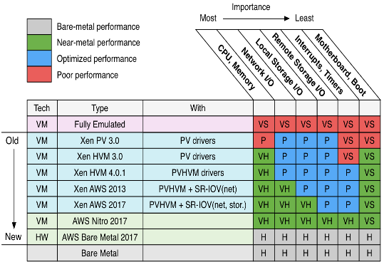
Why Microsoft SQL Server on AWS
Nitro System: based upon the custom developed card that allows to offload most of the VM Hypervisor functions to HW.
Network – 25, 50, 100 Gbps
EBS – up to 14Gbps
EBS – up to 80,000 IOPS
S3 – up to 25 Gbps
http://www.brendangregg.com/blog/2017-11-29/aws-ec2-virtualization-2017.html
Source: Gartner CloudHarmony. Use only in private settings w customers

Slide 67

Summary: Why Microsoft SQL Server on AWS
Best performance in the Cloud
Largest number of Instance Types
Cost benefits through license optimizations
Every region with multiple Availability Zones
Largest Global Reach
Increase innovation and flexibility for future
Improve security posture
Notes:
Largest Global Reach
We have the largest global infrastructure that includes 55 Availability Zones across 18 geographic regions worldwide to help improve uptime and performance. AWS automatically adds new EC2 instances when capacity is reached(and is reduced when utilization is low).
Every region with high availability zones
HA/DR solutions across AZs; AWS Availability Zones may satisfy DR requirements!
Flexible purchasing options to simplify procurement and cost optimization
Increase innovation and flexibility for future
New Instance types, new storage and networking capabilities are being added regularly – and are immediately accessible to customers.
Improve your security posture
The AWS infrastructure puts strong safeguards in place to help protect customer privacy. All data is stored in highly secure AWS data centers. Customers pay only for the services they use, meaning that you can have the security you need, but without the upfront expenses.
When you deploy your SQL Server on AWS, they benefit from all the security capabilities from AWS such as Amazon VPC, data encryption, and integration for AWS Microsoft AD for role-based access control, while also leveraging security enhancements provided in SQL Server 2017 such as Always-Encrypted, dynamic data masking, and row-level security.
AWS has 52 compliance certifications including FISMA, ITAR, EU Model Clauses and more -- 2x more than the compliance certifications of other vendors

Slide 68

Questions Answers

