Slide 1
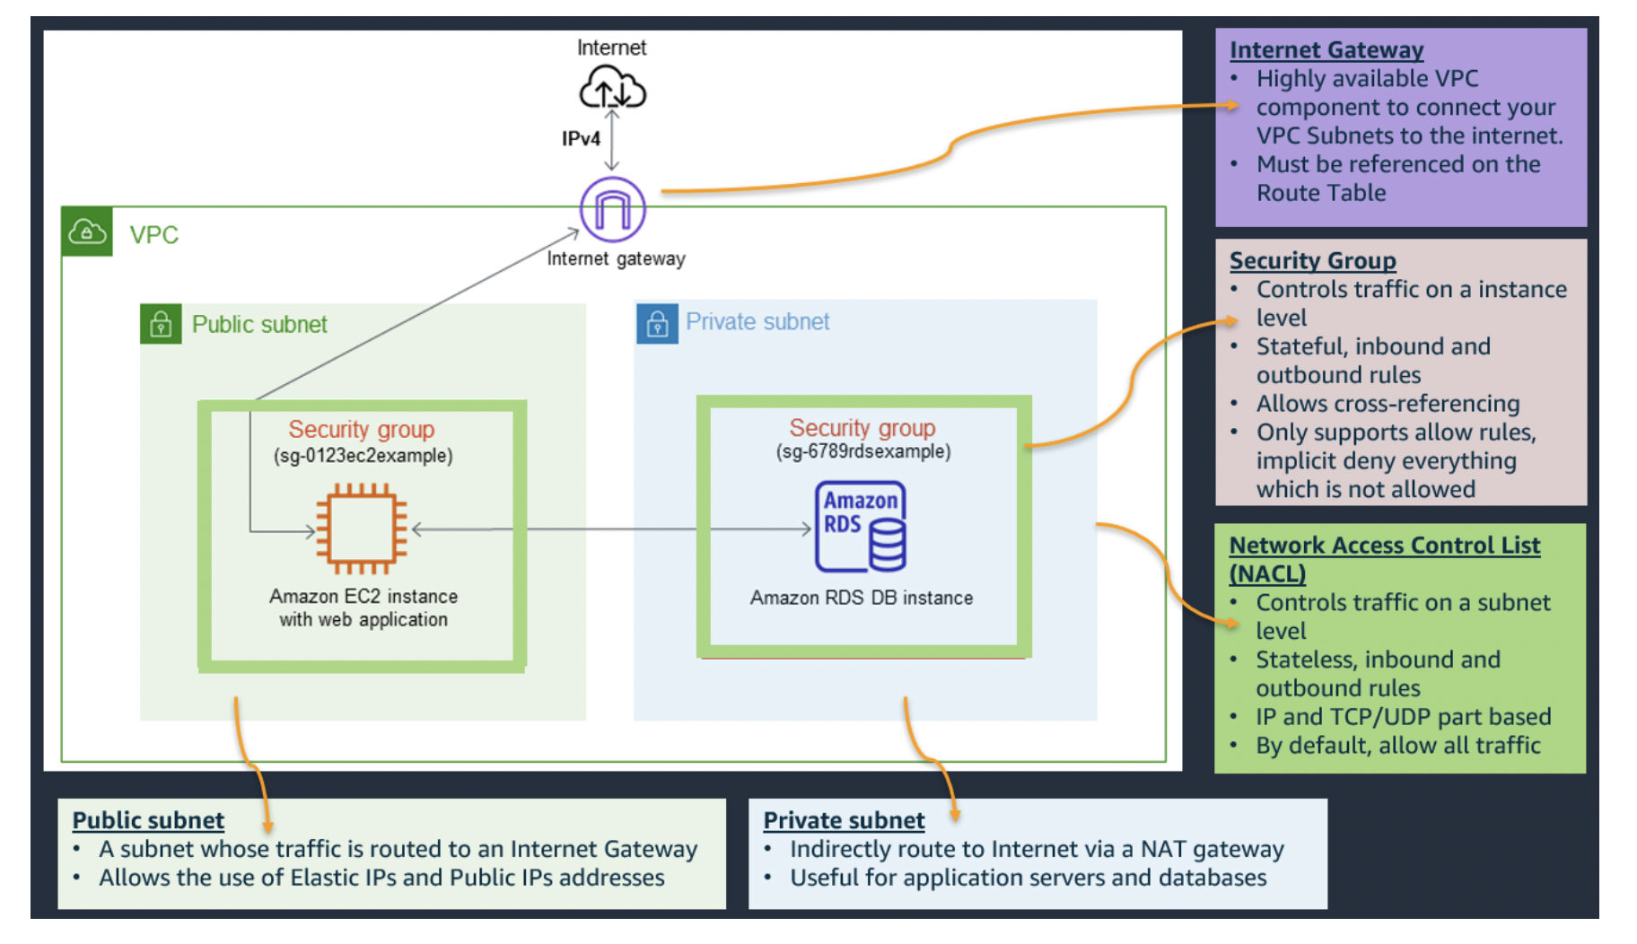

Slide 2






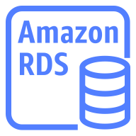
IPv4
VPC
Private Subnet
Indirect route to the internet when using a NAT gateway
Internet Gateway
Network Access Control List
Network Access Control List
Public subnet
Private subnet
Security Group
Security Group
Amazon EC2 Instance
with a web application
Amazon RDS DB instance
Public Subnet
Traffic routed directly to the Internet Gateway
Allows usage of Elastic IPs and public IP adresses
Private Subnet
Indirect route to the internet when using a NAT gateway

Slide 3
IPv4
VPC
Internet Gateway
Network Access Control List
Network Access Control List
Public subnet
Private subnet
Security Group
Security Group
Amazon EC2 Instance
with a web application
Amazon RDS DB instance

Slide 5
State 1: 10GiB
State 2: 4GiB changed
State 3: 2GiB added
10GiB
6GiB
4GiB
6GiB
4GiB
2GiB
10GB
(6GiB)
Referenced
Snapshot A
Referenced
10GiB
Referenced
10GB
(6GiB)
6GiB
4GiB
6GiB
4GiB
2GiB
6GiB
4GiB
Referenced
Snapshot A
Snapshot A
Snapshot B
Snapshot C
Snapshot B
Notes:
Source: https://docs.aws.amazon.com/AWSEC2/latest/UserGuide/EBSSnapshots.html#how_snapshots_work
As with any type of storage, we encourage our customers to have a robust, secure backup strategy in place to secure data. EBS offers a fully managed backup tool built-in with EBS Snapshots.
Snapshots are point-in-time copies of your data that are stored in Amazon S3. They can be used to instantiate multiple new volumes, expand the size of a volume, or move volumes across Availability Zones. When a new volume is created, you may choose to create it based on an existing Amazon EBS snapshot. In that scenario, the new volume begins as an exact replica of the snapshot.
Snapshots give you immediate access to Amazon EBS volume data, the ability to resize EBS volumes. You can also share EBS Snapshots and copy Snapshots across AWS regions.
EBS Snapshots can also have FSR (Fast Snapshot Restore) enabled – so the volume is delivered fully initialized and without any IO penalty when a block is accessed for the first time.
Snapshot functionality provides you geographic protection of your data and enables you to achieve business continuity for your organization.

Slide 7
Block vs File vs Object
Block Storage
File Storage
Object Storage
Notes:
Each storage option has a unique combination of performance, durability, cost, and interface

Slide 8
PUT {
TableName:"Gamers",
Item: {
"GamerTag":"Hammer57",
"Level":21,
"Points":4050,
"Score":483610,
"Plays":1722
}
}
Gamers
Key | Attributes
Gamer tag | Level | Points | High score | Plays
Hammer57 | 21 | 4050 | 483610 | 1722
FluffyDuffy | 5 | 1123 | 10863 | 43
Lol777313 | 14 | 3075 | 380500 | 1307
Jam22Jam | 20 | 3986 | 478658 | 1694
ButterZZ_55 | 7 | 1530 | 12547 | 66
… | … | … | … | …

Slide 9
HINT: mark all on the slide and save as png

Slide 10
Modul 210 architectur with container

Slide 11

















Users
Internet
Region
Amazon CloudFront
Virtual Private Cloud
(172.100.0.0/16)
Application Load Balancer
Amazon S3
Frontend-Hosting
AWS Cloud9
IDE
push image
Availability Zone A
Availability Zone B
Public subnet
(172.100.1.0/24)
Public subnet
(172.100.2.0/24)
Amazon Elastic Container Registry
Amazon ECS Cluster
Backend- Container
Backend- Container
Backend Image
Private subnet
(172.100.3.0/24)
Private subnet
(172.100.4.0/24)
Amazon Elastic Container Service
(Amazon ECS)
Backend Task Definition
Amazon RDS
Primary Database
RDS replication
Amazon RDS
Database Replica

Slide 12
Modul 210 architectur with CICD

Slide 13


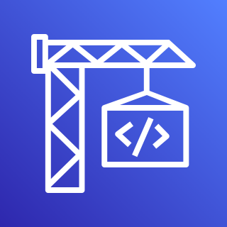

Repository
Users
Internet
Developer
Region
Amazon CloudFront
AWS CodePipeline
Virtual Private Cloud
(172.100.0.0/16)
Application Load Balancer
Amazon S3
Frontend-Hosting
AWS CodeCommit
Availability Zone A
Availability Zone B
Public subnet
(172.100.1.0/24)
Public subnet
(172.100.2.0/24)
Docker container image
AWS CodeBuild
Backend- Container
Backend- Container
Private subnet
(172.100.3.0/24)
Private subnet
(172.100.4.0/24)
Amazon Elastic Container Service (Amazon ECS)
AWS CodeDeploy
Amazon RDS
Primary Database
RDS replication
Amazon RDS
Database Replica

Slide 14
Modul 210 architectur with serverless

Slide 15



Users
Internet
Region
Amazon CloudFront
Amazon API Gateway
Amazon S3
Frontend-Hosting
AWS Lambda
Amazon DynamoDB

