Slide 1


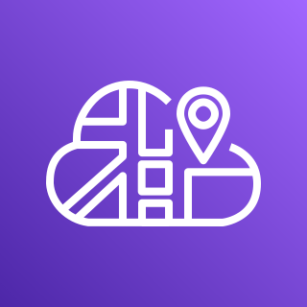

Inbound
traffic
AWS Fargate
AWS Cloud Map
Hello Task
10.0.0.5
DNS Lookup
web.production.internal
10.0.0.5
api.production.internal
10.0.0.6
10.0.1.4
10.0.1.5
Application Load Balancer
Name Task
10.0.0.6
Direct, peer to peer task networking
Name Task
10.0.1.4
Name Task
10.0.1.5

