Slide 1




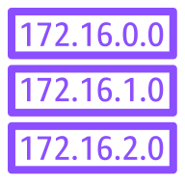
VPC
Public subnet
Public subnet
Internet gateway
NAT gateway
NAT gateway
Private subnet
Private subnet
Route table
Outbound internet traffic
Outbound internet traffic

