Slide 1


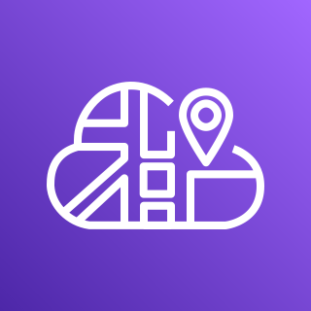

Inbound
traffic
AWS Fargate
AWS Cloud Map
Hello Task
10.0.0.5
DNS Lookup
Application Load Balancer
name.internal
10.0.0.6
10.0.1.4
10.0.1.5
Name Task
10.0.0.6
Direct, peer to peer task networking
Name Task
10.0.1.4
Name Task
10.0.1.5

