Slide 1



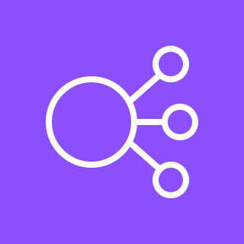


VPC
Public subnet
Public subnet
Traffic
Port 80
Internet gateway
NLB
Private subnet
Private subnet
ALB
Port 8080
Port 8080
Container
Container
AWS Fargate

