Slide 1
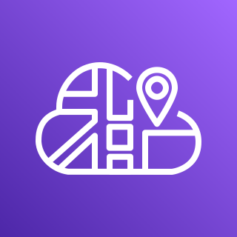




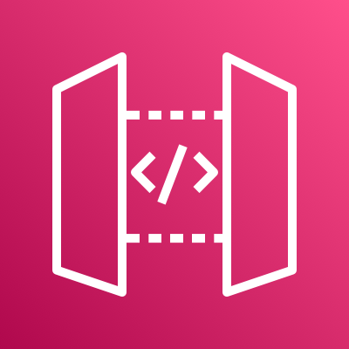
ECS registers tasks in Cloud Map
AWS Cloud Map
Amazon Elastic Container Service (Amazon ECS)
API Gateway uses a VPC link to access private task IP’s
AWS Fargate
API Gateway looks up task IP addresses using Cloud Map
Public subnet
Container
Container
Traffic
Public subnet
Amazon API Gateway
Container
Container

