Slide 1
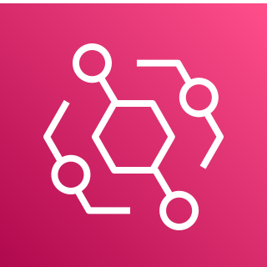



Amazon EventBridge
Scheduler
AWS Lambda
Amazon CloudWatch
On a schedule, gather metrics from all container repositories
Add metrics to CloudWatch, so you can track them over time
Amazon Elastic Container Registry (Amazon ECR)

