Slide 1












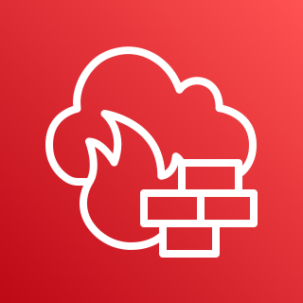
AWS Cloud
AWS Region
VPC 1
Availability Zone A
Endpoints Subnet
Private Subnet
TGW Subnet
Association
AWS Transit Gateway
Inspection VPC
Internet
gateway
VPC endpoints
EC2 instance
Transit Gateway ENI
Pre-Inspection route table
Destination | Attachment
0.0.0.0/0 | Inspection VPC
Availability Zone A
TGW Subnet
Endpoints Subnet
Public subnet
VPC 2
Post-inspection route table
Destination | Attachment
VPC 1 CIDR | VPC 1
VPC 2 CIDR | VPC 2
Availability Zone A
Association
Transit Gateway ENI
AWS Network Firewall
endpoint
NAT gateway
Endpoints Subnet
Private Subnet
TGW Subnet
Association
VPC endpoints
EC2 instance
Transit Gateway ENI
AWS Network Firewall

Slide 2

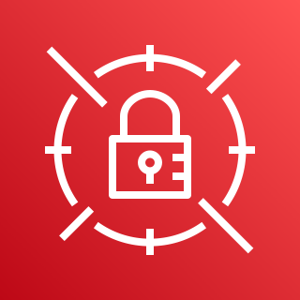
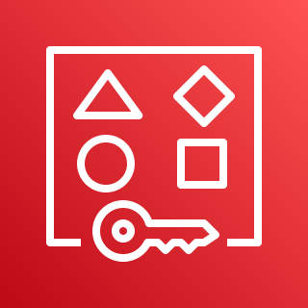

AWS Cloud
AWS Region
Spoke AWS account
Networking AWS account
Security AWS account
VPC 1
AWS Secrets Manager
AWS Resource
Access Manager
Amazon VPC IPAM
Availability Zone A
AWS Transit Gateway
AWS Secrets Manager
Endpoints Subnet
Private Subnet
TGW Subnet
Inspection VPC
Internet
gateway
Pre-Inspection route table
Destination | Attachment
0.0.0.0/0 | Inspection VPC
Availability Zone A
VPC endpoints
EC2 instance
Transit Gateway ENI
TGW Subnet
Endpoints Subnet
Public subnet
AWS Resource
Access Manager
Post-inspection route table
Destination | Attachment
VPC 1 CIDR | VPC 1
VPC 2 CIDR | VPC 2
VPC 2
Transit Gateway ENI
AWS Network Firewall
endpoint
NAT gateway
Availability Zone A
Endpoints Subnet
Private Subnet
TGW Subnet
Firewall Rules
VPC endpoints
EC2 instance
Transit Gateway ENI
AWS Network Firewall

