Slide 1
Pivotal Cloud Foundry on Amazon Web Services

Slide 2
The goals of modernizing development practices
Shorten the time from idea to production
Minimize risks that traditionally slow development
Create continually improving systems

Slide 3
To maintain competitive advantage, digital businesses must innovate as rapidly as possible
Experiment
Innovation Flywheel
Ideas
Feedback

Slide 4
Drivers for modernizing in the cloud
Discover cost savings
Better resource efficiency
Increased operational resilience
Improved business agility

Slide 5
What are customers asking for?
We want:
Agility and Speed
Hybrid unified experience on or off premise
Turn key services that lend to developer satisfaction
Prescriptive guard rails with security considered at every step

Slide 6
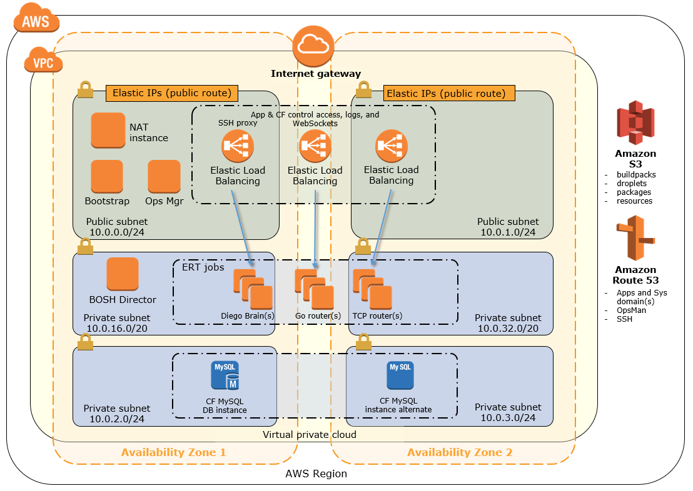
Getting PAS up and running with ease
Notes:
AWS and Pivotal continue to work together to maintain the reference architecture of PCF on AWS.
The AWS Quick Start for PCF enables customers to launch a production ready PCF implementation on AWS within 3 hours by inputting a few parameters into a CloudFormation infrastructure as code template.

Slide 7
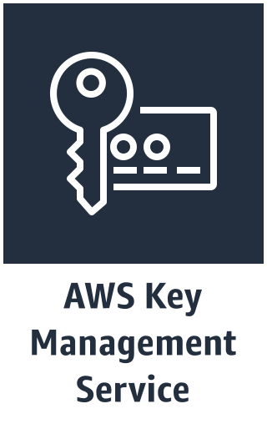
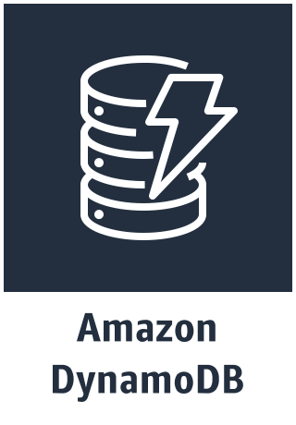
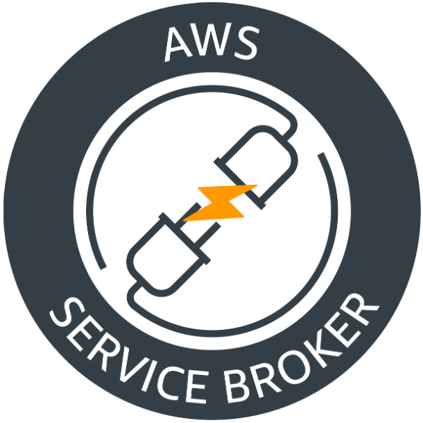
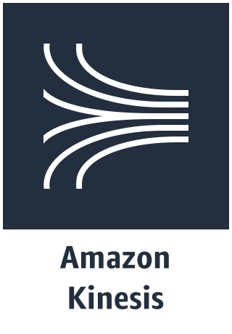
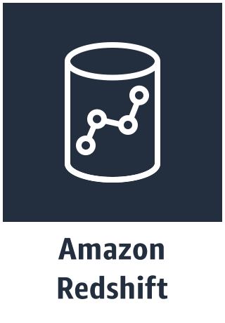
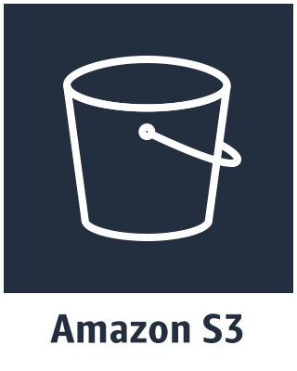
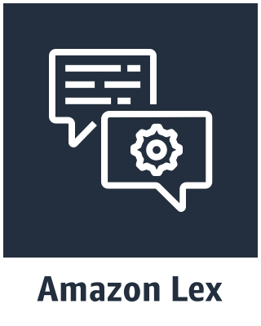
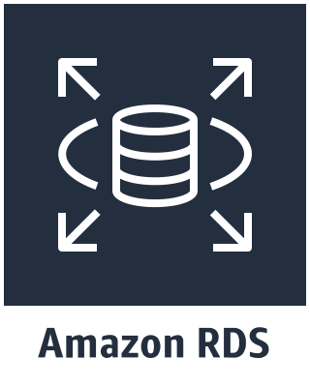
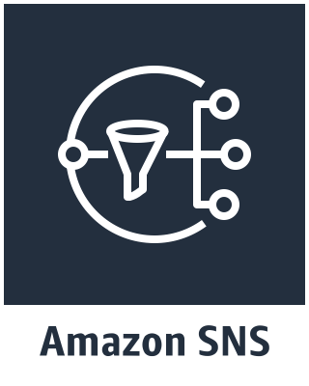
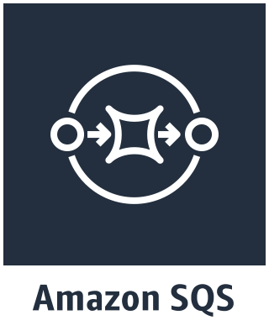
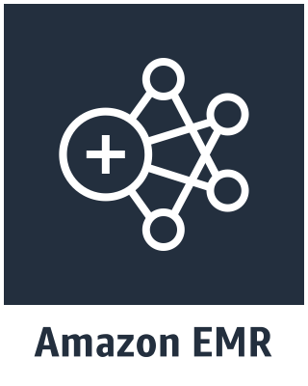
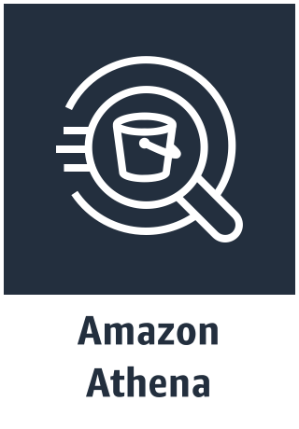
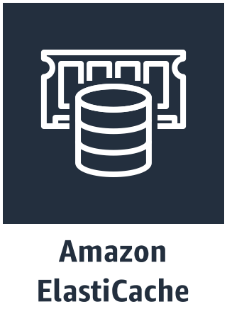
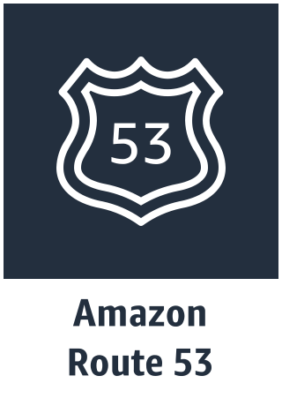
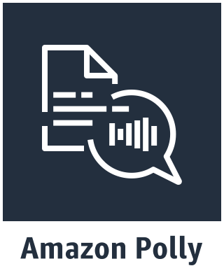

Offering 26 brokered services!
WOW!
Notes:
Speaker Notes:
Companies are constantly searching for new ways to accelerate software delivery. In the past this often meant building an application development platform that would enable developer and IT agility and embrace DevOps inspired methodologies. However, there are many reasons why in this present day and age of cloud platforms, this may not be the best course of action:
It requires more components than most people realize
Integrating disported technologies together is extremely challenging
Running and maintain the platform once its build require a ton of effort and resources
It is very difficult to keep pace with new requirements and shifting priorities
You will be forced to delay your digital transformation until the platform is production-ready
There are number of components that must be integrated together to create a complete platform, positioned to help you achieve your organization’s objectives.
For a more detailed look at the challenges of platform building, check out this blog post by Pivotal’s Jared Ruckle: https://blog.pivotal.io/pivotal-cloud-foundry/case-studies/5-confessions-of-a-platform-builder.
As you can see from this slide, Pivotal Cloud Foundry running on AWS provides the majority of the capabilities you should be concerned with and they are all built natively into the platform. Why would you invest massive amounts of time and money to build something like this in-house?
Not only does PCF on AWS give you this great functionality built in, but the engineers at AWS and Pivotal are continuously looking for ways to both improve the platform itself and ensure that is maintained effectively. Now your IT staff can focus on the things that matter to your business.

Slide 8
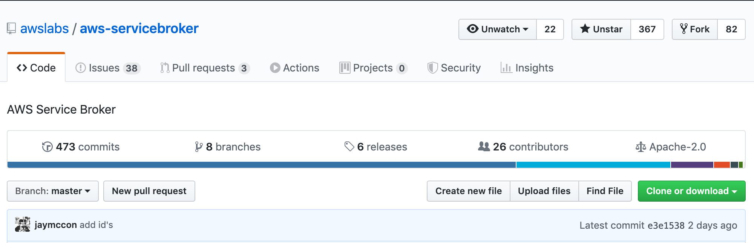
Community driven for enhancements and new services!
Submit Issues to bring attention to services and enhancements you would like to see.
Submit your PRs if you have something to contribute!

Slide 9
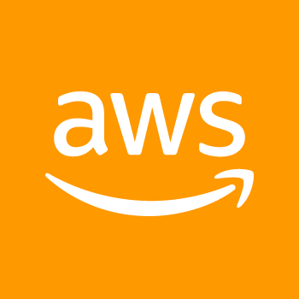
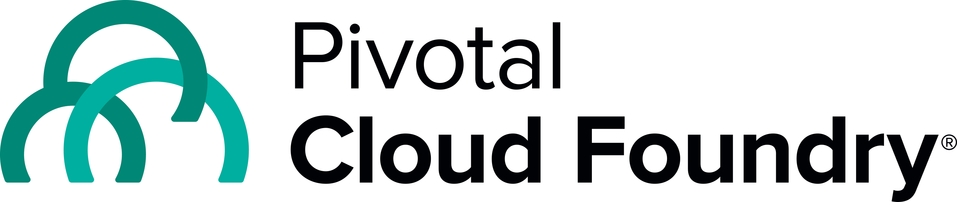
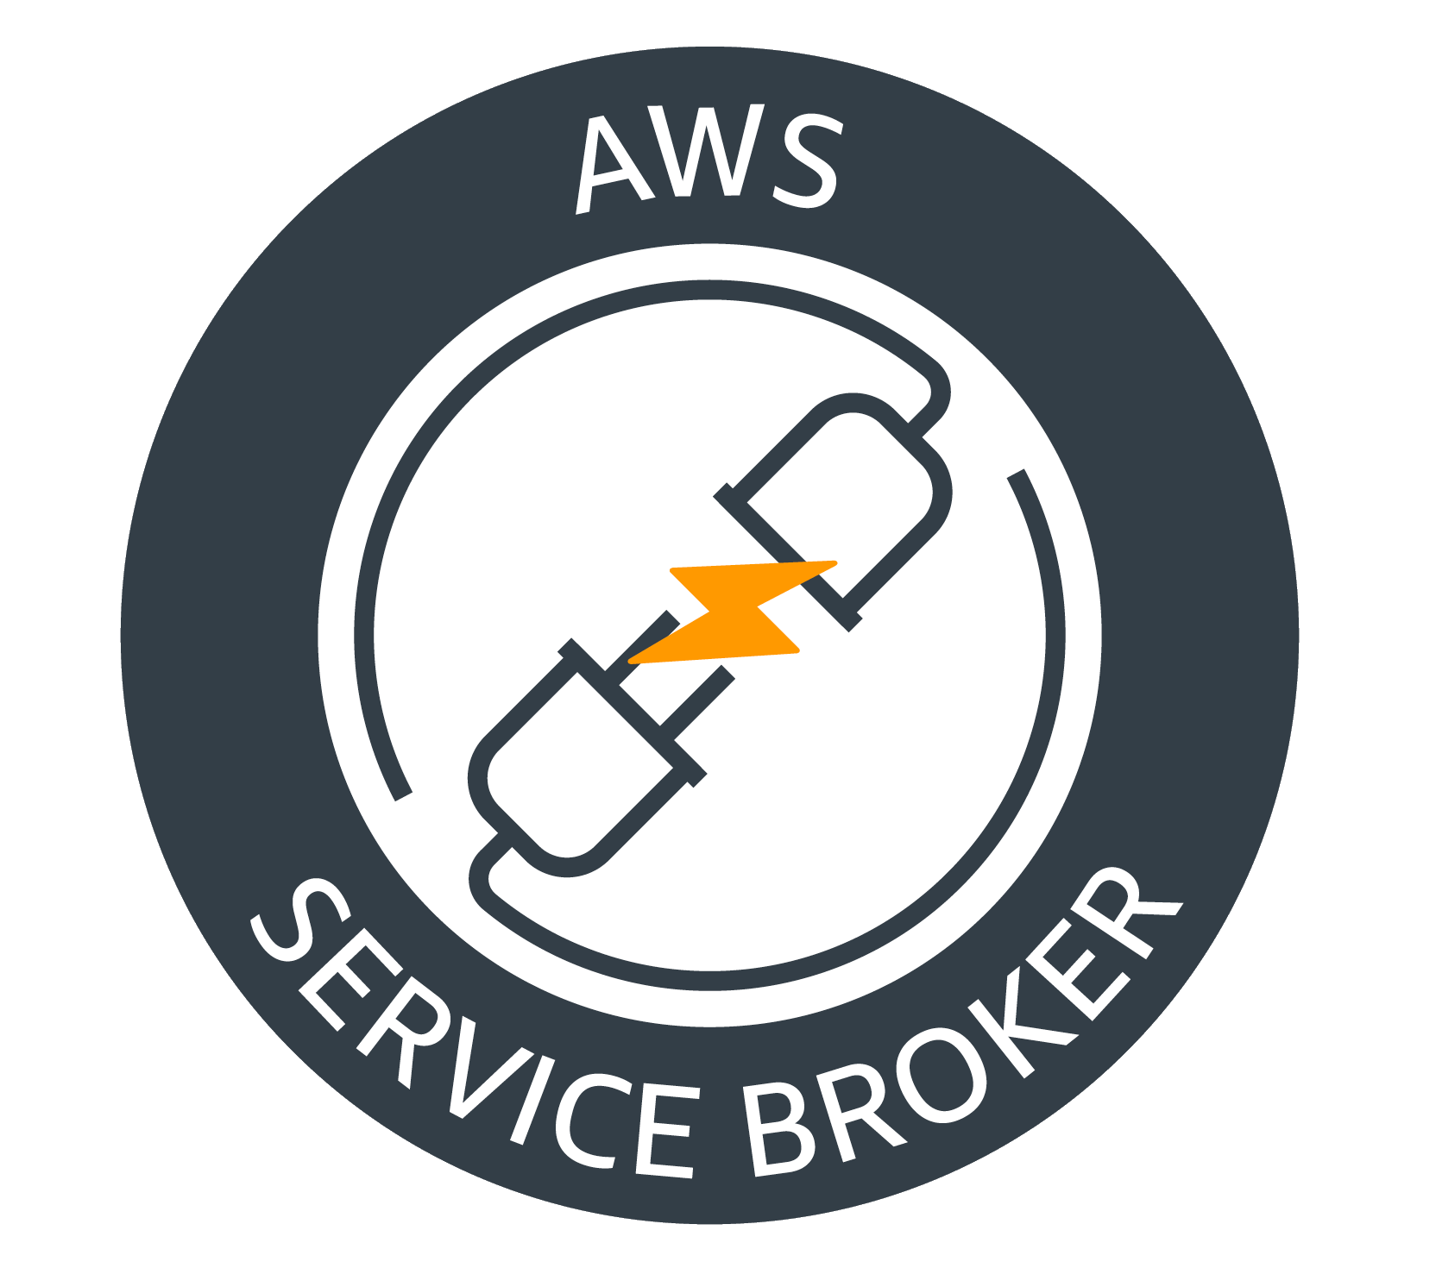
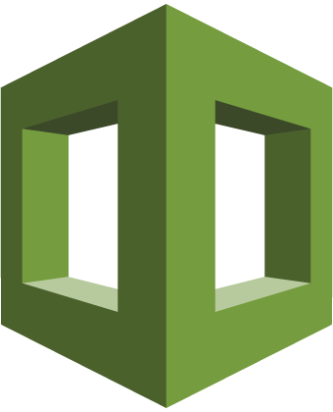

Provision and Bind
Application
Catalog/Marketplace
Push
Provision
CreateStack
Create AWS Services
Application Created
Complete
CREATE_COMPLETE
AWS CloudFormation
Bind Service
Bind
DescribeStack/GetParameter
AWS CloudFormation
VCAP_SERVICES
Bind Credentials
Connection Information
Application Platform
AWS KMS
AWS cloud
Notes:
Speaker Notes:
Companies are constantly searching for new ways to accelerate software delivery. In the past this often meant building an application development platform that would enable developer and IT agility and embrace DevOps inspired methodologies. However, there are many reasons why in this present day and age of cloud platforms, this may not be the best course of action:
It requires more components than most people realize
Integrating disported technologies together is extremely challenging
Running and maintain the platform once its build require a ton of effort and resources
It is very difficult to keep pace with new requirements and shifting priorities
You will be forced to delay your digital transformation until the platform is production-ready
There are number of components that must be integrated together to create a complete platform, positioned to help you achieve your organization’s objectives.
For a more detailed look at the challenges of platform building, check out this blog post by Pivotal’s Jared Ruckle: https://blog.pivotal.io/pivotal-cloud-foundry/case-studies/5-confessions-of-a-platform-builder.
As you can see from this slide, Pivotal Cloud Foundry running on AWS provides the majority of the capabilities you should be concerned with and they are all built natively into the platform. Why would you invest massive amounts of time and money to build something like this in-house?
Not only does PCF on AWS give you this great functionality built in, but the engineers at AWS and Pivotal are continuously looking for ways to both improve the platform itself and ensure that is maintained effectively. Now your IT staff can focus on the things that matter to your business.

Slide 10
Assuming Roles for provisioned services:
https://github.com/awslabs/aws-servicebroker/blob/master/docs/README.md#managing-resources-via-assumed-role
The aws-service-broker has the ability to assume a role for all resources it manages.
This role can be in the same account, or a separate target account.
Parameter Overrides:
https://github.com/awslabs/aws-servicebroker/blob/master/docs/README.md#parameter-overrides
The aws-service-broker can override parameter values by providing environment variables in the broker execution environment.
The broker provides a hierarchy of parameter overrides to prescribe values for common parameters like AWS credentials, region, VPC ID or any other parameter in a service plan.
An override can be broker wide, or only apply to a particular org/cluster, space/namespace, or ServiceClass.

Slide 11

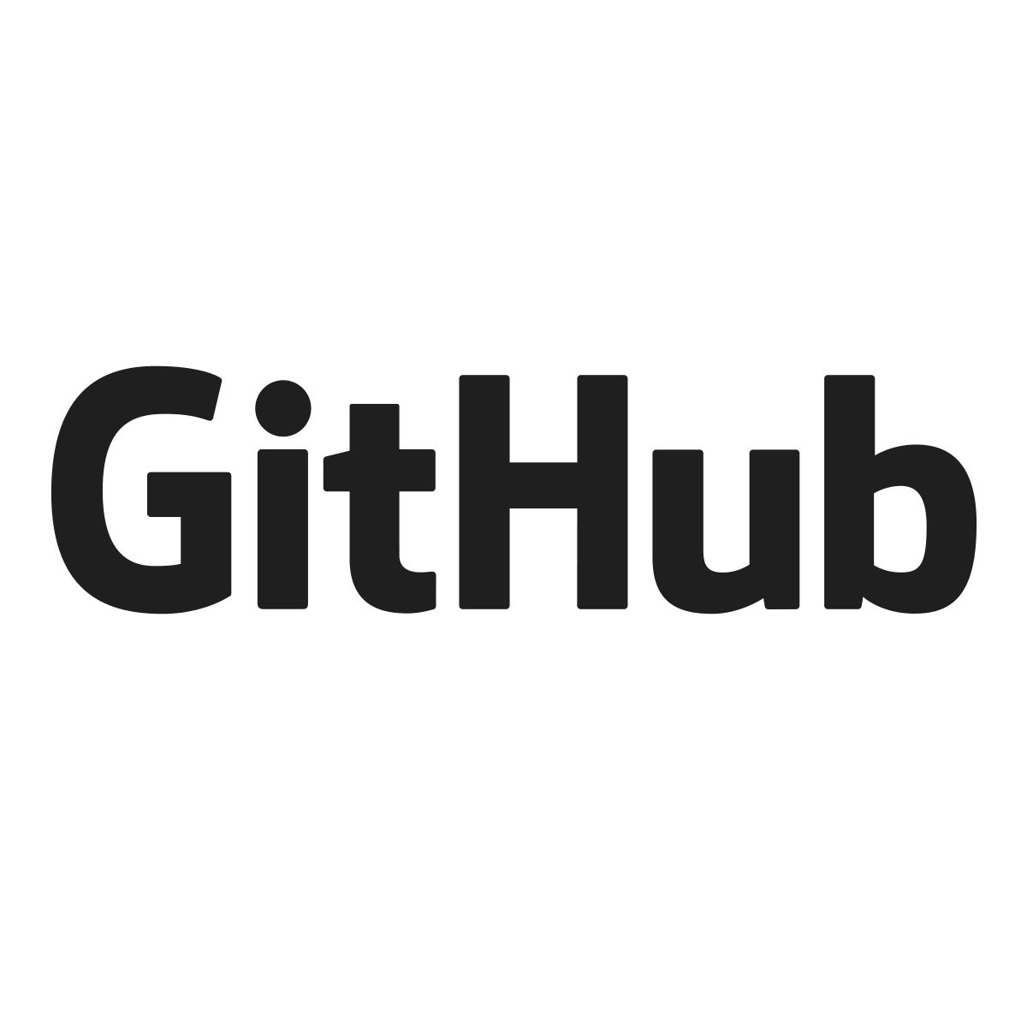
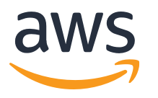
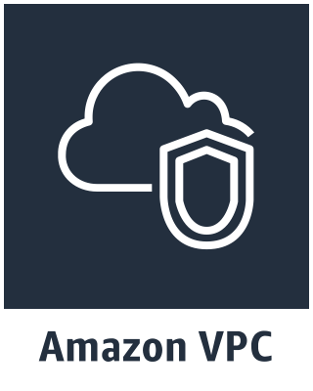
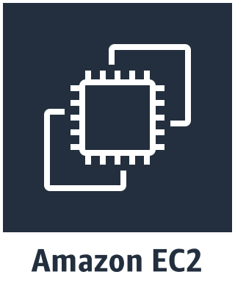
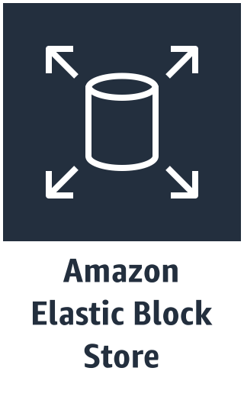
How PAS and AWS work together
Continuous
delivery
Application Code & Frameworks
Buildpacks | Spring Boot | Spring Cloud | Steeltoe
Pivotal Network
Open Service Broker API
Pivotal Application Service (PAS)
IAM
v1
Concourse
>cf push
Java | .NET | NodeJS
CVEs
Product Updates
v2
Embedded OS
(Windows & Linux)
“3 Rs”
v3
...
Repair
— CVEs
Repave
Rotate
— Credhub
Concourse
Amazon Web Services Infrastructure Services
Notes:
Amazon RDS for PostgreSQL
Amazon S3
Amazon RDS for MySQL
Amazon Aurora
Amazon RDS for SQL Server
Amazon DynamoDB
Amazon RDS for Oracle Database
Amazon RDS for MariaDB
Amazon SQS

Slide 12

LAB CONTENT OVERVIEW
Lab 0 – Explore the AWS Quick Start
Lab 3 – Deploy Polly solution
Lab 1 – Getting Started
Lab 4 – Deploy S3 solution
Lab 2 – Install and configure AWS Service Broker
Lab 5 – Explore the GUI
Notes:
Speaker Notes:
Companies are constantly searching for new ways to accelerate software delivery. In the past this often meant building an application development platform that would enable developer and IT agility and embrace DevOps inspired methodologies. However, there are many reasons why in this present day and age of cloud platforms, this may not be the best course of action:
It requires more components than most people realize
Integrating disported technologies together is extremely challenging
Running and maintain the platform once its build require a ton of effort and resources
It is very difficult to keep pace with new requirements and shifting priorities
You will be forced to delay your digital transformation until the platform is production-ready
There are number of components that must be integrated together to create a complete platform, positioned to help you achieve your organization’s objectives.
For a more detailed look at the challenges of platform building, check out this blog post by Pivotal’s Jared Ruckle: https://blog.pivotal.io/pivotal-cloud-foundry/case-studies/5-confessions-of-a-platform-builder.
As you can see from this slide, Pivotal Cloud Foundry running on AWS provides the majority of the capabilities you should be concerned with and they are all built natively into the platform. Why would you invest massive amounts of time and money to build something like this in-house?
Not only does PCF on AWS give you this great functionality built in, but the engineers at AWS and Pivotal are continuously looking for ways to both improve the platform itself and ensure that is maintained effectively. Now your IT staff can focus on the things that matter to your business.

Slide 13
Workshop:
pcf.clouddoundry.awsworkshop.io

Slide 14
Thank you

