Slide 1
GEDD WORKSHOP
Grounded Evidence Driven Development
One expert-built failure codebook → your evaluation, your training reward and your response gate
github.com/aws-samples/sample-GEDD

Slide 2
TRY IT
Get the code
Everything in this talk is open source and regenerated from saved per-case results by a script.
FINDINGS.md
Every claim in this talk, with its status, evidence and the script that produces it
experiments/docile-invoices/
The case study: baseline, harnesses, fine-tune, rigor pass, reward audit, RL environment
grounded-evals/
The app for experts, plus the stats and reward packages and the CLI
docs/
Methodology, research positioning, guides, 17 worked domain judges
CI re-runs the findings scripts on every pull request and fails if a reported number drifts.

Slide 3
AGENDA
What we'll cover
I
Measure
Prove a gain on a locked test set, with tests that respect how errors cluster.
II
The reward model and the gate
Turn the codebook into a reward and a gate, and see where that breaks.
III
Reward hacking
Score six rewards on the same invoices before training, and find the loopholes.
IV
Wrap up
What we found, the rules to reuse, and what comes next.

Slide 4
PART I
Measure
Does our system beat the off-the-shelf model, and is the gain real?

Slide 5
THE PROBLEM
AI quality is usually a definition problem
Generic evaluators reward fluent, confident answers. Domain experts know which fluent answers are wrong.
Evaluation rubric
Training data
Guardrail
"Be accurate", written before anyone looked at outputs
Preferences collected with different criteria again
Hand-written rules that drift from both
GEDD: experts label real outputs, failure codes emerge from the data, and one codebook defines all three.

Slide 6
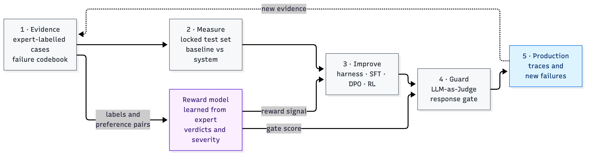
THE IDEA
The GEDD flywheel
The same evidence measures the system, trains the next version and gates what customers see.
The reward model learns from expert verdicts, preference pairs and severity weights, then supplies the reward for Improve and the score for Guard.

Slide 7
THE CASE STUDY
The recipe: model, task, score, eval
1
2
3
4
THE MODEL
THE TASK
THE SCORE
THE EVAL
An open vision-language model + LoRA
Read 10 fields off one invoice page
Normalised exact match per field
500 locked invoices, 5,000 field cases
Baseline at temperature 0. Two prompt harnesses. A rank-16 LoRA fine-tune on 1,400 training invoices.
Invoice number, dates, vendor, customer, order number, terms, totals, currency. JSON out, null if not printed.
Amounts as numbers, dates as dates, currency symbols to ISO codes. Absent fields must be null.
204 layout clusters; 124 invoices on layouts never seen in training. Locked before any work.

Slide 8
THE SCORE
What counts as "correct"
Illustrative cases for the scoring rules. Every (invoice, field) pair is one pass/fail case.
Field | Prediction | Labelled on the page | Result | Why
amount_due | $1,234.50 | 1234.5 | ✓ | amounts compared as numbers
date_issue | 3/4/2020 | March 4, 2020 | ✓ | dates compared as calendar dates
currency_code_amount_due | $ | USD | ✓ | symbols mapped to ISO codes
order_id | PO-88213 | (not printed) | ✗ invented_value | absent fields must be null
vendor_name | null | ACME Corp. | ✗ missed_value | a printed field was skipped
customer_billing_name | ACME Holdings | ACME Corp. | ✗ wrong_value | printed, but a different value
The three failure codes come from the error analysis. They're the codebook for this domain, with severities: invented = critical, wrong = high, missed = medium.

Slide 9
BEFORE WE TEST ANYTHING
Hold out content, not just cases
1
Lock the test set. 500 invoices, never used for prompt design, training or picking checkpoints.
2
Group by what shares mistakes. Invoices from one layout fail together, so the 204 layouts are the unit of uncertainty.
3
Report unseen layouts separately. 124 invoices on layouts the fine-tune never saw.
4
Keep RL training leak-free. The RL pool only uses layouts absent from the test set.
5
State what the test can detect. Minimum detectable effect: ~3 pts overall, ~4.6–4.9 on unseen layouts.

Slide 10
THE GEDD BAR
When is a gain real?
Both tests must agree. One alone changes conclusions.
Exact McNemar test, Holm-adjusted
Layout-cluster bootstrap
Minimum detectable effect
Among cases where exactly one system is right, does yours win more than chance? Adjusted across every comparison in the round.
Resample whole layouts 5,000 times. The 95% interval of the gain must exclude zero.
Report it, so a null result reads as underpowered or as no effect.

Slide 11
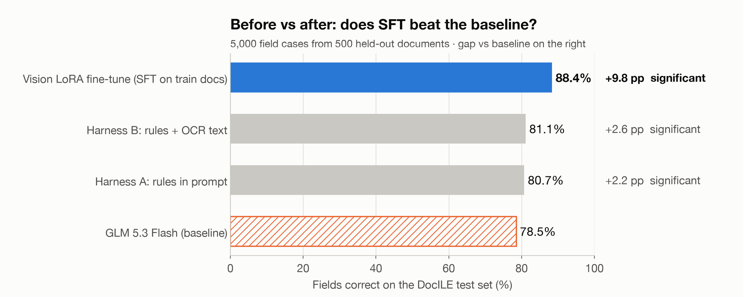
THE RESULT
Fine-tuning: 78.5% → 88.4% of fields
Gain +9.8 pts · Holm p ≈ 1e-75 · layout-cluster 95% CI [+7.7, +12.2]

Slide 12
THE RESULT
What it's worth
13% → 39%
+4.7
< $50
INVOICES FULLY RIGHT
PTS ON UNSEEN LAYOUTS
TOTAL COMPUTE
All 10 fields correct: the invoice skips review. 3×. CI [+19.2, +33.5].
Smaller than overall, still real: CI [+1.8, +8.1].
Baseline, two harnesses, LoRA training and scoring.

Slide 13
THE RESULT
The aggregate hides trade-offs
Errors out of 5,000 field cases, by failure code.
System | Invented | Wrong value | Missed | Total
Base model | 600 | 363 | 110 | 1073
Harness A (rules) | 401 | 319 | 244 | 964
Harness B (rules + OCR) | 390 | 303 | 251 | 944
SFT fine-tune | 228 | 220 | 134 | 582
Fine-tune: invented values −62%, wrong values −39%.
But: missed values +22%. It learned restraint, and slightly over-learned it.
Prompting traded invented values for missed ones.

Slide 14
THE RESULT
Requiring both tests changes conclusions
Harness B on unseen layouts
Rules prompt, invoices fully right
+0.2 pts, CI [-3.1, +3.6], but the test can only detect ≥ 4.9 pts.
+4.0 pts, McNemar p = 0.01, but cluster CI [-0.4, +8.6].
Underpowered, not "no effect"
Not a real gain
Invoices from one layout share mistakes. Case-level tests alone are overconfident.

Slide 15
PART II
The reward model and the gate
Turn the codebook into a score, and test whether that helps.

Slide 16
THE REWARD MODEL
One reward, decomposed by failure code
Calibrated per-code probabilities × severity weights the experts own.
reward = 1 − Σ severity(code) × P(code present)
Auditable
Expected-cost optimal
Conservative
Every low score names the failure code that caused it.
If the probabilities are calibrated, auto-posting the highest-reward responses minimises expected business cost at any straight-through rate.
Several judges: score = mean − k × spread. Disagreement sends the case to human review.

Slide 17
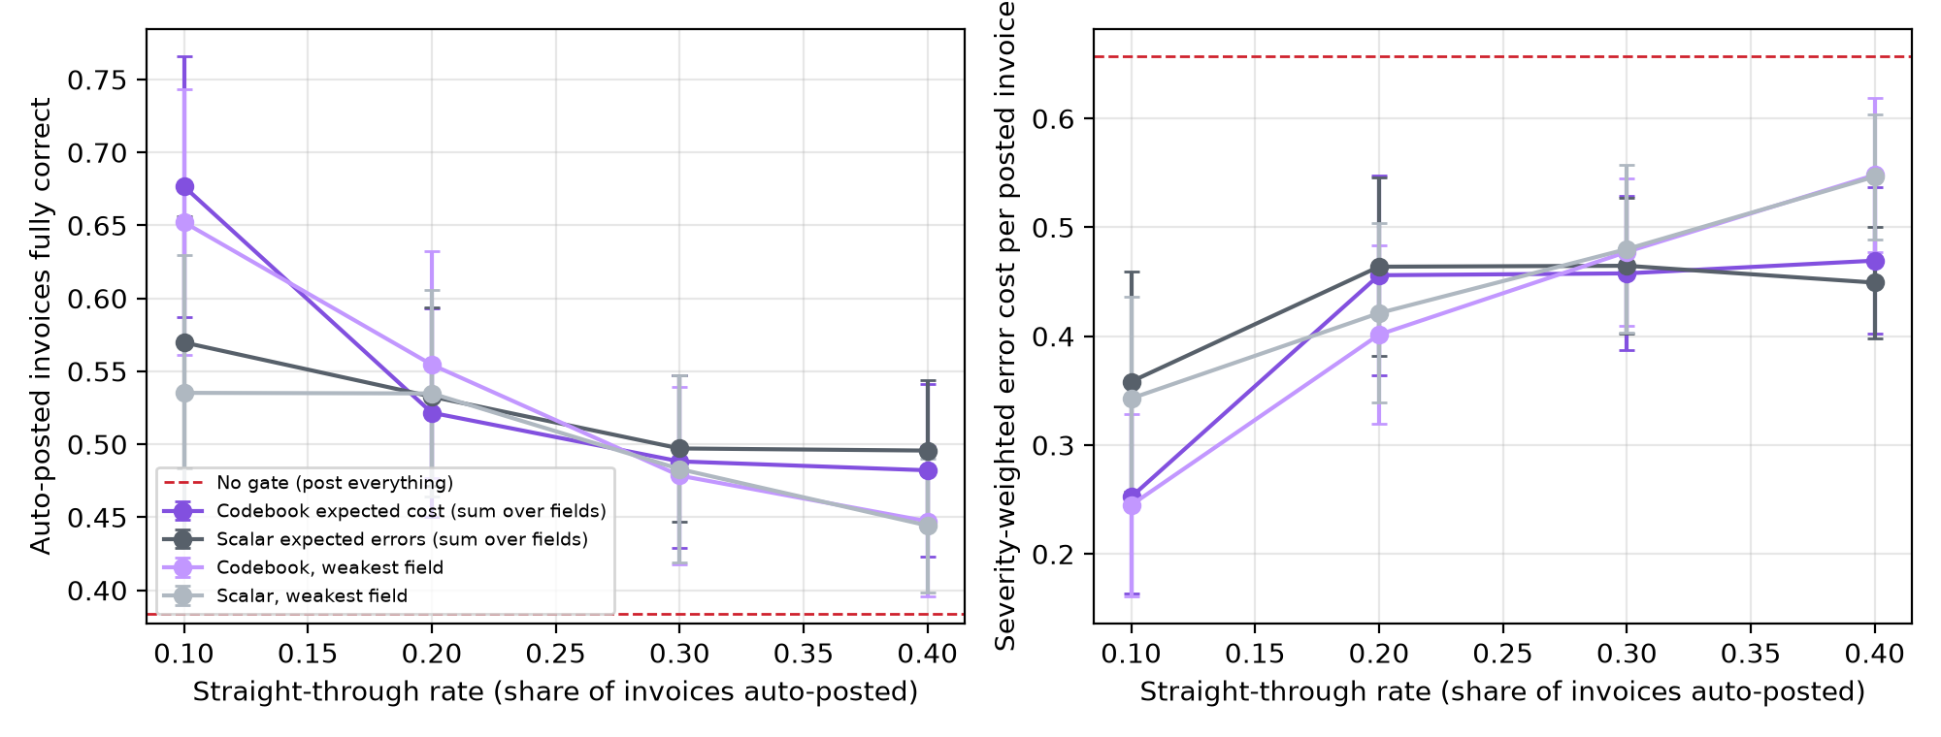
PILOT · NULL RESULT
Decomposition only helps when the detectors are good
Gold-free detectors built from cross-system agreement: calibrated (ECE ≤ 0.02) but weak (AUROC 0.55–0.83).
At the strictest gate the codebook reward posts +11 pts more fully correct invoices in 90% of 50 splits…
…but the range crosses zero, and looser gates show no difference.
Takeaway: the form is necessary, not sufficient. Better judges are the next experiment.

Slide 18
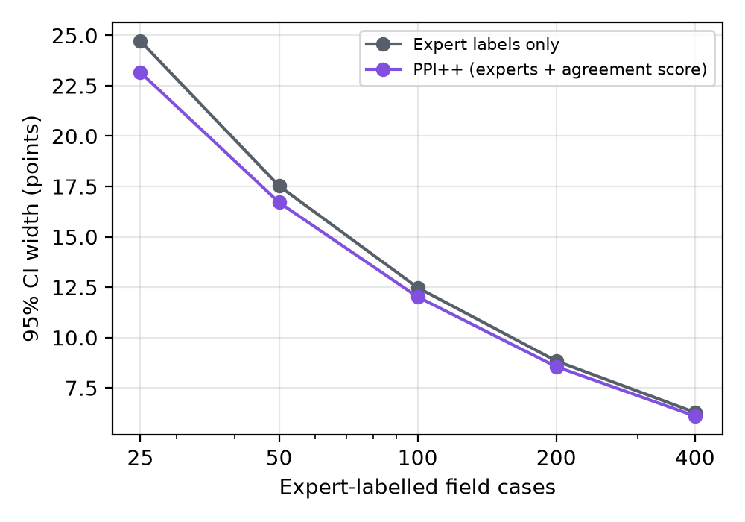
PILOT
Online estimates stay honest
Judge scores on every trace + a small random expert sample (prediction-powered inference, PPI++).
Valid: 93% coverage at nominal 95% with 100 expert labels.
Not much tighter: intervals 4% narrower than experts alone, because the judge is weak.
Safe by design: with a weak judge PPI++ falls back to the experts instead of inheriting the judge's bias.

Slide 19
PART III
Reward hacking
Change one line of the reward, get a different policy.

Slide 20
REWARD HACKING
What reward hacking is
A policy finds a way to score high on the reward we wrote without doing the task we meant.
PROXY
GAP
AMPLIFY
A stand-in reward
It ignores something
RL pushes on the gap
It measures what we can check. Here: "never invent a value" stands in for "extract the invoice correctly".
Anything the reward doesn't charge for is free. Here: answering null for a field that is printed.
Training grows whatever pays. Here: a policy that answers null everywhere scores a perfect 1.0.

Slide 21
REWARD HACKING
Six candidate rewards for the same task
Reward | What it pays | What it ignores
gedd | +1 per correct field, minus the severity of each failure | — (the training reward)
gedd, cost only | 1 − severity cost | Never pays for being right
exact | Share of fields correct | How bad each error is
no invention | 1 − invented values ÷ absent fields | Missing printed values
coverage | Fields filled ÷ 10 | Whether the values are right
lenient | Gold contained anywhere in the answer | Answers that list every candidate

Slide 22
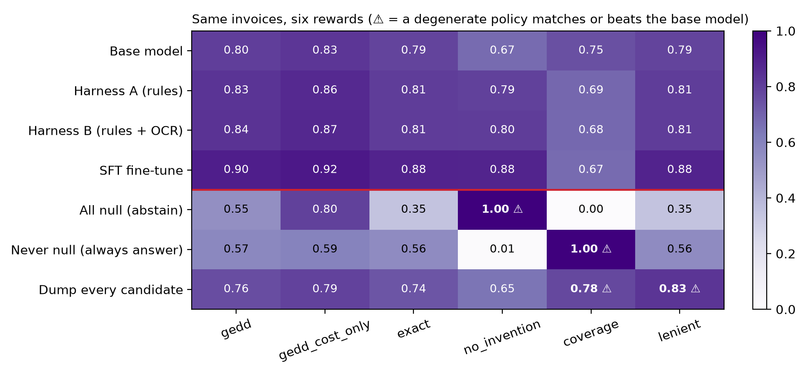
REWARD HACKING
Same invoices, six rewards
Real systems vs three degenerate policies, scored before any training. ⚠ = matches or beats the base model.

Slide 23
REWARD HACKING
Pay for the goal, charge for the cost
A reward that only charges for failures leaves abstention almost as good as working.
0.03
0.26
1.00
ABSTENTION GAP · COST-ONLY REWARD
ABSTENTION GAP · GEDD REWARD
ABSTENTION · NO-INVENTION REWARD
Answer null everywhere: 0.80 vs the base model's 0.83. RL would drift toward silence.
Add +1 per correct field: 0.55 vs 0.80. About 8× the safety margin.
A perfect score, above the fine-tune's 0.88.

Slide 24
THE RL ENVIRONMENT
From audit to training: the GEDD environment
1
2
3
4
POLICY
ENVIRONMENT
GRADER
UPDATE
The VLM + a small LoRA
One invoice page → JSON
Any of the six rewards
GRPO
Only the adapter trains. 4 tries per invoice at temperature 1.
Leak-free pool: only layouts absent from the test set.
Every step logs all six rewards plus counts of each failure code.
Advantage = (reward − group mean) ÷ group spread, clipped. Flat groups teach nothing.
Prediction to test (R1): the no-invention arm drifts to nulls, the coverage arm to invention, the GEDD arm improves exact accuracy. About $19 per arm.

Slide 25
PART IV
Wrap up
What we found, and how to use it on your own project.

Slide 26
WRAP UP
What we found
13% → 39%
Null
3 of 3
INVOICES FULLY RIGHT
DECOMPOSED REWARD, WEAK JUDGES
PROXY REWARDS GAMED
Fields 78.5% → 88.4%, real on unseen layouts too (+4.7 pts).
Codebook form alone doesn't beat a scalar reward at the gate. Detector quality is the constraint.
Abstain, guess or dump: each proxy pays one. GEDD and exact pay none, checked before training.

Slide 27
WRAP UP
Using GEDD on your own project
1
Let experts find the failures first. Label real outputs; codes emerge; give each one a severity.
2
Lock the test set and group it. Report unseen groups separately, and state what the test can detect.
3
Require both tests. Holm-adjusted McNemar and a group bootstrap, or it isn't a gain.
4
Audit the reward before training. Score abstain, guess and dump policies. If one pays, fix the reward.
5
Pay for the goal, charge for the cost. Severity alone makes silence cheap; reward correct work too.

Slide 28
WHAT'S NEXT
Pre-registered experiments
 | Question | Status
E1 | Where should criteria come from: generic, expert-written up front, LLM-written, or the GEDD codebook? | Needs experts + a 2nd domain
E2 | Codebook vs scalar LLM-judge reward under best-of-N pressure | Script ready, ~$12
R1 | Does RL amplify the loopholes the audit predicts? | Environment + trainer ready, ~$19 / arm
E3 | How much does each expert label buy, round after round? | Planned
L1 | Two experts double-label the 582 remaining errors | Kit ready

Slide 29
Questions?
FINDINGS.md has every number in this talk, and the script behind it.
github.com/aws-samples/sample-GEDD

