Slide 1




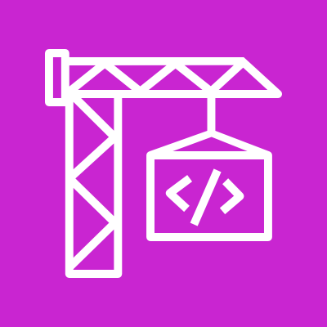

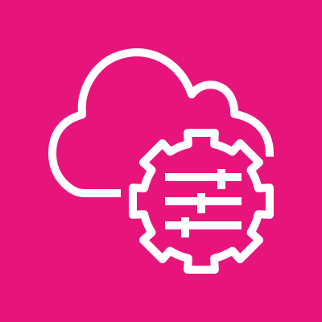


PROFILE ARCHITECTURE · BUILD
PROFILE · GREENFIELD
Greenfield · the complete platform path
A clean AgentCore landing zone with identity, tools, memory, build automation, and trace visibility.
AWS ACCOUNT · CENTRALIZED DEPLOYMENT
AMAZON BEDROCK AGENTCORE
MODEL INVOKE
U
Caller
Cognito
JWT
Runtime
MCP + JWT
Gateway
Bedrock
User or M2M app
OIDC · M2M
Orchestrator · HTTP
MCP · custom JWT
Foundation model inference
Identity
Memory
Gateway targets
Token Vault · gateway M2M
Session recall
Lambda sample tool · web search
DEPLOY & OPERATE
CodeBuild
Amazon ECR
SSM registry
CloudWatch + X-Ray
Default profile: all security hardening remains opt-in and deliberate.
Solid blue = live request path · Purple = AgentCore / model path · Dashed = build, registry, or telemetry relationship.
© 2026, Amazon Web Services, Inc. or its affiliates. All rights reserved.
1

Slide 2

PROFILE ARCHITECTURE · MODERNIZE
PROFILE · MIGRATION
Migration · wrap the agent, preserve ownership
The existing container lands behind an AgentCore adapter while data, triggers, traffic, and cutover stay customer-operated.
CUSTOMER ENVIRONMENT
AWS ACCOUNT · ACCELERATOR-MANAGED
ID
Microsoft Entra ID
Cognito
AMAZON BEDROCK AGENTCORE RUNTIME
Enterprise sign-in
Federation broker
Bedrock
Model inference
Adapter
Existing agent
Existing agent container
:8080 · /invocations
unchanged process · :8000
OpenShift / ECS / EC2 source
CodeBuild
ECR
ARM64 rebuild
Pinned digest
NO MEMORY BY DEFAULT
Existing data & APIs
OPTIONAL CUSTOMER CONNECTIVITY
Private dependencies remain in place
Secrets
Gateway
Targets
Observability
Manager · registry + child values
MCP tools
Lambda + web search
CloudWatch + X-Ray
Triggers · traffic · cutover / rollback
not deployed by this profile
Solid blue = live request path · Dashed purple = image migration · Dashed amber = optional customer connectivity, with an approved receipt.
© 2026, Amazon Web Services, Inc. or its affiliates. All rights reserved.
2

Slide 3

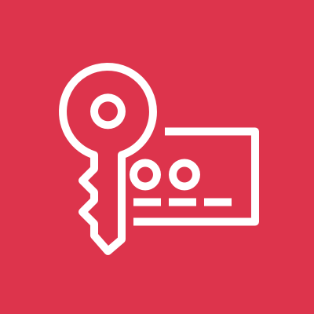


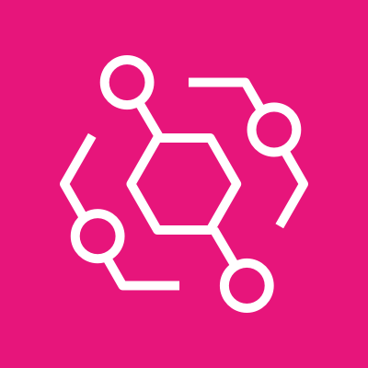
PROFILE ARCHITECTURE · HARDEN
PROFILE · SECURITY-FOCUSED
Security-focused · controls around every hop
The Greenfield platform plus VPC placement, model and tool governance, resource policies, encryption, audit, and traceability.
AWS ACCOUNT · CENTRALIZED DEPLOYMENT
VPC · PRIVATE SUBNETS
Guardrail
Model IAM
Bedrock
U
Caller
Cognito
Runtime
Ungoverned invoke denied
Pinned allow-list
Guardrailed inference
User or M2M
JWT issuer
Orchestrator · VPC mode
Gateway
Egress filter
Tool targets
MCP · JWT · Cedar LOG_ONLY
Guardrail masking
Lambda + web search
NO INBOUND · TCP 443 EGRESS
Memory
AWS KMS
Cedar observes in LOG_ONLY.
Switch to ENFORCE only after reviewing live decisions.
Interface endpoints
KMS + org resource policy
Customer-managed key
AUDIT & TRACEABILITY
CloudWatch · X-Ray
CloudTrail
Audit S3
Events → SNS
Preset defaults shown. This is hardened workshop posture; production mode additionally requires approved retention, alert destinations, and operating evidence.
© 2026, Amazon Web Services, Inc. or its affiliates. All rights reserved.
3

