Slide 1
ASM Transformation-as-a-Service
DRAFT
Rethinking Scientific Data

Slide 2
ASM Transformation-as-a Service: Motivation
Accelerating the adoption and usage of the Allotrope Simple Models (ASMs)
Facilitating easy! integration ASMs within member organizations
Community grown and driven solution
Leveraging collective community effort
“Democratizing” the converter functionality
Unlocking the dependency on a 3rd party solution provider
Flexible and scalable design
Client/server architecture
Implemented using modern cloud components and infrastructure
Transformation functionality to ASM (libraries) can be developed and produced by any specific instrument vendor, solution providers, users' community etc.

Slide 3
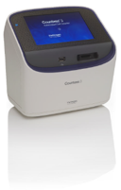

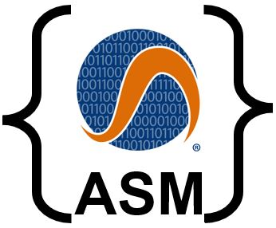

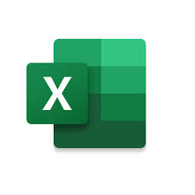
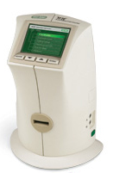


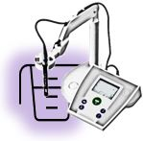


ASM Transformation-as-a Service
Instrument-X
Vendor-A
Instrument-Y
Vendor-B
Instrument Vendor-A
Instrument-Z
Vendor-C
Transformation Request
ASMs Transformation library
ASM Transformation-as-a Service
Transformation Response
Community Member-F
Pharma/Chemical
Company Lab
ASMs Transformation library
Solution Provider - M
ASMs Transformation library

Slide 4
ASM Transformation-as-a Service: Service deployment
Transient service; no client data is persisted
B2B security and privacy model (provided by the cloud provider)
Deployed on a major cloud provider
Commercial off-the-shelf (COTS) functionality

Slide 5
ASM Transformation-as-a Service: Library Development and Deployment
Transformation libraries to ASM are developed by:
Instrument vendors (“encouraged” by AF member companies)
Solution providers (motivated to offer them as integral or complementary components of larger data/analytical projects)
Allotrope community projects (motivated to address interoperability challenges)
Transformation libraries (code)
Encouraged to be open-sourced
If not open-sourced, may be licensed (?)
Open-sourced libraries are preferably hosted on a managed public repository (e.g., GitHub, GitLab)
Binaries (ready to deploy/executables) can be hosted on a managed binary repository (e.g., jFrog)
Adhere to a define set of I/O service APIs
Ready for deployment as a service (e.g., microservices utilizing Docker containers and optional Kubernetes orchestration)

Slide 6


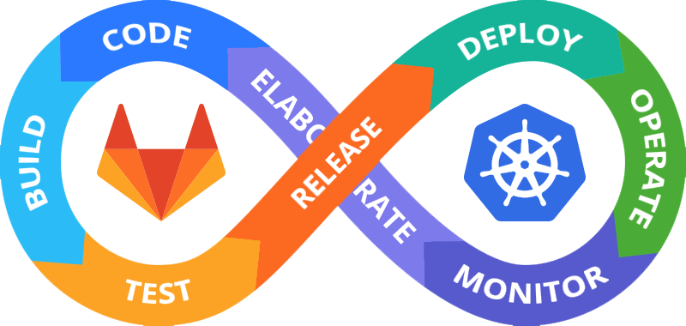
ASM Transformation-as-a Service: Implementation example, based on API Gateway and Microservices
Instrument
Vendor-A
Pharma
Lab-1
Pharma
Lab-2
API
Gateway
Community
Member-F
Clients
Chemical
Lab-3
Microservices
Solution
Provider-M
CRO
Lab-4
Instrument
Vendor-B
Commercial-off-the-shelf (COTS) API gateway (cloud based)

Slide 7
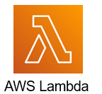

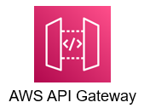
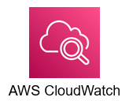


ASM Transformation-as-a Service: AWS implementation based on API Gateway and Microservices
Instrument
Vendor-A
Pharma
Lab-1
Pharma
Lab-2
API
Gateway
Community
Member-F
Clients
Chemical
Lab-3
Microservices
Solution
Provider-M
CRO
Lab-4
Instrument
Vendor-B
Activity logs
and monitoring

Slide 8
ASM Transformation-as-a Service: Potential expansions (beyond converter transformation)
Automation with OPC UA + ASM for Lab Connectivity as IIoT:
Leveraging the Spectaris/LADS and OPC Foundation recent collaboration breakthrough (see press release), this solution supports plug-and-play connectivity and information data via OPC UA and NodeSet2-compliant ASM libraries—enabling interoperable communication between lab instruments and informatics platforms.
The accompanying cloud-based service delivers OPC UA IIoT functionalities

