Slide 1
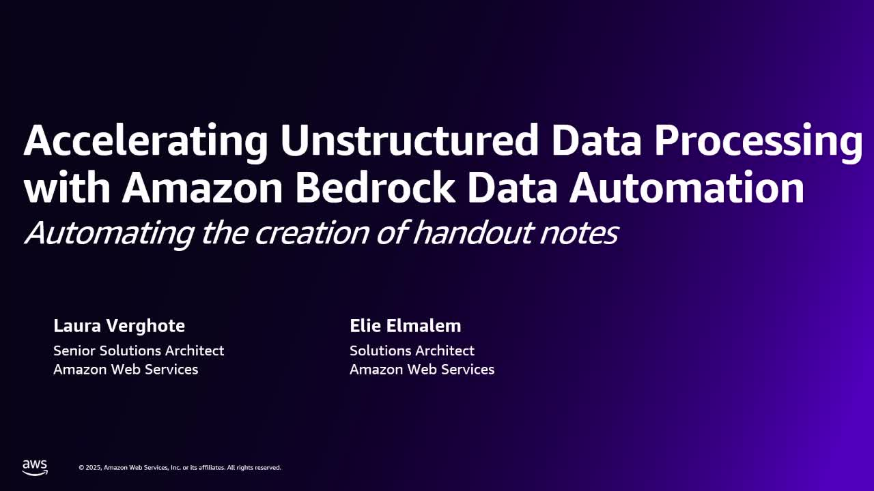
Notes:
Hello everyone. In this session we are going to discuss how we can accelerate the processing of unstructured data using Amazon Bedrock data automation, and more specifically, we are going to do this with an example around processing a webinar session. I am Laura Verhota. I'm a senior solution architect at AWS, and with me I have Ellie. Hello everyone, my name is Ellie. I'm also a solutions architect at AWS and looking forward to jumping into this presentation.

Slide 2
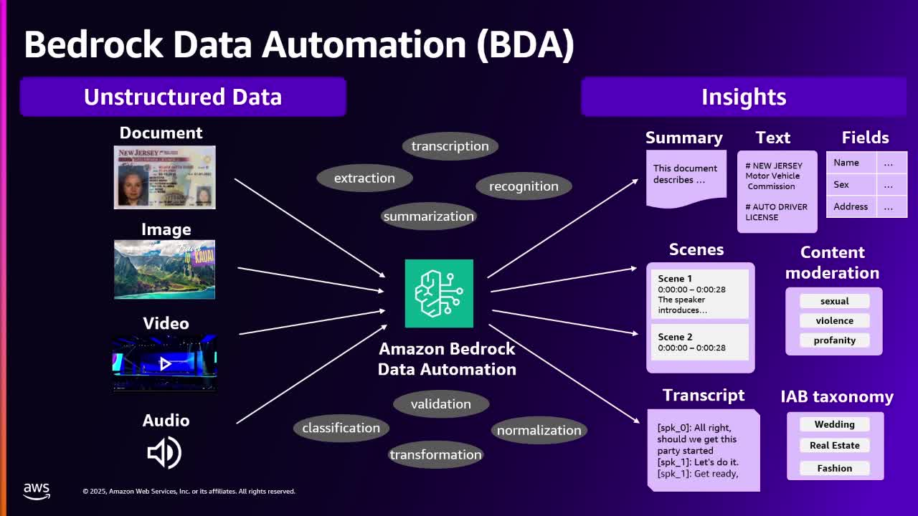
Notes:
So let's start with a high-level overview of Bedrock Data Automation or BDA. So essentially, BDA is a service that converts unstructured data into useful insights. So here, unstructured data means documents, images, videos, and audio. And these data types are ingested by BDA, and behind the scenes, there are many processes like data extraction, transcription, and summarization, and so on. And as a result, we can generate a variety of insights depending on the input modality and project configuration. So here are some examples of the insights we can include: summaries or extracted text or fields for documents, detected scenes and content moderation for videos, full transcripts for audio, and some categorical information for image and video.

Slide 3
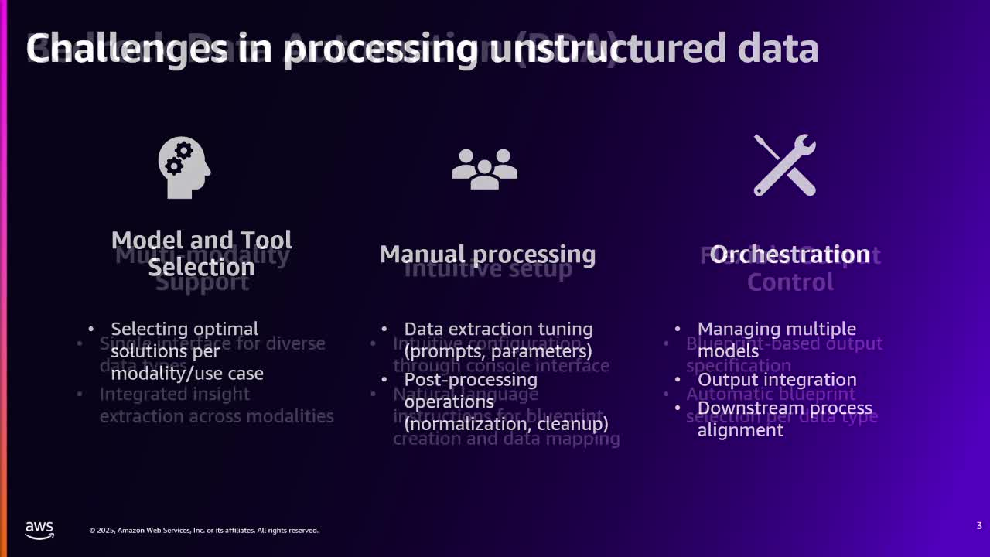
Notes:
So why can working with unstructured data be so challenging? Well, as you know, unstructured data comes in various forms, like documents, images, videos and audio, and selecting the right tools or models for each type is often the first hurdle. Additionally, customizing solutions for specific use cases can be time consuming. And on top of that, manual processes like tuning models or prompts or cleaning up extracted data require significant effort. And even after processing, orchestrating multiple models and aligning outputs for downstream tasks remains complex. And so this is where BDA comes in.

Slide 4
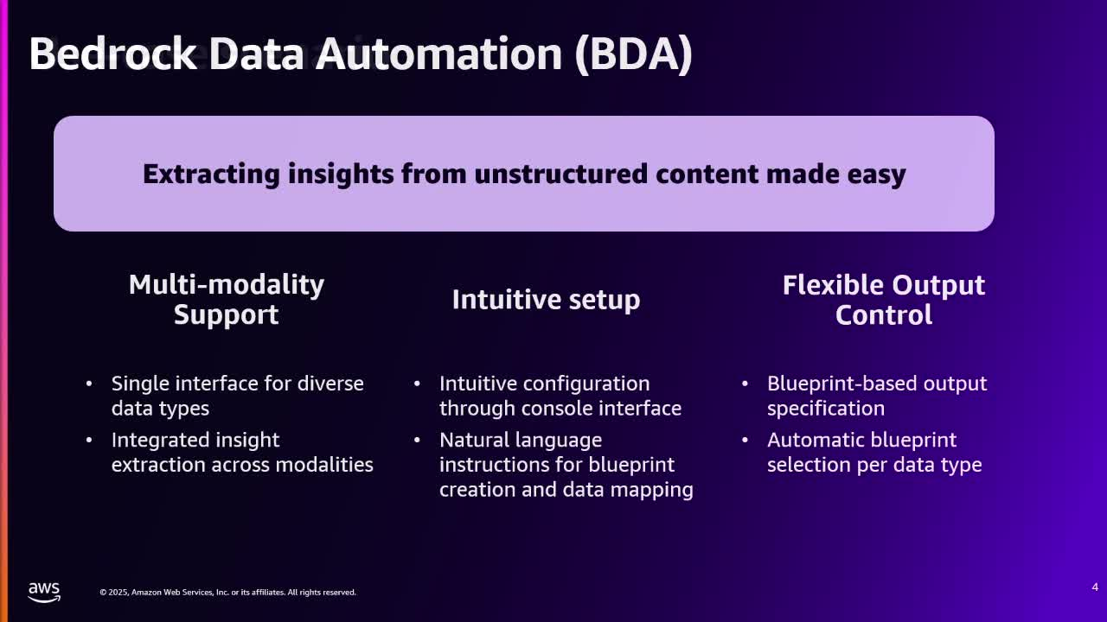
Notes:
So it simplifies the process of extracting insights from unstructured data. And one key advantage of BDA is its multi-modality support. BDA provides a unified interface for diverse data types. Another feature is its intuitive setup. The console interface makes setup and configuration very simple, and it even allows for natural language instructions when you create custom blueprints which I will explain shortly. The third key feature is the flexible output control. By creating blueprints, you can configure BDA to extract the information that you need.

Slide 5
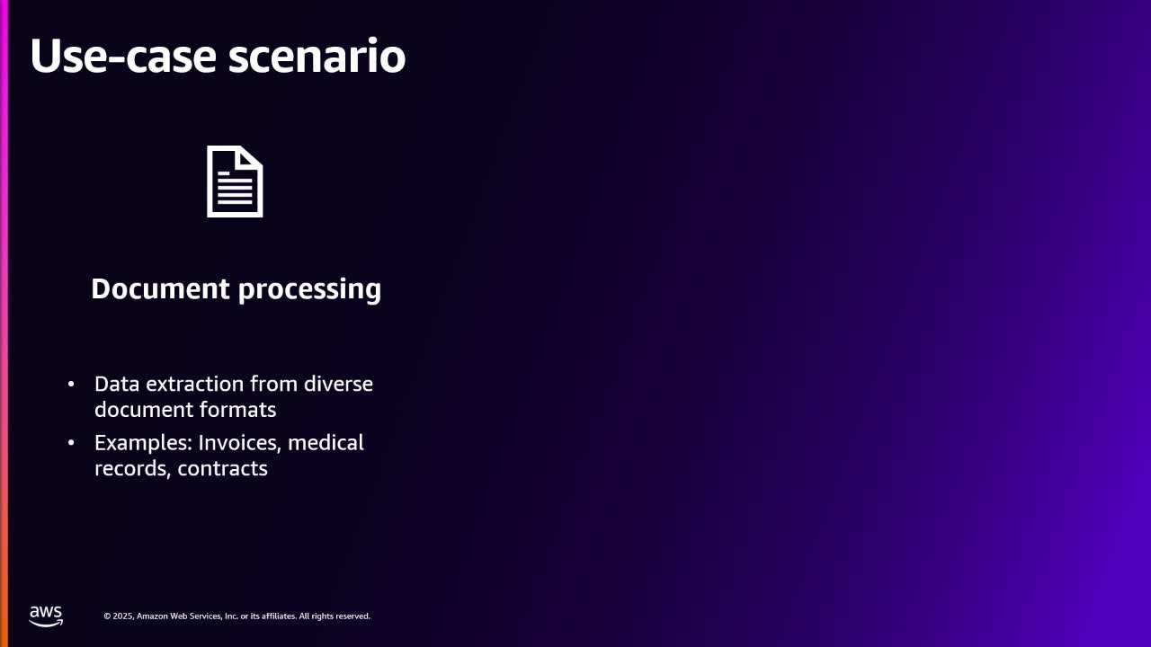
Notes:
So here are some example use cases. The first one is document processing. So imagine you need to handle documents in multiple formats like invoices, medical records, contracts, and you need to extract specific information. Then AI can handle this effort at scale without the need to orchestrate complex document processing tasks like classification, extraction, normalization, or validation.

Slide 6
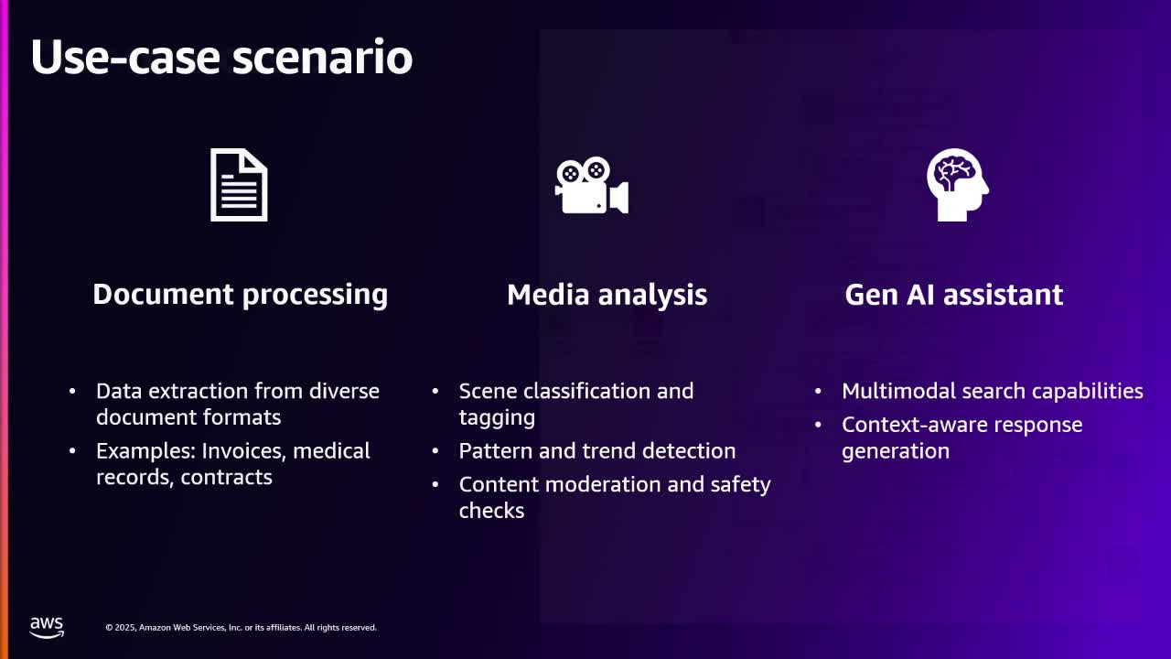
Notes:
Another example is media analysis. So BDA can classify and tag video content and summarize scenes or perform content moderation and safety checks. It can add meaningful insights to unstructured videos, create summaries of each scene, extract text that appears in the video, and classify content based on advertisements or brands. We will use this part to detect different shots in our video and to get a video transcript with associated timestamps. It is also powerful for building generative AI assistants. It can enhance the performance of your retrieval augmented generation or RAG powered question answering applications by powering them with rich, modality-specific data representations extracted from your documents, images, video, and audio.

Slide 7
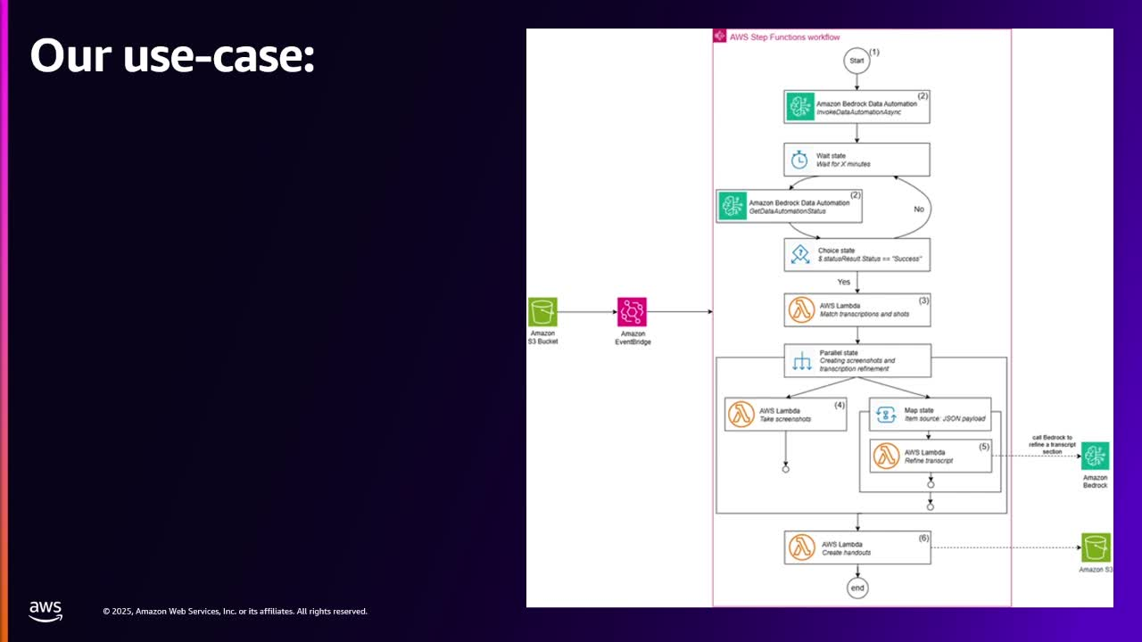
Notes:
Now let's have a look at how we leverage this service. So our solution leverages a server architecture by AWS that functions to process presentation recordings into comprehensive handouts. The workflows consist of the following steps. The workflow begins when a video is uploaded to Amazon Athena. This triggers an event notification that, through Amazon EventBridge rules, initiates a video processing workflow in Amazon Step Functions. Once the workflow is triggered, Amazon Rekognition will initiate a video transformation job to identify different shots in the video, which in our case is represented by a change of slides. We then move into a waiting state, after which we check for the transformation job progress. If the job is in progress, then we go back to the waiting state, and once the job is done, we move on and have extracted both the visual shots and the spoken content. These visual shots and spoken content will then feed into a synchronization step. In this Lambda function, we use the outputs of the Amazon Rekognition job to match the spoken content to the correlating shots based on the matching of timestamps. Once we have matched our spoken content to the visual shots, we go into a parallel state, and one of the legs of the state is the generation of screenshots. The other leg of the parallel state is the refinement of our transcriptions. Amazon Transcribe processes and improves each raw transcription section through a map state. Lastly, once the screenshots and the refined transcripts have been created, we use another Lambda function to create handouts. These final handouts are then stored in Amazon S3 for distribution.

Slide 8
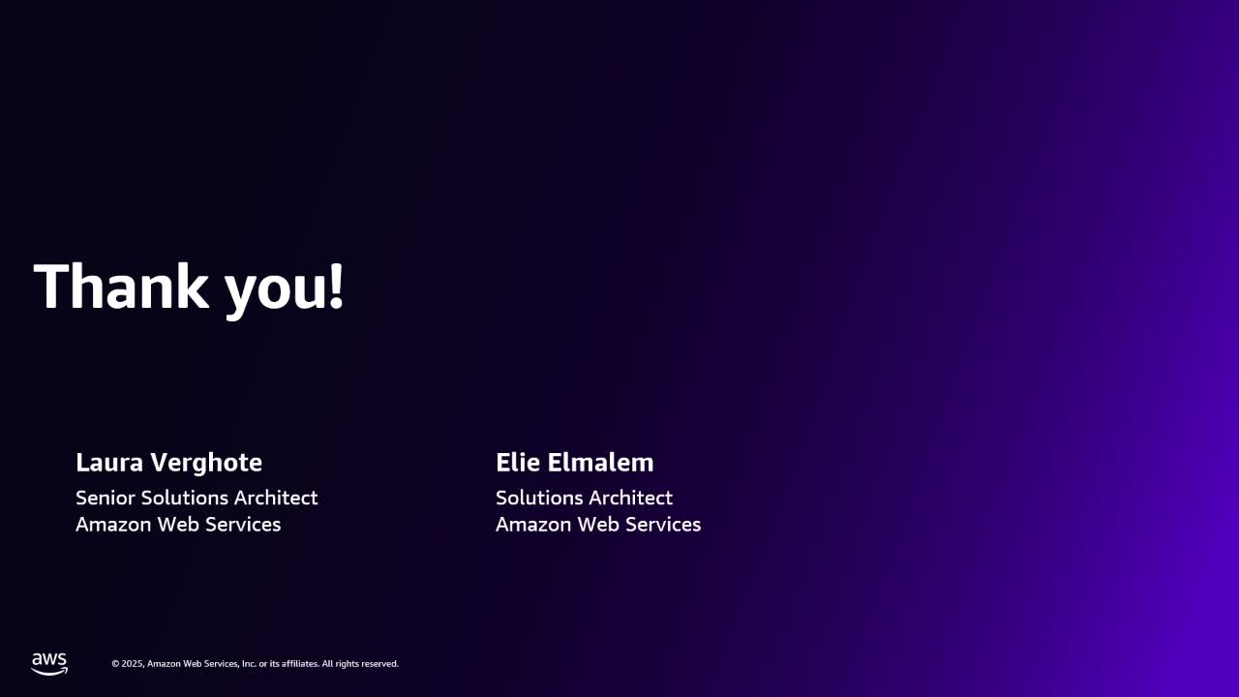
Notes:
OK, that was it for our short presentation. Feel free to use our blog and sample code to try it out and recreate a slide deck for this presentation. Thank you.

