Slide 1






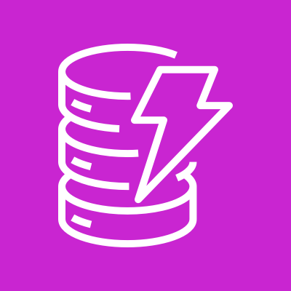
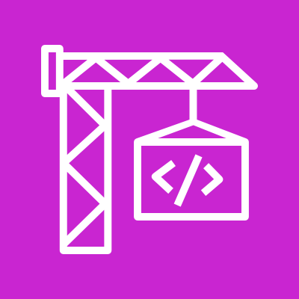

AI-Powered Modernization Factory - Target architecture
AWS Cloud · us-east-1
1
2
4
logs & metrics
Developer
Elastic Load Balancing
Amazon ECS on Fargate
AWS Step Functions
Amazon CloudWatch
(browser)
Application Load Balancer
Web App (FastAPI)
orchestrator
logs · metrics · dashboard
3
Amazon S3
Amazon DynamoDB
uploads + results
run state (TTL)
9
read / write artifacts
5
CodeBuild sandboxes · isolated
6
on validation fail
InvokeModel
7
8
Transformer
Validator
Remediator
Amazon Bedrock
AWS Transform (atx)
build + test
AI auto-fix
Claude (inference profile)
re-validate (loop, up to max attempts)

