Slide 1






Search Relevant
Information
Knowledge
Sources
2
Query
1
Prompt
3
Relevant Information for
Enhanced Context
Application
6
Controller
Response
5
Generated
Text Response
4
Prompt + Query + Enhanced Context
Large Language model

Slide 2









Amazon Simple Storage Service (Amazon S3)
Frontend
AWS Lambda
Amazon Bedrock
Amazon API Gateway
Lambda function
Amazon Cognito
Amazon OpenSearch Service
Amazon DynamoDB

Slide 3




AWS Cloud
Region
Virtual private cloud (VPC)
Private subnet
Amazon Cognito
AWS Lambda
AWS Lambda
Amazon OpenSearch Service
Frontend
Amazon API Gateway
Amazon Bedrock
Amazon Simple Storage Service (Amazon S3)
Amazon DynamoDB

Slide 4
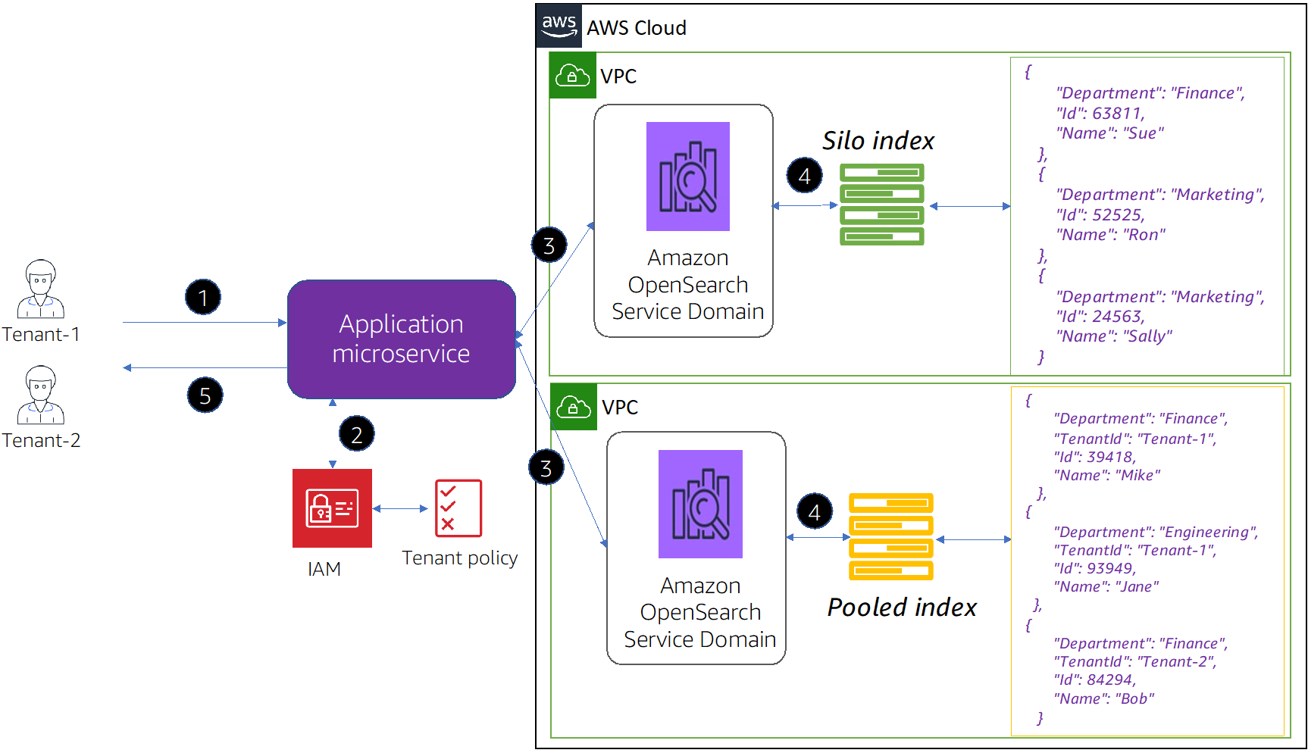

Slide 5


AWS Cloud
Virtual private cloud (VPC)
Private subnet
Amazon OpenSearch Service
{
“body”: “…”,
“embedding”: [xxx, xxx, …],
},
Silo index for
tenant-a
Silo domain for
tenant-a
AWS Lambda
{
“body”: “…”,
“embedding”: [xxx, xxx, …],
},
Silo index for
tenant-b
Amazon OpenSearch Service
{
“body”: “…”,
“embedding”: [xxx, xxx, …],
“tenant_id”: “tenant-c”,
},
{
“body”: “…”,
“embedding”: [xxx, xxx, …],
“tenant_id”: “tenant-d”,
},
Pooled domain for
tenant-b, c, and d
Pooled index for
tenant-c and d
Amazon DynamoDB
Routing information for all tenants

