Slide 1
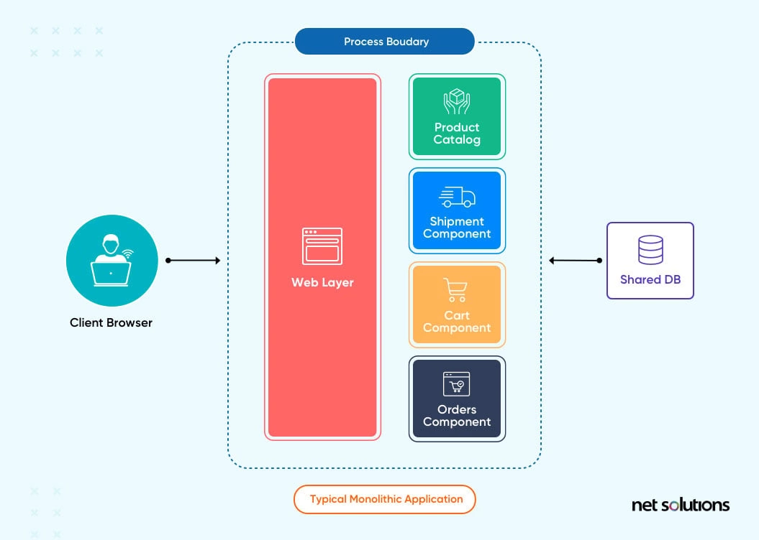



Server
Database

Slide 2
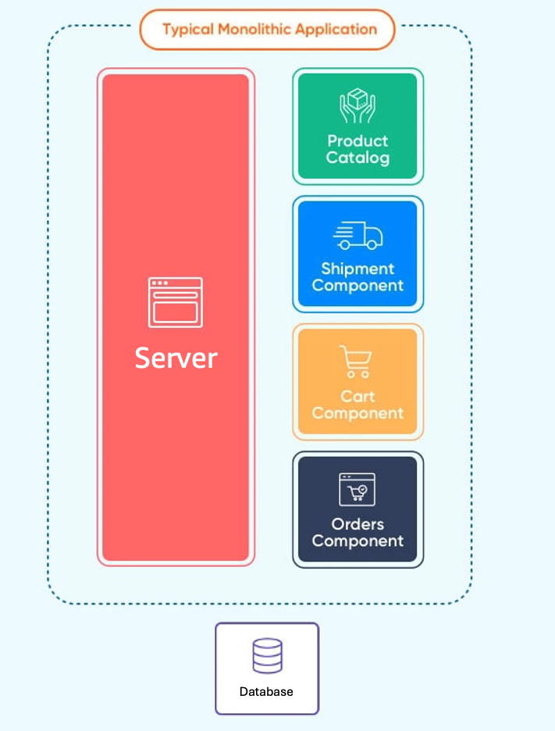
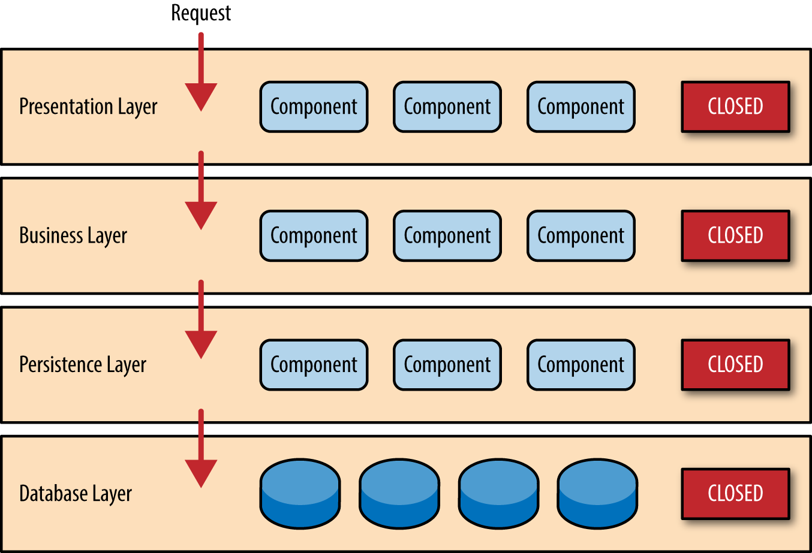
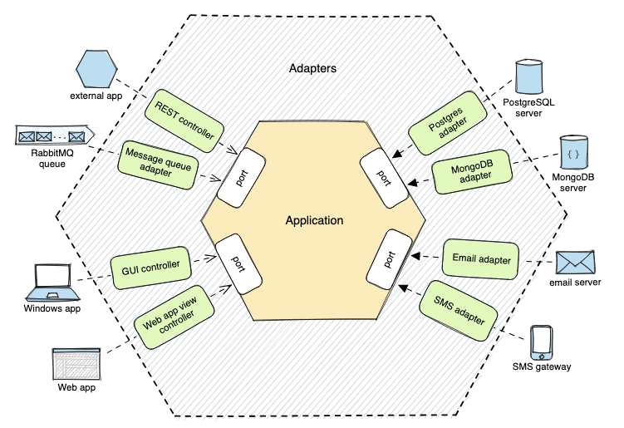
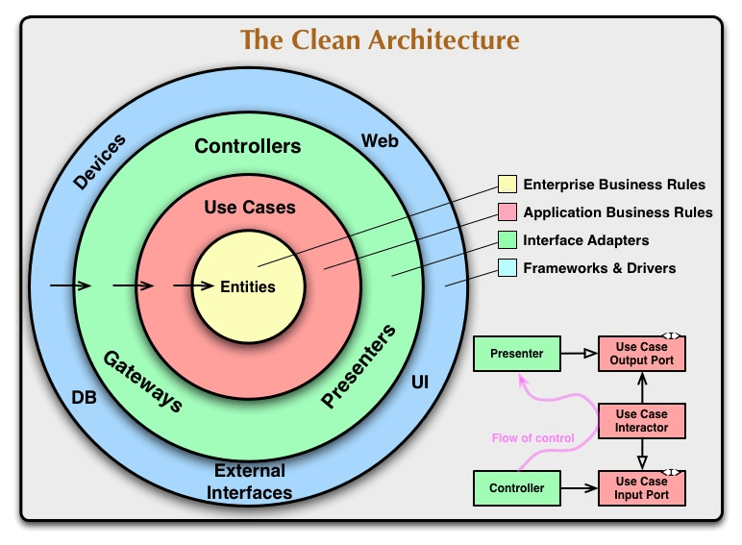
Monolith
Layered
Architecture
Hexagonal
Architecture
Clean
Architecture

Slide 3



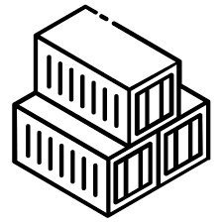




Deployment Options / Strategies
localhost
127.0.0.1
Docker localhost
127.0.0.1
Lambda
ZIP
Lambda
Container
Lambda
Web Adapter
ECS
Container
EKS
Container

Slide 4
Layered
Architecture
Hexagonal
Architecture
Clean
Architecture
Monolith
Lambda
ZIP
Lambda
Container
Lambda
Web Adapter
ECS
Container
EKS
Container

Slide 5


ANYMORE
"Every design or architectural decision involves trade-offs."
Innumerous authors

Slide 6
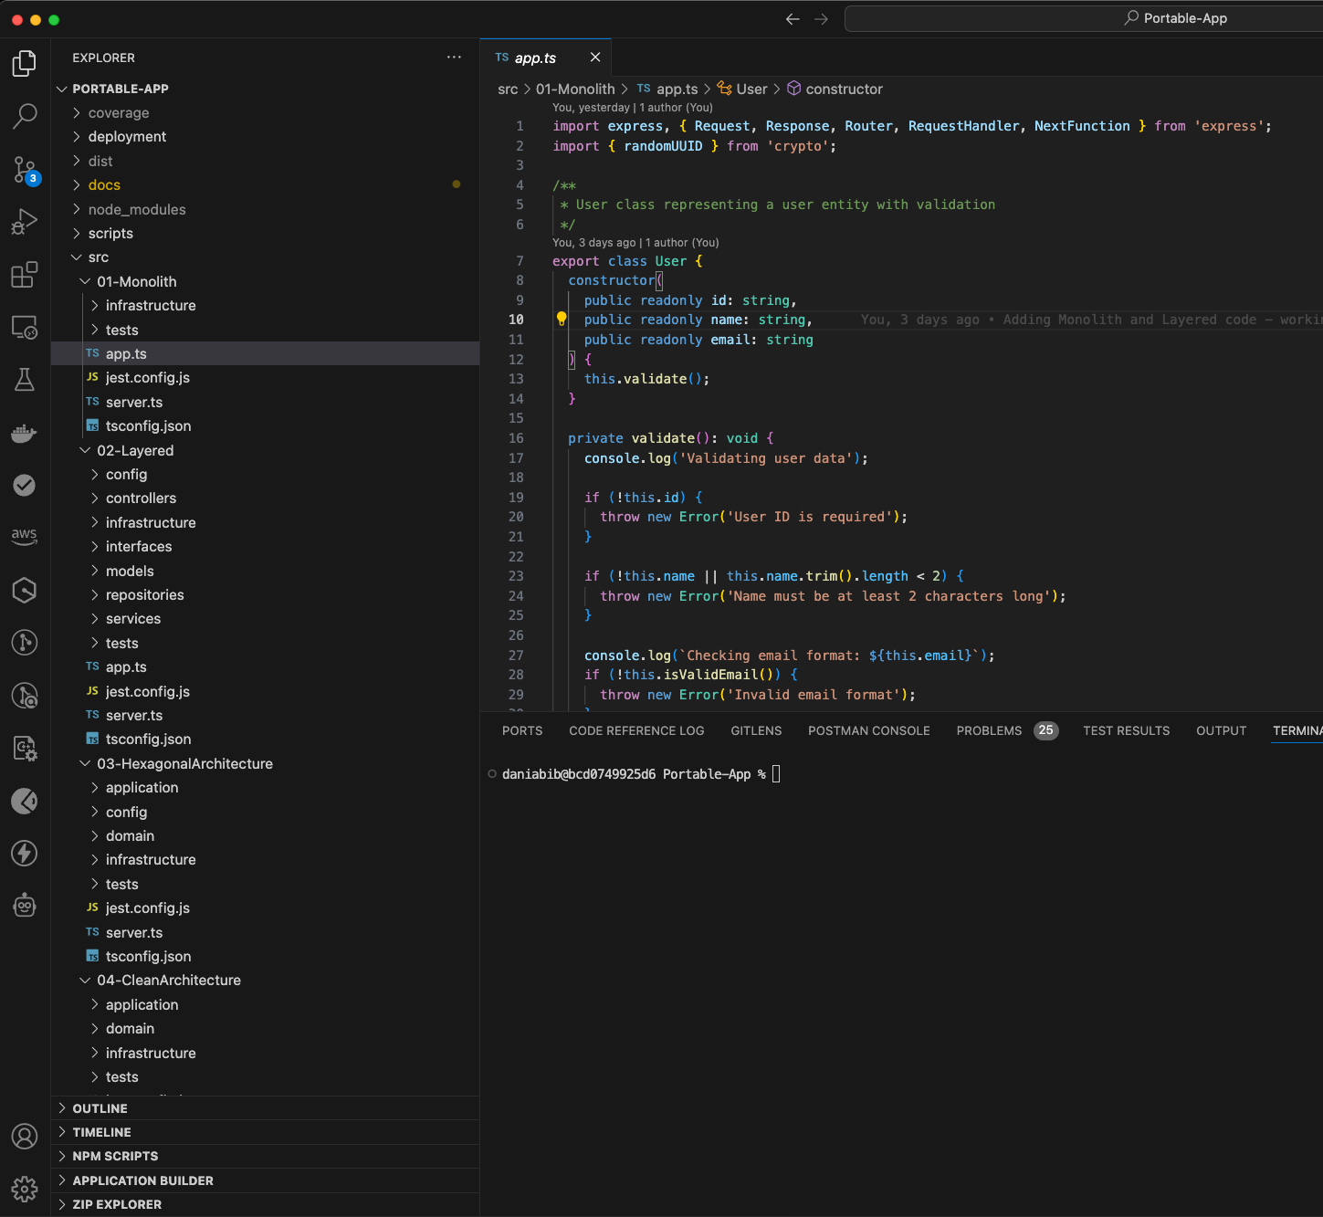

npm run build
npm run build
npm run build
npm run build

