Slide 1
VIDEO TRANSCRIPT SEARCH AGENT

Slide 2


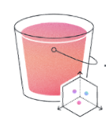
Indexing With Titan V2 Model Into A S3 Vector Bucket
Feed to
Vector Index + Metadata
Column Names
Content Link
Deck Link
Video Length
Internal Broadcast Video Link
External Youtube Link
Video Transcript Summary
When Was Each Topic Discussed
Full Video Transcript
Titan V2 embedding model
S3 vector bucket

Slide 3
Vector index generation from video transcripts
S3 Vector Index
[0.1.0.8…]
[0.4,0.2…]
Metadata:
Deck Link
Video Length
Internal Broadcast Video Link
.
.
.
1.Transcripts are split into individual chunks of 6000 tokens each
Full Video Transcript
Column Names
Content Link
Deck Link
Video Length
Internal Broadcast Video Link
External Youtube Link
Video Transcript Summary
When Was Each Topic Discussed
Full Video Transcript
Vectors
2.Chunks are converted into individual vectors
Metadata
Metadata
All Other Columns

Slide 4
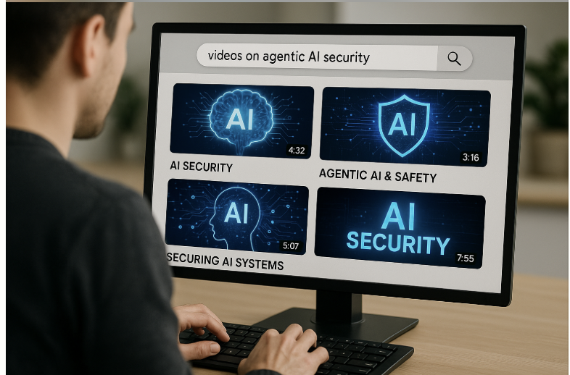

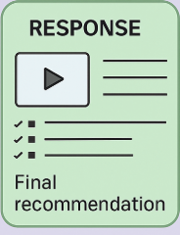
Hybrid Search – Semantic + Keyword search
Agentcore Runtime
S3 Vector Index
[0.1.0.8…]
[0.4,0.2…]
Metadata:
Deck Link
Video Length
Internal Broadcast Video Link
.
.
.
Strands Agent
Search For Videos on Agentic AI Security
Inline Tool
SEARCHTRANSCRIPTS
HYBRID SEMANTIC + KEYWORD SEARCH
User
Video Links and Recommendation
S3 vector bucket
Notes:
Typically there will be a frontend. But here the user is directly interacting with agentcore runtime which hosts the strands agent

Slide 5
Hybrid Search – Semantic + Keyword search
Agentcore Gateway
Agentcore Runtime
MCP Server
Strands Agent
Search For Videos on Agentic AI Security
Inline Tool
SEARCHTRANSCRIPTS
HYBRID SEMANTIC + KEYWORD SEARCH
app.py
User
Video Links and Recommendation
S3 vector bucket
Notes:
Typically there will be a frontend. But here the user is directly interacting with agentcore runtime which hosts the strands agent

Slide 6
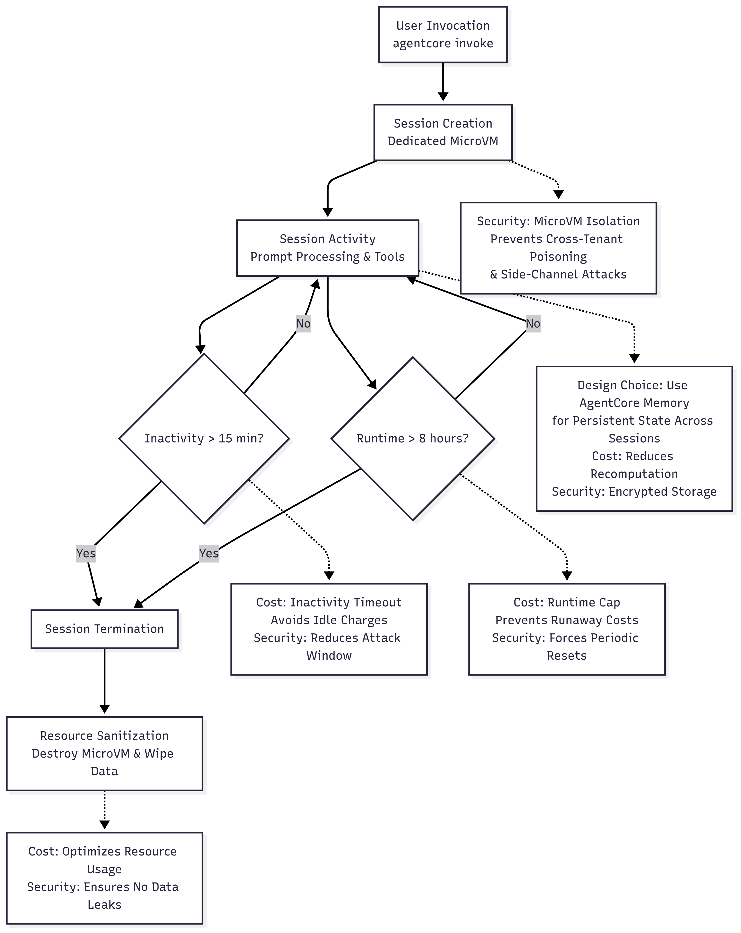
Agentcore Runtime Security and Cost benefits

