Slide 1
VIDEO TRANSCRIPT SEARCH AGENT

Slide 2



Indexing With Titan V2 Model Into A S3 Vector Bucket
Feed to
Vector Index + Metadata
Column Names
Content Link
Deck Link
Video Length
Internal Broadcast Video Link
External Youtube Link
Video Transcript Summary
When Was Each Topic Discussed
Full Video Transcript
Titan V2 embedding model
S3 vector bucket

Slide 3
Vector index generation from video transcripts
S3 Vector Index
[0.1.0.8…]
[0.4,0.2…]
Metadata:
Deck Link
Video Length
Internal Broadcast Video Link
.
.
.
1.Transcripts are split into individual chunks of 6000 tokens each
Full Video Transcript
Column Names
Content Link
Deck Link
Video Length
Internal Broadcast Video Link
External Youtube Link
Video Transcript Summary
When Was Each Topic Discussed
Full Video Transcript
Vectors
2.Chunks are converted into individual vectors
Metadata
Metadata
All Other Columns

Slide 4
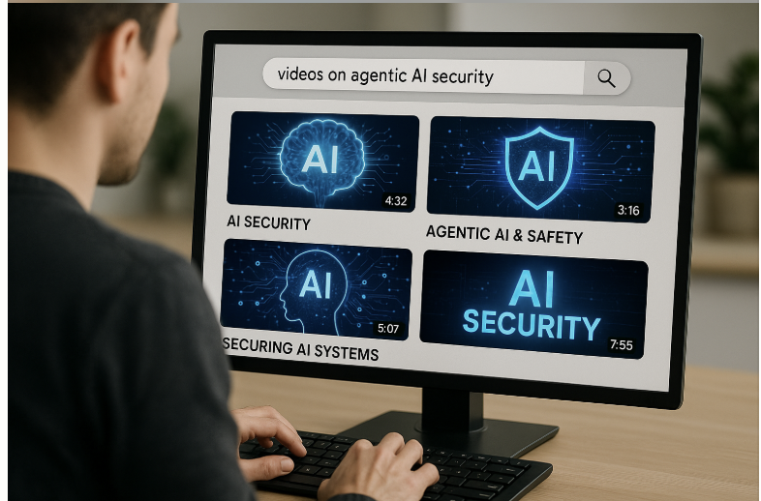


Hybrid Search – Semantic + Keyword search
Agentcore Runtime
S3 Vector Index
[0.1.0.8…]
[0.4,0.2…]
Metadata:
Deck Link
Video Length
Internal Broadcast Video Link
.
.
.
Strands Agent
Search For Videos on Agentic AI Security
Inline Tool
SEARCHTRANSCRIPTS
HYBRID SEMANTIC + KEYWORD SEARCH
User
Video Links and Recommendation
S3 vector bucket
Notes:
Typically there will be a frontend. But here the user is directly interacting with agentcore runtime which hosts the strands agent

Slide 5
Hybrid Search – Semantic + Keyword search
Agentcore Gateway
Agentcore Runtime
MCP Server
Strands Agent
Search For Videos on Agentic AI Security
Inline Tool
SEARCHTRANSCRIPTS
HYBRID SEMANTIC + KEYWORD SEARCH
app.py
User
Video Links and Recommendation
S3 vector bucket
Notes:
Typically there will be a frontend. But here the user is directly interacting with agentcore runtime which hosts the strands agent

Slide 6
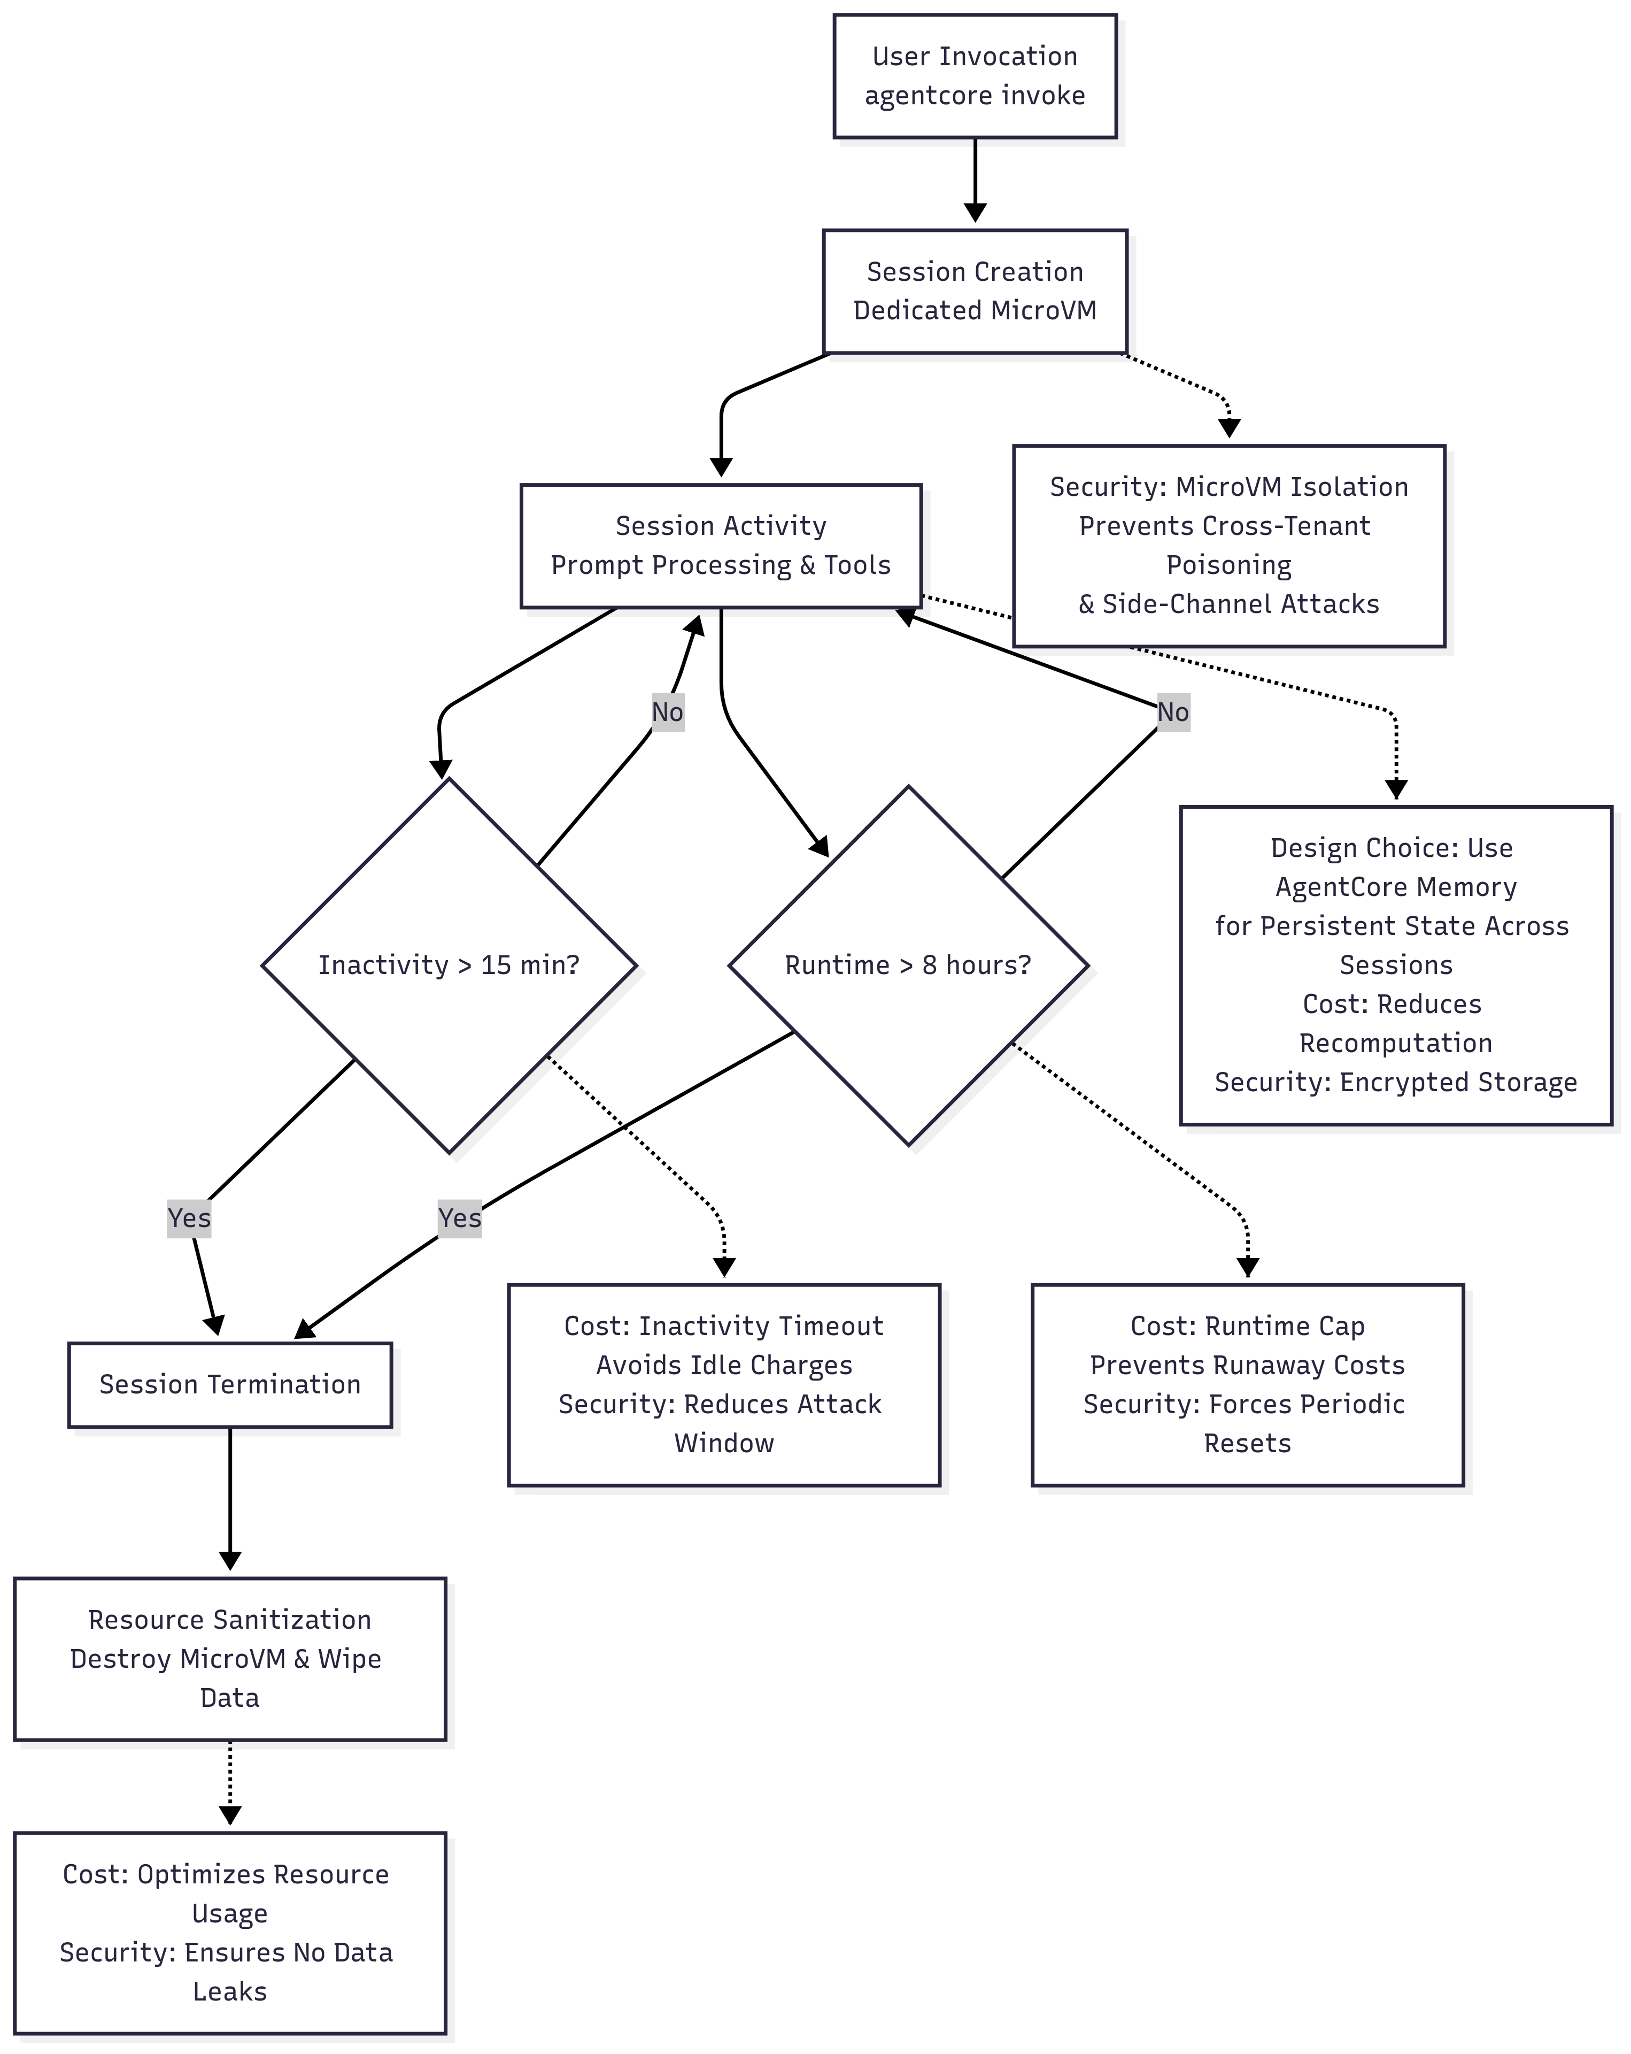
Agentcore Runtime Security and Cost benefits
Notes:
Enterprise Grade Security – The dedicated microVM model provides strong tenant isolation preventing side channel attacks( eg. Spectre/Meltdown) and cross tenant poisoning. Sanitization ensures compliance with the data privacy regulations such as GDPR and HIPAA making it suitable for sensitive workloads
Security Advantages of AgentCore Runtime
AgentCore runtime (part of AWS Bedrock AgentCore) is designed for deploying agentic AI applications in a secure, scalable, and isolated manner. It leverages AWS services like Bedrock, ECR (Elastic Container Registry), IAM (Identity and Access Management), and CloudWatch to provide a runtime environment for agents that interact with foundation models, vector stores, and other components. Based on the deployment script and policy, here are the key security advantages:
Least Privilege Principle Enforcement: The runtime uses a dedicated IAM execution role with narrowly scoped permissions. This role only allows specific actions (e.g., invoking Bedrock models, querying vector stores) on explicitly defined resources, reducing the blast radius if compromised. For instance, it restricts access to only the necessary Bedrock foundation models and S3 buckets, preventing broader AWS account exploitation.
Containerized Isolation: Applications run in Docker containers pushed to ECR, providing process-level isolation. This prevents the agent from directly accessing host resources or other workloads. The Dockerfile specifies a non-root user (bedrock_agentcore with UID 1000), adhering to the principle of least privilege at the OS level and mitigating risks like container escapes.
Secure Credential Management: Environment variables (e.g., model IDs, bucket names) are baked into the Docker image during build, avoiding runtime exposure. No sensitive credentials (like AWS keys) are hardcoded; instead, the runtime relies on IAM role assumption for authentication, eliminating the need for long-lived secrets.
Service Trust Boundaries: The IAM trust policy ensures only the Bedrock AgentCore service (from the same AWS account) can assume the execution role, preventing unauthorized external entities from using it. This is conditioned on source account and ARN patterns.
Auditing and Monitoring: Integration with CloudWatch Logs and Metrics allows for centralized logging of agent activities (e.g., invocations, errors). This enables detection of anomalies, compliance auditing, and forensic analysis. X-Ray tracing (mentioned in the policy) could further support distributed tracing for security investigations.
Immutable Infrastructure: The script cleans up existing ECR images before building new ones, ensuring deployments use fresh, uncached artifacts. This reduces risks from outdated or tampered images. AgentCore's launch process includes auto-updates on conflicts, promoting consistent, secure deployments.
Data Access Controls: Permissions for vector stores (S3Vectors) and S3 buckets are read-only where possible (e.g., GetObject, QueryVectors), preventing unauthorized writes or deletions. This protects sensitive data like embeddings or indexes.
Compliance with AWS Best Practices: By using Bedrock's managed services, it inherits security features like encryption at rest/transit (via KMS), model isolation, and regional boundaries. The policy includes KMS permissions for encryption, ensuring data protection.
Overall, these features make AgentCore runtime suitable for security-sensitive applications (e.g., agentic AI for CISOs), minimizing attack surfaces while supporting functionalities like model invocation and vector querying.

