Slide 1


AWS Student Builder Groups
Seneca Polytechnic | Event 1: Kickoff
AWS Student Builder Group · Seneca Polytechnic
Notes:
Arrive 20-30 min early. Slides loaded, AWS Console open and already logged in, demo HTML ready locally, Discord QR tested, food and music out before people arrive.
This slide runs while people walk in. Play music, talk to people already seated, do not stand at the front staring at the screen. Wait for a natural pause in the room energy before starting. (~2 min)

Slide 2
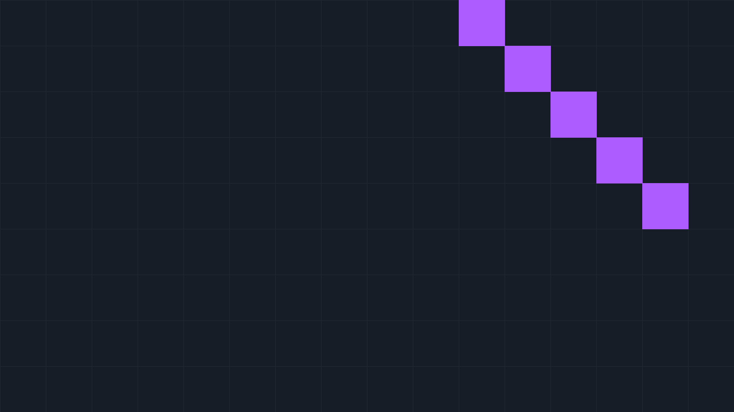

Event Overview.
01
What this club is actually about
02
A live demo, deploying something real, together
03
How to join the community before you leave
04
Quick housekeeping: a one minute feedback form
AWS Student Builder Group · Seneca Polytechnic
Notes:
Slide 2 combines Welcome + Tonight. Say the welcome line warmly, then: 'Quick rundown of what tonight looks like... should take about an hour.'
Then say housekeeping out loud now, plainly, so it is not a surprise later: feedback form after every event, and everyone joins Discord before they leave tonight, with a QR code, ten seconds.

Slide 3




Who's in the room?
Used AWS or any cloud platform before
Heard of AWS, never touched it
No idea what this is, just came to see what was going on
AWS Student Builder Group · Seneca Polytechnic
Notes:
Run a three-part show of hands using the three prompts on screen. Laugh warmly at the third group: 'Perfect, you're exactly who this club is for.'
This breaks physical passivity before you've said anything of substance, and signals curiosity is welcome. Read the room: if most hands are in group two, you're speaking to curious beginners. (~2 min)

Slide 4
Why this club is different.
MOST CLUBS
THIS ONE
Show up.
Listen.
Add it to your resume.
Forget it by summer.
Real skills.
Real projects.
Real people.
AWS Student Builder Group · Seneca Polytechnic
Notes:
Don't just read the slide. Say: 'I want to be upfront about what this is and what it isn't. A lot of clubs are good for attendance, maybe good for your LinkedIn. This one is built differently.'
Deliver this like you mean it, because you do. (~3 min)

Slide 5


06
WHAT AWS is in simple terms
Someone else's computer
that you rent.
AWS is roughly 200 services built on top of that one idea.
Notes:
Strip away every abstraction before introducing any new ones. 'The cloud is not magic. It's a datacenter, a building full of servers, that you access over the internet instead of managing yourself.'
This slide feels too simple to bother with. Do not skip it. People who've touched AWS will nod along; people who haven't will feel the doors open. (~3 min)

Slide 6



Why every company uses it.
Scale without buying hardware
Pay only for what you use
Global reach in minutes
Netflix: 1 million → 15 million simultaneous viewers. Zero new servers.
Netflix · Airbnb · Slack · NASA · Stripe
AWS Student Builder Group · Seneca Polytechnic
Notes:
Pull real company logos before the event, not stock clouds. 'Before cloud computing existed, if your product went viral you had to buy more servers. That took weeks. AWS changed that completely.'
When you're job hunting, this isn't niche knowledge anymore, it's expected. (~3 min)

Slide 7


Five services you'll hear everywhere.
EC2
Virtual servers, computing power you can spin up and shut down
S3
File storage, store anything and access it anywhere
IAM
Identity and access, who's allowed to do what
RDS
Managed databases without the server admin work
Lambda
Run code without managing a server at all
AWS Student Builder Group · Seneca Polytechnic
Notes:
There are over 200 AWS services. Most engineers spend 90% of their time in fewer than ten. These five show up in almost every architecture and every job posting.
Go through each in thirty seconds or less. The goal is familiarity, not comprehension, so it clicks when they hear it again at Event 2. (~4 min)

Slide 8

What these skills actually get you.
AWS CERTIFIED
Entry-level cloud and DevOps roles, Toronto
Cloud
Practitioner
Almost every posting lists EC2, S3, or general AWS experience.
The entry-level cert. We walk toward it together across the year, one thread through every session.
No community to study with? That's what this club is for.
AWS Student Builder Group · Seneca Polytechnic
Notes:
Pull a few real job postings the week of the event so the data is fresh. Salary numbers and job titles are blunt instruments but they work.
'By the hackathon, a real number of people in this room should be ready to sit the exam.' (~3 min)

Slide 9
What this year looks like.
Q1
Q2
Q3
Q4
Foundation
Go deeper
Build
Ship
Kickoff (tonight), AWS 101 Workshop
System Design x AWS, Cloud Career Panel
DevOps + CI/CD, Quiz Night, Hackathon
Year wrap and leadership transition
Hackathon: teams of 3–4, one day, AWS credits provided.
AWS Student Builder Group · Seneca Polytechnic
Notes:
Before this slide: introduce everybody on the exec team. Let the room get familiar with who's who and know that everyone here is around to help them.
We're not doing random topics each month, there's a progression: fundamentals, then system design, then actually shipping things.
Name the highlights specifically. Event 2, our very next one, is a hands-on workshop, everyone leaves with something running on AWS, bring your laptop. Event 4 is a career panel, we're bringing in people from industry for a real Q&A. Event 7 is the hackathon, the one I'm most excited about, it's where all of this pays off. Give Event 2 slightly more airtime since it's happening next. (~4 min)

Slide 10





What you'll walk away with.
Skills
Credentials
Merch
Cloud fundamentals, system design thinking, DevOps, and CI/CD.
A clear path to AWS Cloud Practitioner, plus exam vouchers.
Yes, don't worry, you'll get your goodies too.
Connections
Projects
Career panel speakers, the GDG network, and this room.
Real deployments and a hackathon submission for your resume.
AWS Student Builder Group · Seneca Polytechnic
Notes:
Be explicit: this list is not a soft pitch about community, it's specific things you will have that you don't have now.
The connections category is often undervalued in the pitch but overdelivered in practice. Acknowledge it but don't oversell it, let it be a pleasant surprise. (~3 min)

Slide 11

Culture
01
Contribution over attendance
02
Engineers teaching engineers
03
No gatekeeping. Curiosity is the only credential
04
Ideas from anyone, not just exec
05
Build in public
AWS Student Builder Group · Seneca Polytechnic
Notes:
Say 'no gatekeeping' at least twice and mean it both times: 'You do not need to know anything about AWS to belong here. If you're the person who showed up with no idea what any of this is, welcome. You're not behind.'
The culture you describe in the first meeting is the culture that sticks, make sure the actual behavior matches. (~3 min)

Slide 12

Let's do something real.
Notes:
Switch modes here. Close the slide deck, open the browser. 'I want to show you something live before we wrap up. This is the kind of thing you'll be able to do yourself after Event 2. Watch what happens.'
Don't explain what you're about to do in detail, just say watch and do it. (30 sec)

Slide 13


S3 static site deploy.
1
Open the AWS Console, already logged in
4
Enable static website hosting, index.html
2
Create a new S3 bucket in ca-central-1
5
Upload the pre-built index.html file
3
Turn off Block all public access, it's a website
6
Open the endpoint URL, live for anyone
AWS Student Builder Group · Seneca Polytechnic
Notes:
Full step by step is in the runbook. Say the region out loud when you set it: 'We're putting this in Canada, that's the AWS datacenter in Montreal.'
After it loads, say nothing for two seconds, let the room see it. Optional phone moment: have everyone open the URL on their own phone and say when it loads. If something breaks, narrate it, don't fake it. (~13 min)

Slide 14

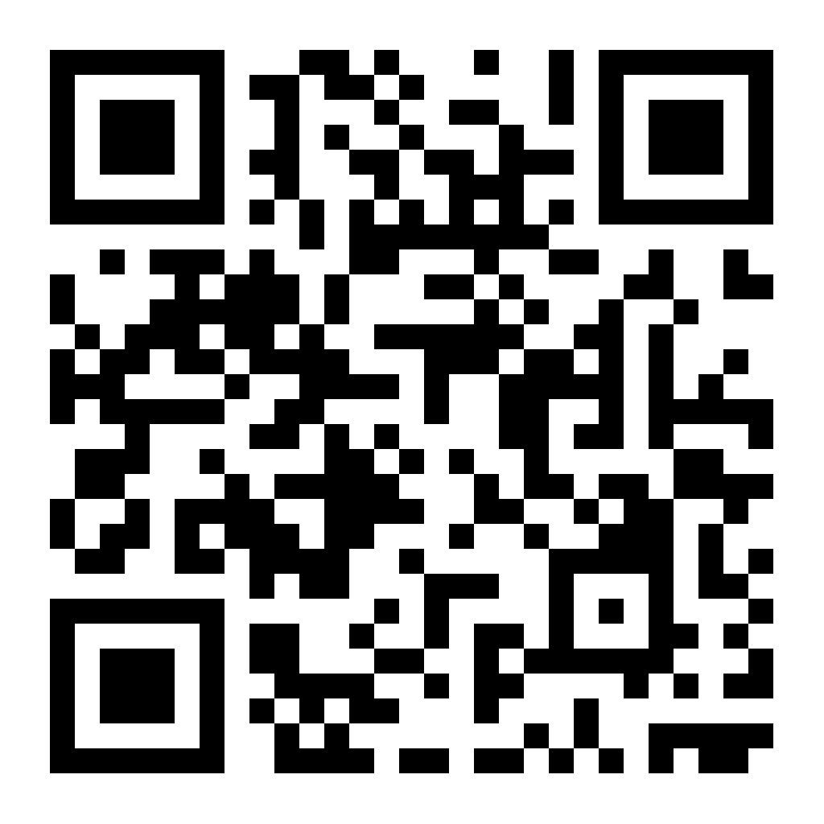
Join the Discord.
Scan before you leave, then say hi or give an intro in #general.
EVENT 2
AWS 101 Workshop
Set up your AWS account, deploy real infrastructure, leave with something running. Bring your laptop.
Date and time in the Discord · updates on Instagram too
AWS Student Builder Group · Seneca Polytechnic
Notes:
'Before we wrap, I want everyone in this room in the Discord. Not later tonight, right now. Pull out your phone.' Watch the member count tick up and say the numbers out loud.
After a minute: 'If you've joined, drop a message in #general, say hi, that's your first contribution.' Then cover Event 2 details, and open the floor. Stay after, don't pack up, the best conversations happen in the last ten minutes.

