Slide 1


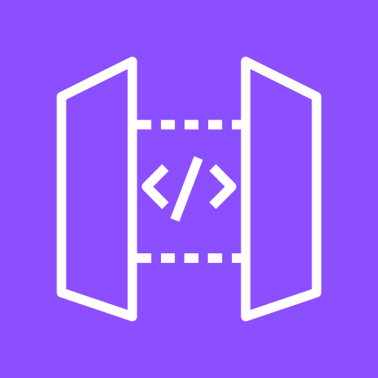

CVX Agentic Orchestration
How a connected-vehicle owner's voice, chat, or app request reaches the AI and gets answered
CVX account / region
Amazon Connect
13a
2
Supervisor Lambda (proxy)
14
1
Amazon API Gateway (+ Cognito)
2'
Customer (A)
13b
12
3
1'
Bedrock AgentCore Runtime
Triage Classifier Lambda
5
4
6/7/8/9
10
→ Diagram 2 grounding data path
→ Diagram 3 escalation / warm-transfer

Slide 2

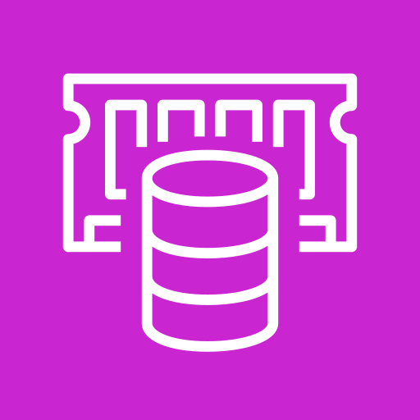
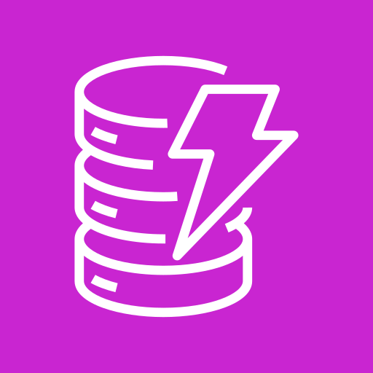
CVX Data Foundation & Composition
Where CVX gets the facts: live vehicle telemetry + governed fleet data grounding every answer
CVX account / region
ADP account / region — cross-account authorization boundary
← Diagram 1 per-turn from Supervisor [3]
Bedrock AgentCore Runtime
3
4b
7
Bedrock Knowledge Base
4c
6
Bedrock AgentCore Memory
4a
CMS foundation — real-time operational state
Centralized Data Repository
CMS Redis LKS (ElastiCache)
9
CMS DynamoDB
8
CMS Recalls Integration Lambda

Slide 3
CVX Escalation & Human Hand-off
When a safety issue or customer ask needs a real person — not just the AI — to take over
CVX account / region
← Diagram 1 [5] triage() returns P0/P1/P2 or explicit customer request
Bedrock AgentCore Runtime
10b
Amazon Connect
10a
11
CVX operational DynamoDB
Tier-2 Human Agent

