Slide 1
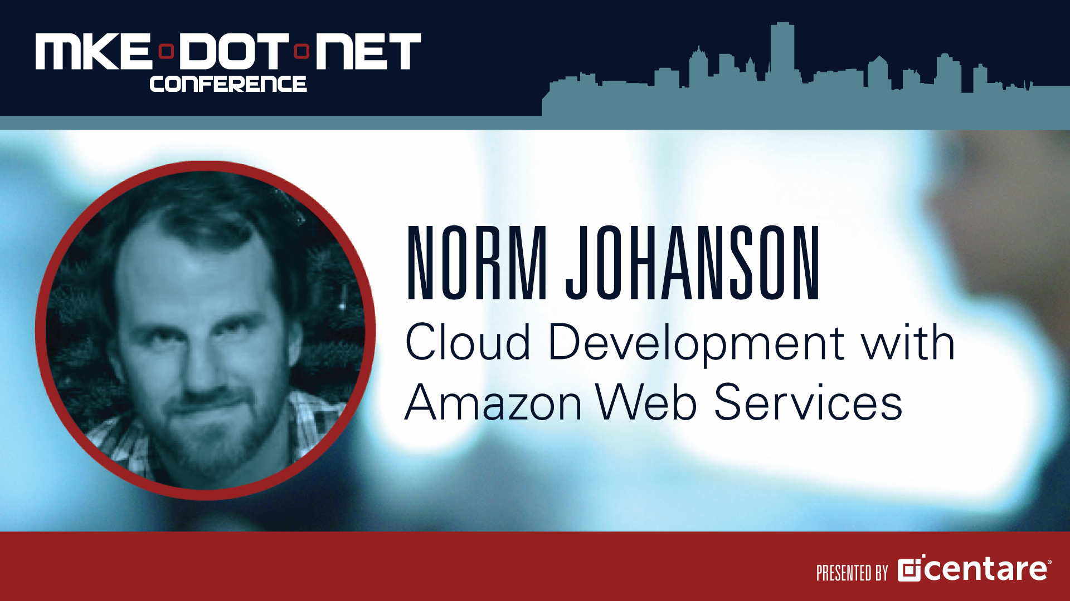

Slide 2
Overview
Overview of the AWS Services
Getting Started with the Windows Tools
AWS SDK for .NET
AWS Tools for Windows PowerShell
AWS Toolkit for Visual Studio
Running Applications on AWS
Code on GitHub at : https://github.com/awslabs/aws-sdk-net-samples/

Slide 3
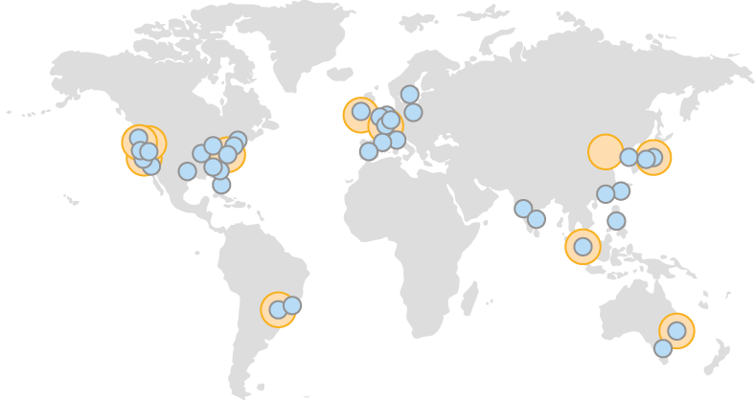
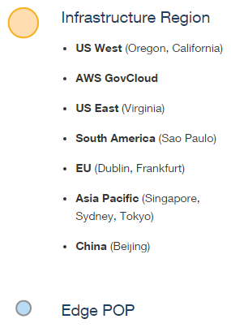
Regions and Availability Zones

Slide 4
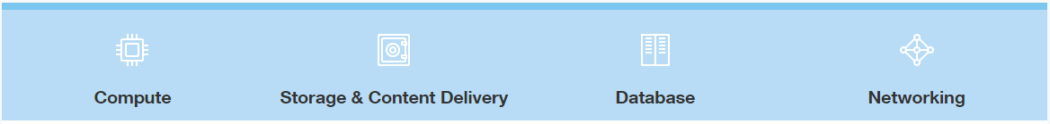
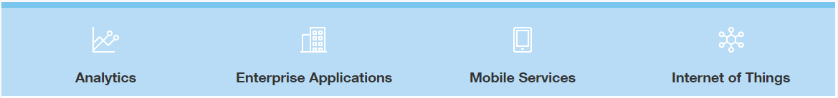
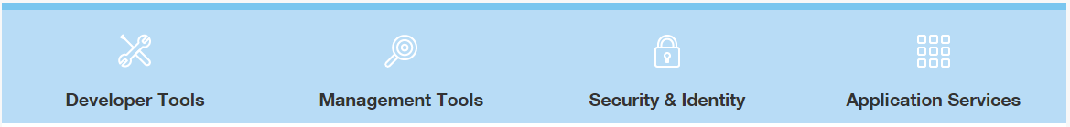
50+ Cloud Services
Infrastructure Services
Platform Services
Developer Productivity and Operational Efficiency Services

Slide 5
Compute & Networking
Amazon Elastic Compute Cloud (EC2)
Elastic Load Balancing
Auto Scaling
Virtual Private Cloud (VPC)

Slide 6







An example VPC setup
No access to/from wider internet – all non-local traffic is routed to private
gateway and onto corporate network
10.0.0.1
10.0.0.2
10.0.0.3
Subnet 1: 10.0.0.0/24
Availability Zone A
corporate data center
Router
Virtual Private
Gateway
VPN Connection
Customer
Gateway
10.0.1.1
10.0.1.2
10.0.1.3
Subnet 2: 10.0.1.0/24
Availability Zone B
10.0.0.0/16

Slide 7
Storage & Databases Services
Amazon Simple Storage Service (S3)
Object Storage
Amazon DynamoDB
Managed NoSQL
Amazon Relational Database Service (RDS)
Oracle
MySQL
PostgreSQL
Amazon Aurora
SQL Server

Slide 8
Deployment Services
AWS CloudFormation
Define AWS resources with a JSON document
AWS Elastic Beanstalk
Sets up all the resources to run an application
Deploys .NET Web Applications
AWS CodeDeploy
Scriptable deployments

Slide 9
Tools for .NET Developers
AWS SDK for .NET
AWS Tools for Windows PowerShell
AWS Toolkit for Visual Studio
https://aws.amazon.com/sdkfornet
SDK available through NuGet

Slide 10
AWS SDK for .NET
Version 3
Release last July
Each service separate NuGet packages
AWSSDK.S3
AWSSDK.EC2
ASP.NET 5 Support
Support in the 3.2 beta versions of the SDK
dnxcore-development Git branch
Open Source
https://github.com/aws/aws-sdk-net

Slide 11
Credentials
Requests need to be signed with Credentials
AWS Access Key ID
Secret Access Key
Identity and Access Management Service (IAM)
Root Credentials (Full Access)
IAM Credentials (Restricted Access)

Slide 12
Demo Using S3
Object storage
Images
Videos
Objects are stored in a bucket
Buckets have globally unique names
Objects identified by a user-defined key
Keys are often filenames

Slide 13
AWS Tools for Windows PowerShell
Setting Up
Credentials
Region
CmdLet Naming
PowerShell Verbs
Service Acronym
Finding CmdLets
Get-AWSCmdletName

Slide 14
AWS Elastic Beanstalk
Automatically creates necessary AWS resources
Retain full control over AWS resources
Deploys WebDeploy archives
Integrates with Visual Studio

Slide 15
AWS Elastic Beanstalk primitives
Application
Logical container for the application
Application version
Pointer to the application bundle in S3
Environment
The AWS resources that run the application

Slide 16
ZipCode Deployment Summary
Elastic Beanstalk
Handles Deployment, Provisioning, Load Balancing & Auto Scaling
IAM Roles
Controls Access
Delivers AWS Credentials
EC2 Key Pair
Decrypts Windows Password
Application Bundle
WebDeploy Archive

Slide 17
What Next
Simple Queue Service & Simple Notification Service
Distributed Computing
CloudWatch
Monitoring & Alarms
AWS CodeDeploy
Custom Deployments
Micro Services Architecture

Slide 18
SDK GitHub
https://github.com/aws/aws-sdk-net
Samples and Talks
https://github.com/awslabs/aws-sdk-net-samples
AWS PowerShell
http://aws.amazon.com/powershell/
AWS Toolkit for Visual Studio
http://aws.amazon.com/visualstudio/
AWS .NET Blog
http://blogs.aws.amazon.com/net
Twitter
@awsfornet

Slide 19
AWS Tools for Windows & .NET Developers
Thank You

