Slide 1


Device
Message
Server
1
3
2
Protocol
Endpoint
4
Topics
Acknowledgment
commands/deviceID
commands/deviceID/ack

Slide 2
Device
Server
5
Protocol
Endpoint
Topic
1
namespace/deviceID/#
3
2
4
Registration Authority
Privilege Escalator

Slide 3

Device
Message
Server
1
4
3
9
Message
Device State
6
5
Topics
2
state/deviceID/update
state/deviceID/update/delta
state/deviceID/update/accepted
5
Message
8
7

Slide 4
Device
Message
Server
1
2
6
3
Device State
Topics
4
Message
state/deviceID/update
state/deviceID/update/delta
state/deviceID/update/accepted
5

Slide 5
1
Server
Device
Gateway
2
Message
3
4
Message
5
telemetry/deviceID
commands/deviceID
etc/deviceID
Message
Protocol
Endpoint
Message
Topics
telemetry/deviceID
commands/deviceID
etc/deviceID
up
1
Server
Device
Gateway
Message
Message
telemetry/deviceID
commands/deviceID
etc/deviceID
5
Message
4
3
Message
2
Topics
telemetry/deviceID
commands/deviceID
etc/deviceID
down

Slide 6
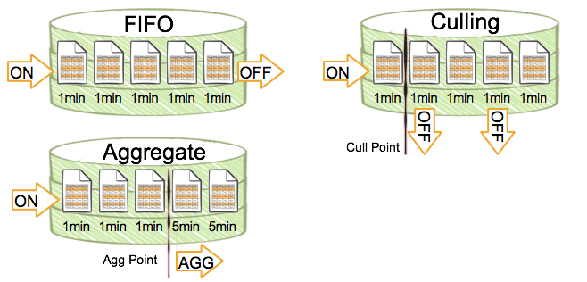

Slide 7
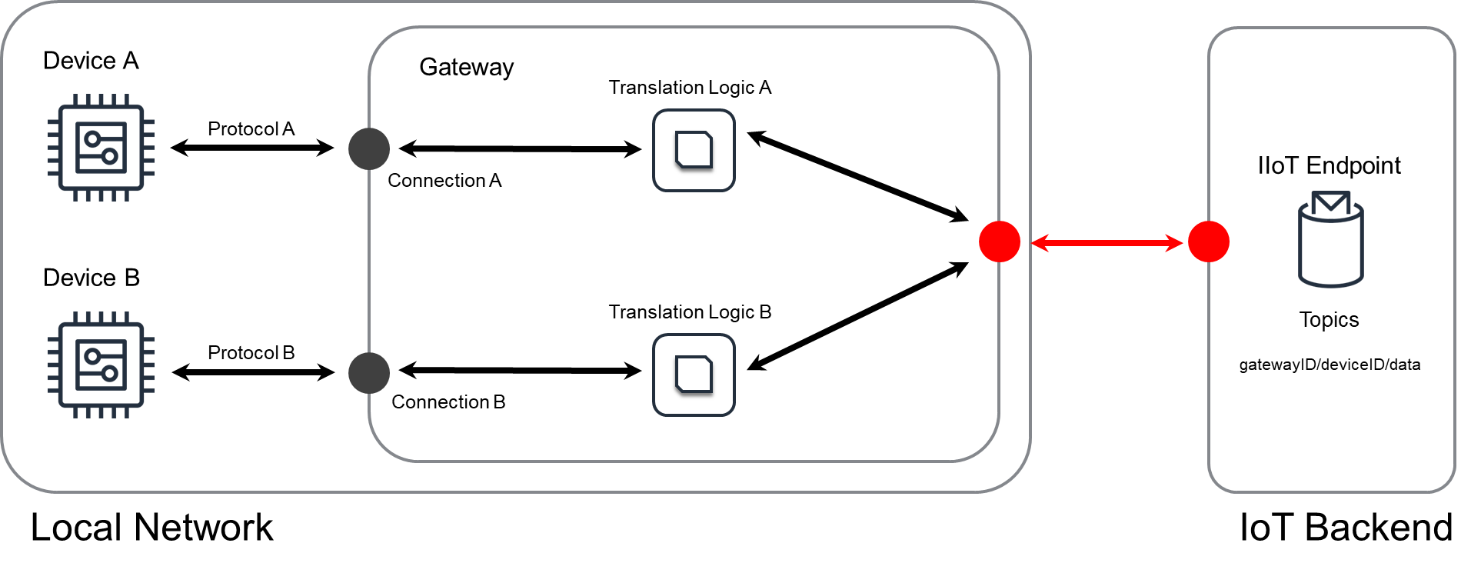

Slide 8
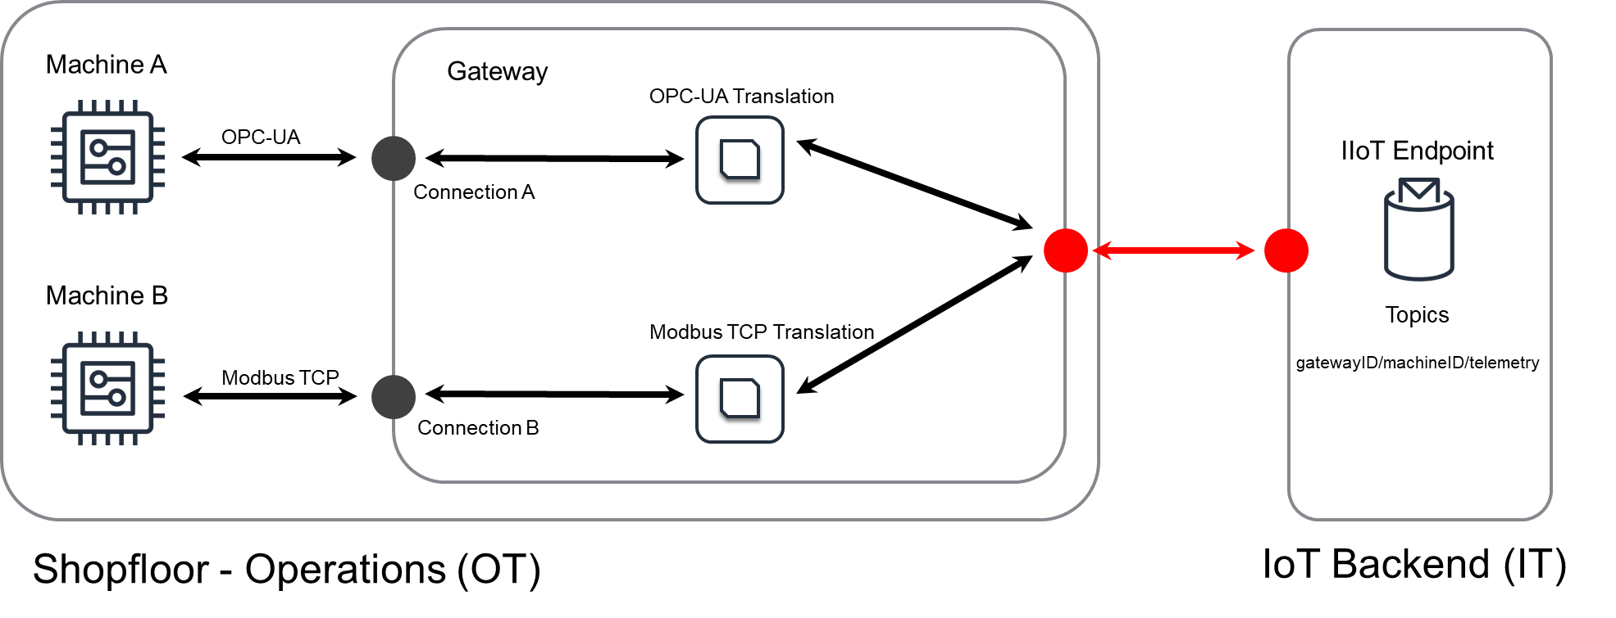

Slide 9

Device
Server
1
Message
Device State
6
5
Topics
state/deviceID/update
state/deviceID/update/delta
state/deviceID/update/accepted
4
Message
9
8
3
7
2
https://../software/version/new

Slide 10

Device
Server
Message
2
3
Protocol
Protocol
Endpoint
1
Topic
telemetry/deviceID
Sensor

Slide 11



Device
Server
4
Message
2
3
Processing Component
Protocol
Rules
1
telemetry/deviceID
5
telemetry/deviceID/replay
Raw Records
Processed Records
Sensor
6
Replay Component

