Slide 1
Virtual model train set
By Emily Quarles and Andrew Schultz

Slide 2
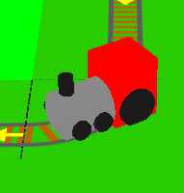
Model train
The train moves according to a series of transformations specified by whatever tile it is on.

Slide 3
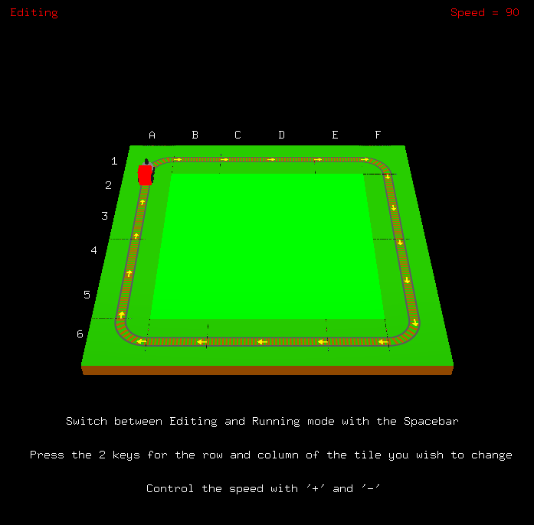
Train track
You can switch from edit mode to running mode with the spacebar.
The speed is controlled with “+” and “-”.

Slide 4
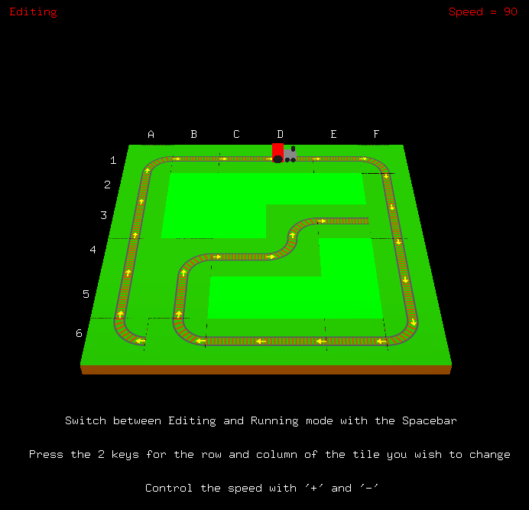
Editing mode
In edit mode, you can hit the letter/number address of a tile to change it.
Tile changes cycle through all the track options.

Slide 5
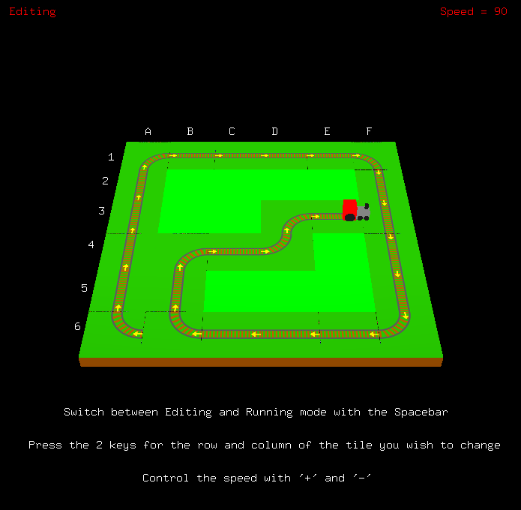
crashing
If the train runs out of connected track, the program will automatically go to edit mode so you can correct the problem.

Slide 6
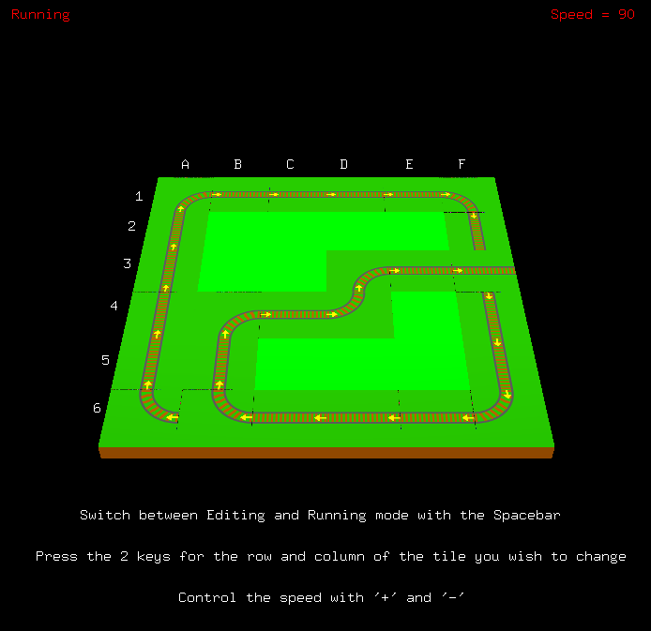
falling
If the train leaves the field entirely, it will fall down.

Slide 7
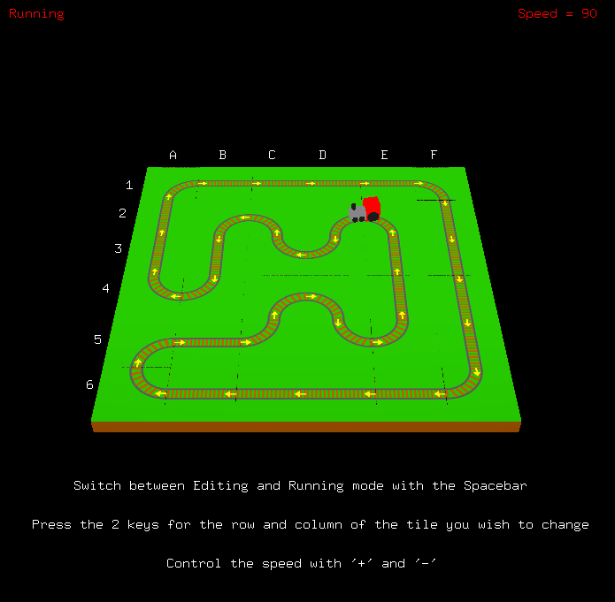
Many shapes are possible

