Slide 1
Designing Automated Traffic Control with RGB LEDs and only Digital Logic Circuits
Presented by
Group -1
1706066-Awsafur Rahman
1706067-Abdul Mukit Majumdar
1706068-Nabila Tasnim
1706069-Joyita Halder
1706093-Anika tabassum

Slide 2
Objective
To control the Traffic Control with RGB LEDs (পলাশীর মোড়, Dhaka)
Designing where appropriate traffic lights would need to be placed.
Making a sketch of the roads and planning accordingly
Making a model of the roads using foamboard / cork-sheet / hard paper, and making small models of the traffic lights.

Slide 3
Methodology:

Slide 4
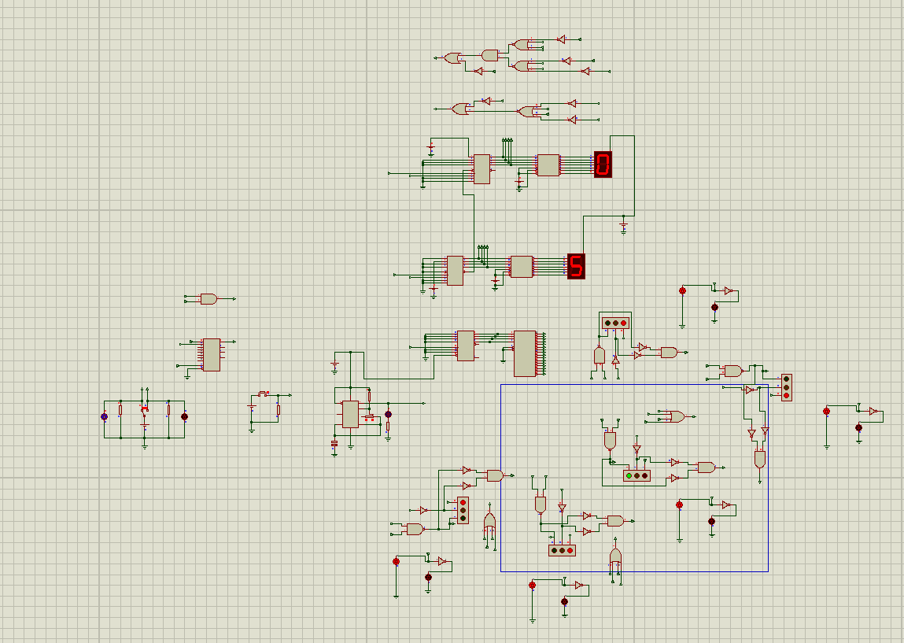
Overview:
Simulink model of the design:

Slide 5
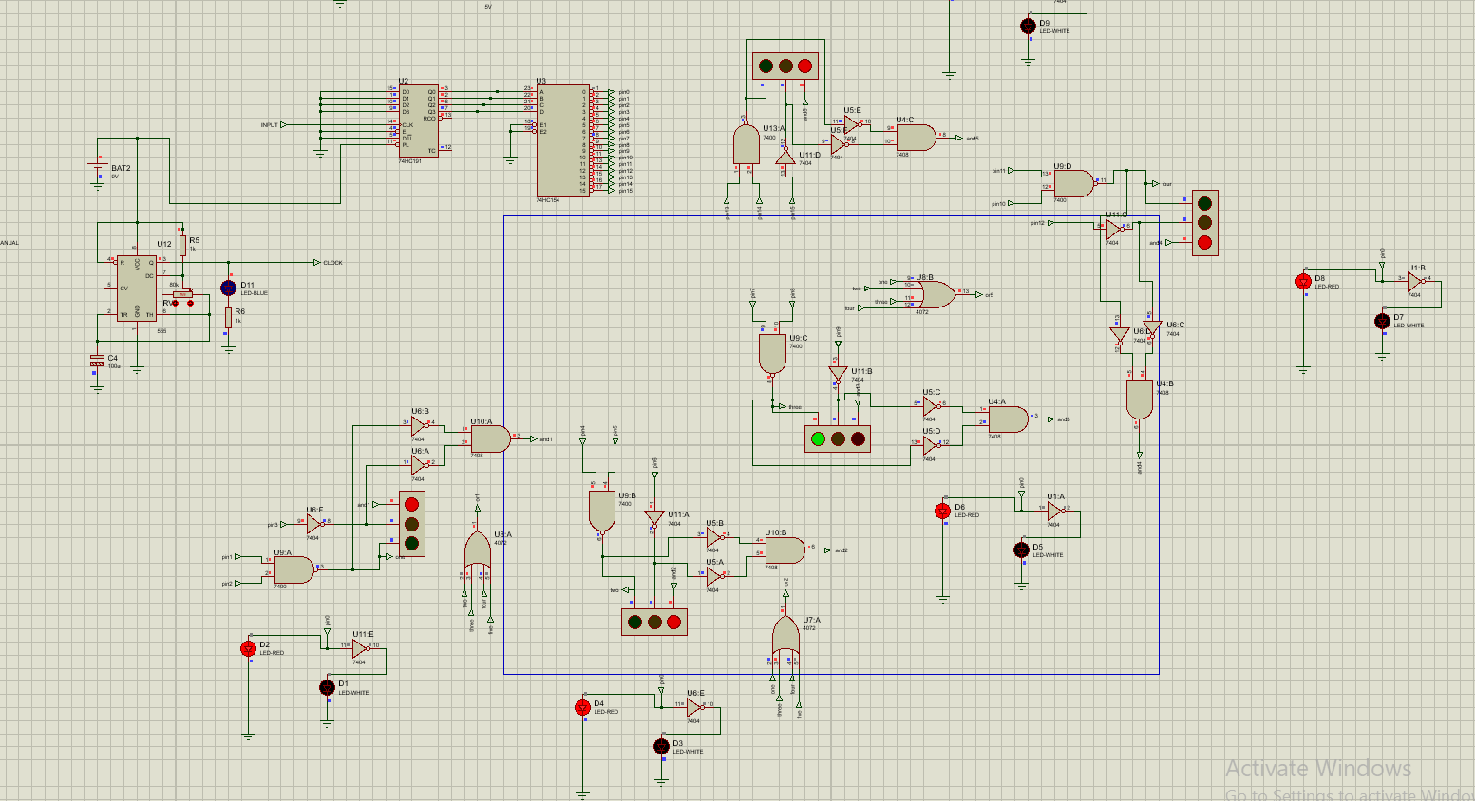
The LED Lights controlling:

Slide 6
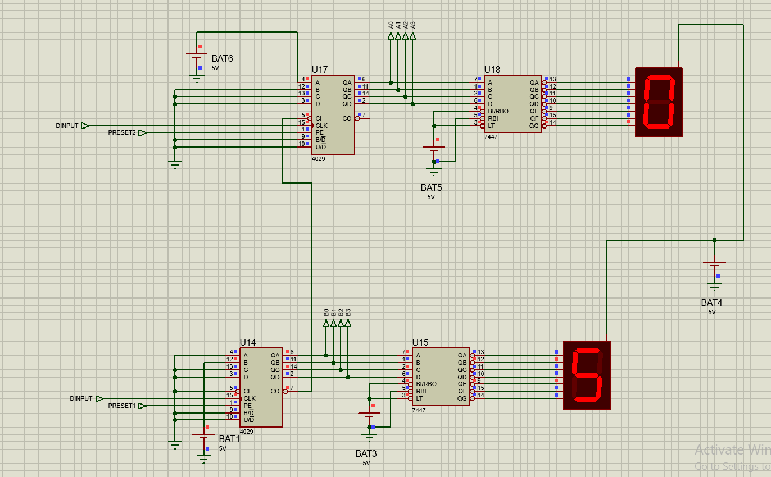
Timer circuit controlling:

Slide 7
Timer circuit controlling:

Slide 8
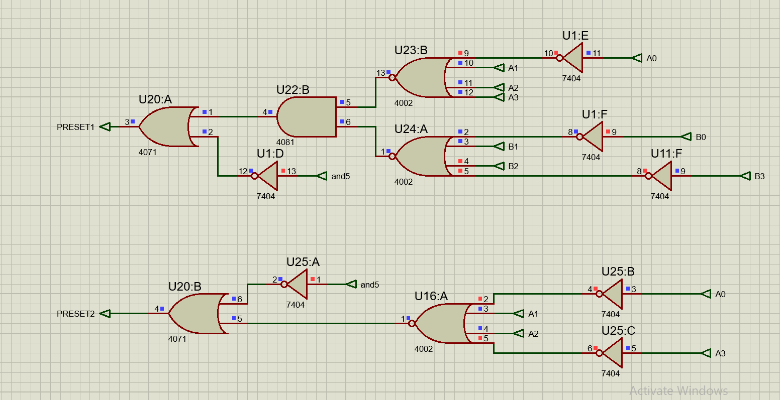
Preset setting for the counters:

Slide 9
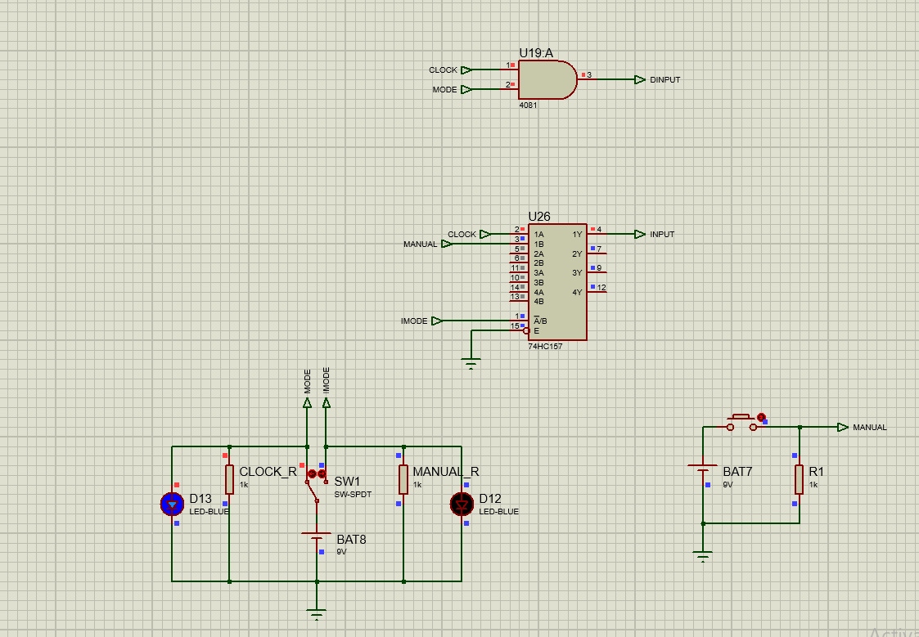
Manual switching:

Slide 10
Hardware part:

Slide 11
Outputs

Slide 12
Future plan:

Slide 13
Conclusion

