Slide 1
Design of BPSK and ASK Modulator and Demodulator
Presented by
1706066-Md. Awsafur Rahman
1706067-Abdul Mukit
1706068-Nabila Tasnim
1706069-Joyita Halder

Slide 2
Objectives:
Digital signal transmission using modulation
Signal modulation using amplitude variation in ASK and phase variation in BPSK
Observing the effect of channel noise on the modulated signal
Denoising the signal using Integrate and Dump Filter and Bandpass and Lowpass Filter
Reconstruction of modulating signal
Comparison of ASK and BPSK using bit error rate

Slide 3

Binary Phase Shift Keying (BPSK) Modulation
Methodology:
Digital input : Binary Pulse Train
Carrier signal:
S₁(t)=sin(2$π$f_{c}t) ; 0 $≤$t$≤$ T_{b} ; for binary ‘1’
S₂(t)=sin(2$π$f_{c}t+$π$) ; 0 $≤$t$≤$ T_{b} ; for binary ‘0’

Slide 4
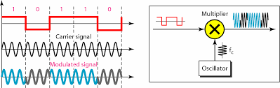
Figure: BPSK modulation process

Slide 5
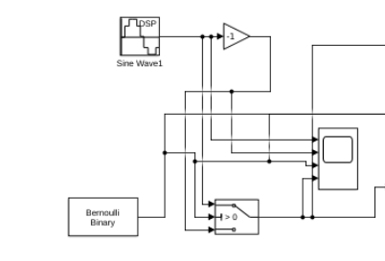
Simulation Process:
Block diadram:
Figure: Simulation Diagram
Discrete sine wave block
(carrier wave)
Bernoulli
Binary block(digital signal)
Output block (BPSK)
(If 0 multiplied by -1)
Switch block
For checking whether 1 or 0

Slide 6
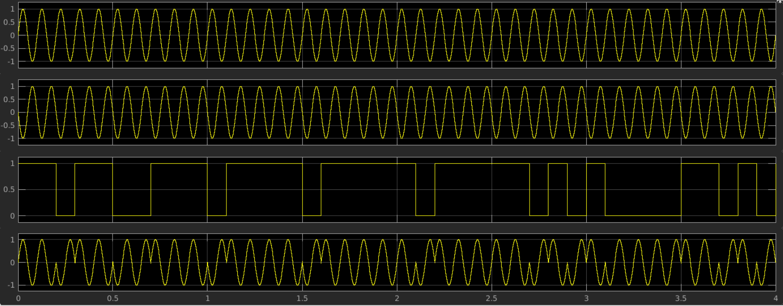
Result:
Figure: BPSK Modulation Simulated Result

Slide 7
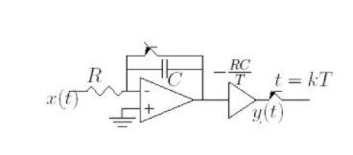
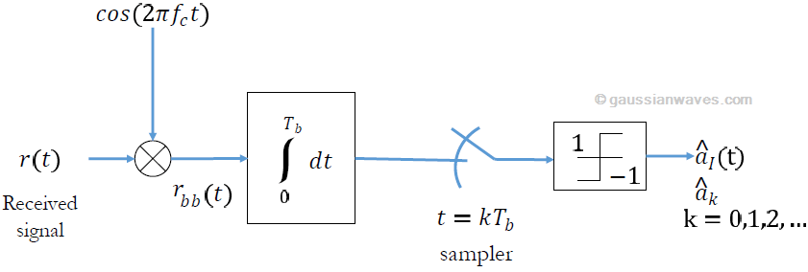
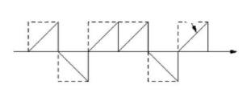
Binary Phase Shift Keying (BPSK) Demodulation
Methodology:
Figure: Coherent detection of BPSK
Output is completely synchronized
Output is integrated over one bit period using an integrator. A threshold detector makes a decision on each integrated bit based on a threshold which is 0

Slide 8
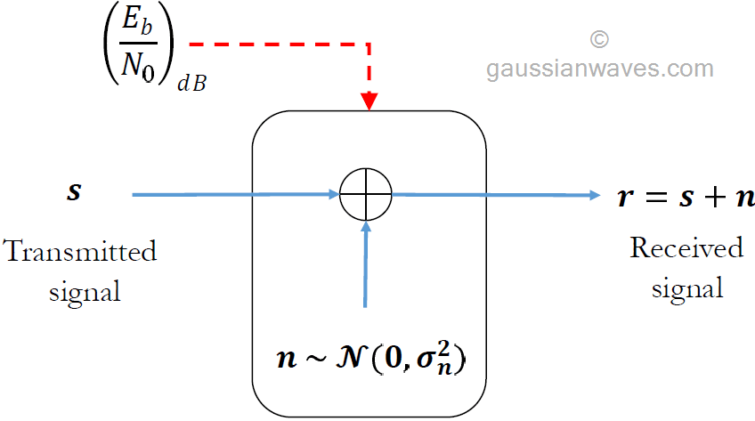


Addition of AWGN channel model:
Figure: Simulation model for awgn channel
(1) Let N denotes the length of the signal vector s. The signal power for the vector s can be measured as,
(2) The required power spectral density of the noise vector n is computed as
(3) The generated noise vector (n) is added to the signal (s)

Slide 9
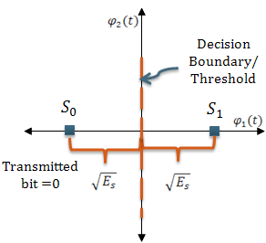
BPSK BER – optimum receiver in AWGN channel (Integrate & Dump Filter):
The ideal constellation diagram of a BPSK transmission contains two constellation points located equidistant from the origin.
When the BPSK symbols are transmitted over an AWGN channel, the symbols appears smeared/distorted in the constellation depending on the SNR condition of the channel.
Figure: BPSK – ideal constellation

Slide 10
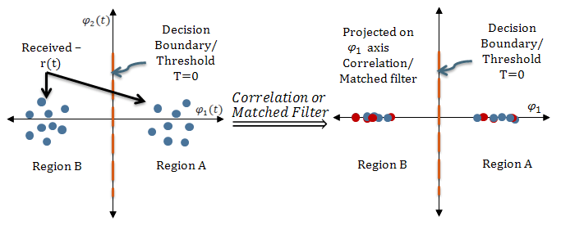
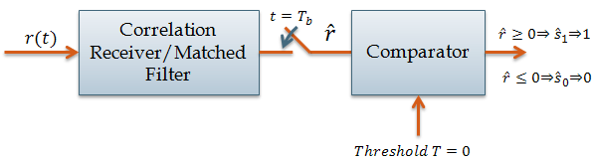
Figure: Role of correlation/Matched Filter
Figure: Optimum Receiver for BPSK

Slide 11
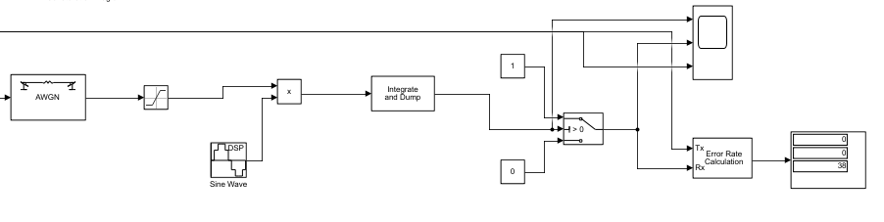
Simulation Process:
Figure: Simulation Diagram
The modulated signal is transmitted through Additive White Gaussian Noise (AWGN)
The noisy signal is fed to the saturation blockwhich imposes upper and lower bounds on signal
This saturated signal is then multiplied a synchronous carrier with same phase and frequency as that of received signal, then fed to integrate and dump filter block
Then the signal is fed to the control input to compare with data inputs of switch block.

Slide 12
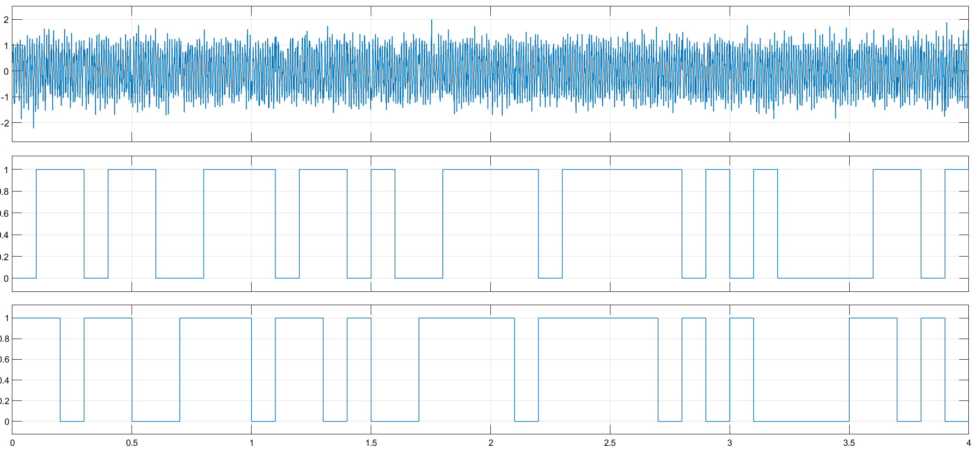
Result:
Figure: Simulated Result

Slide 13
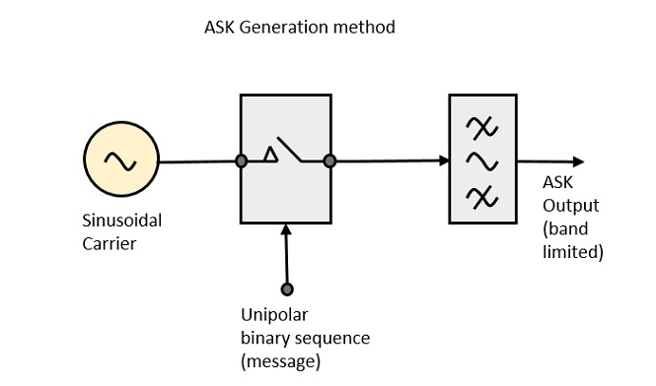
Amplitude Shift Keying (ASK) Modulation
Principle and Methodology:
A type of Amplitude Modulation which represents
the binary data in the form of variations in the
amplitude of a signal.
ii. The amplitude of the carrier only changes in the
two states.
iii. "1" is output when a carrier wave is output, and
"0" is transmitted when no carrier wave is output.

Slide 14
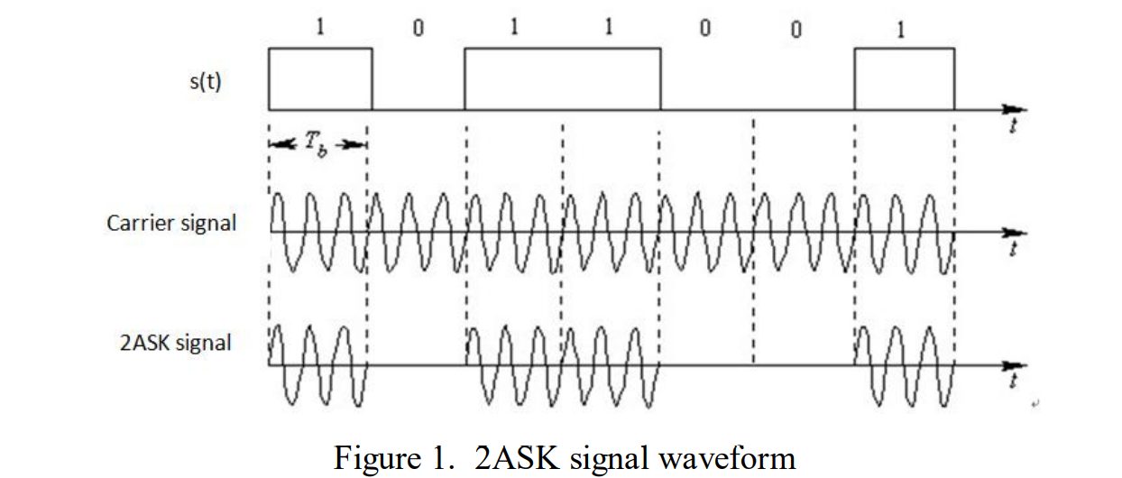
Principle and Methodology: ASK signal can be expressed as: e(t) = s(t) * Acos (w_{c}t) Where A is the amplitude of carrier and w_{c} is the angular frequency. s(t) is the unipolar NRZ rectangular pulse train. s(t) = ∑ a_{n} g(t – nT_{b}) Where s(t) is a rectangular pulse of duration Tb and height 1, and is often called a gate function.

Slide 15
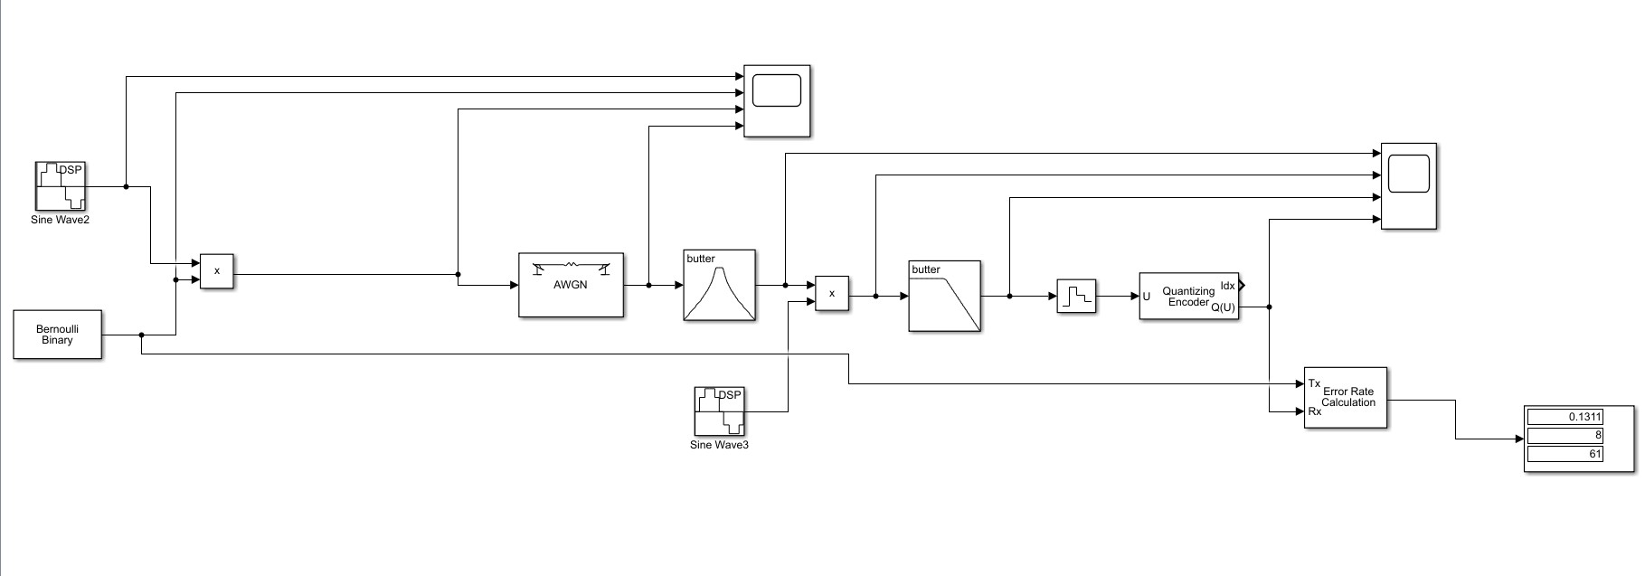
Simulation Process:
The signal source output (Binary Data Generator) and the carrier (sine wave) are multiplied by the multiplier.
The multiplied signal is then transmitted into the additive white Gaussian noise (AWGN) channel. the carrier signal frequency is generally greater than the frequency of the signal source.
The transmission channel adds white gaussian noise to the signal.

Slide 16
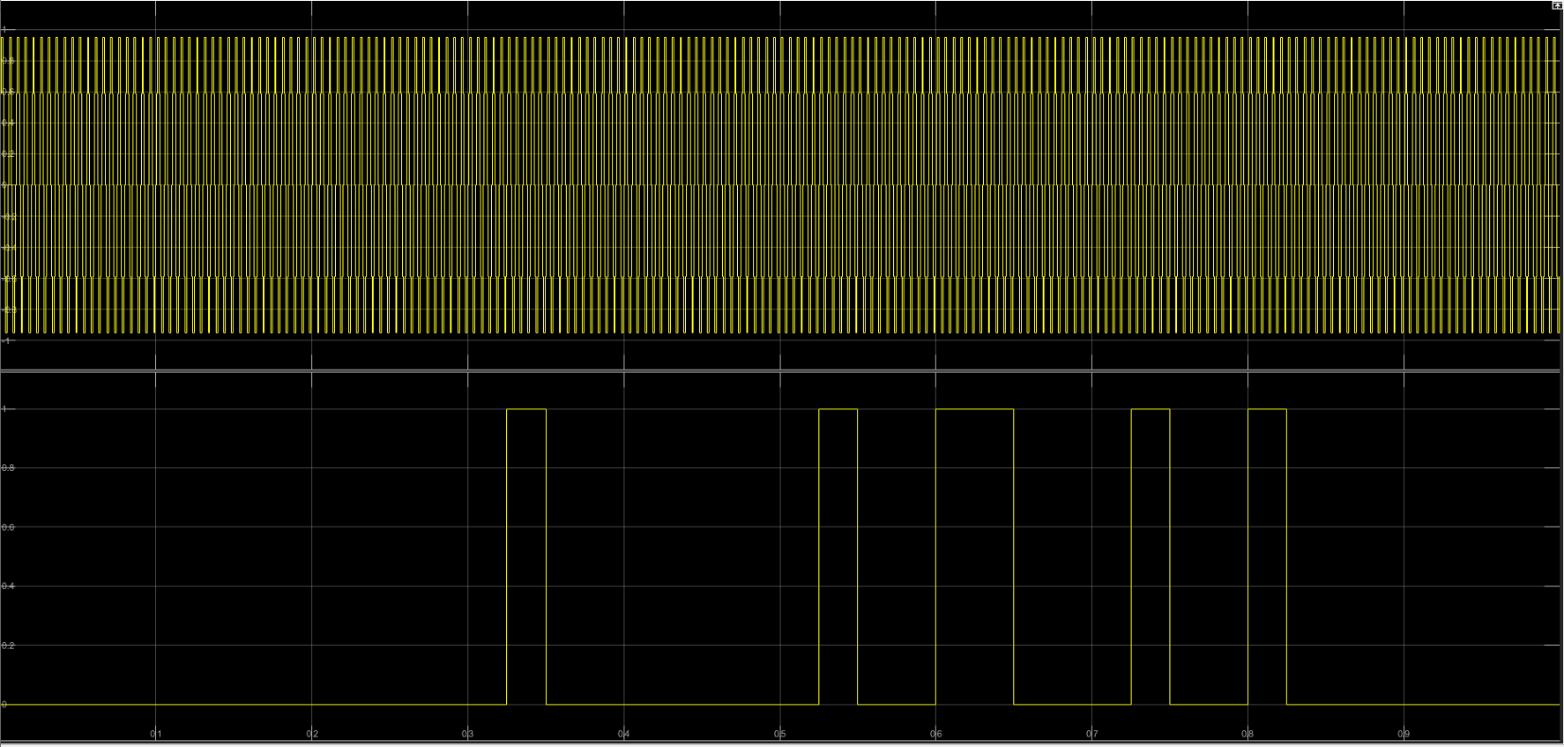
Result:
Here, the graph shows the output attached to of the carrier wave (above) and Binary Data (message signal).
The binary data is generated Randomly from Bernoulli Binary Generator and it is unipolar not return to zero.

Slide 17
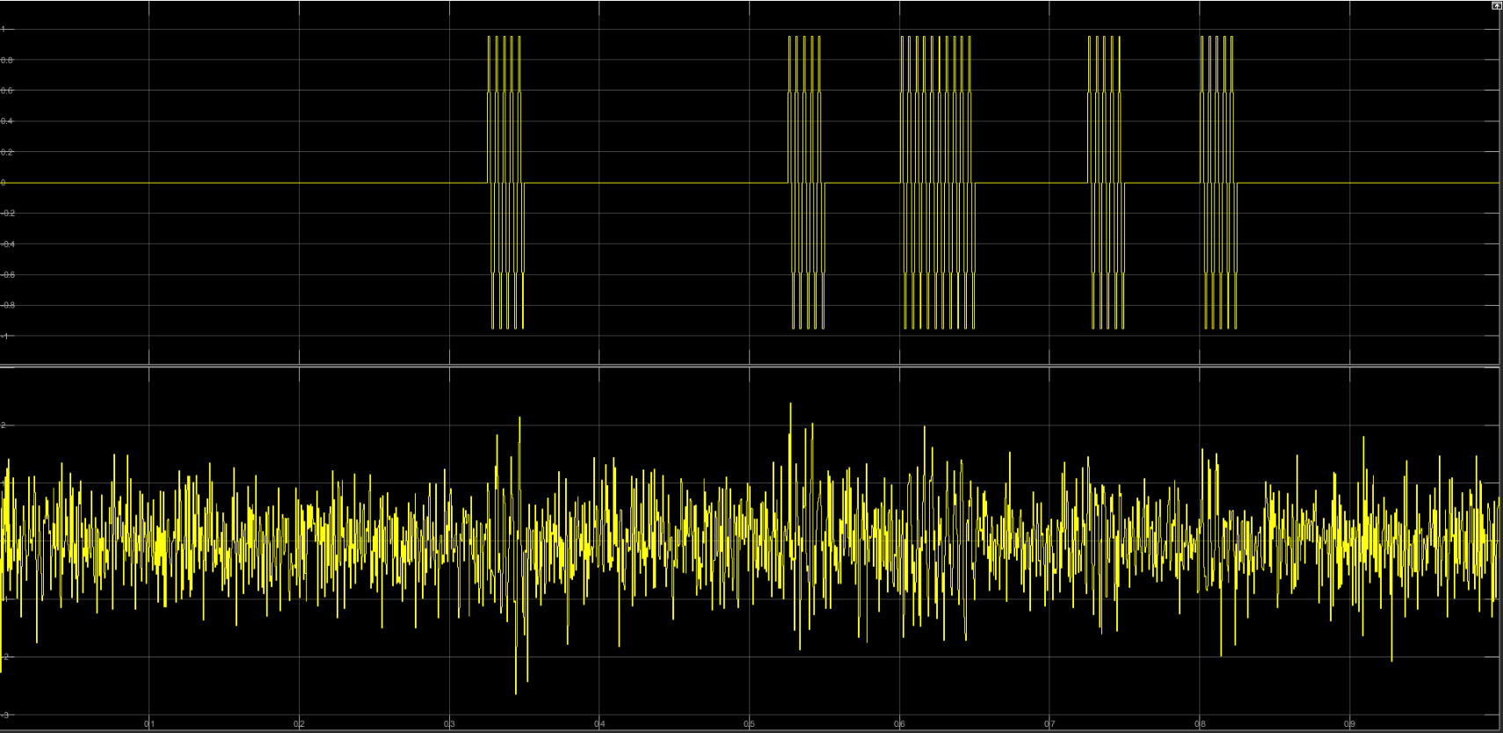
Result:
The graphs show the modulated wave after the multiplier (above) and the modulated wave at the receiving end after crossing the channel (below).

Slide 18
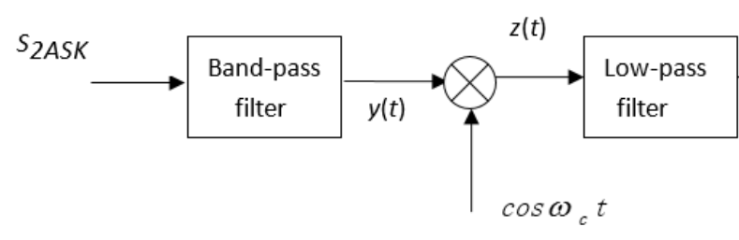

Synchronous demodulation or Coherent demodulation:
Modulated signal goes through the band-pass filter to suppress out-of-band interference from the channel.
Modulated signal is multiplied with synchronous carrier to reverse the removal of the spectrum to restore the baseband signal.
Modulated signal passes through low-pass filter to suppress high-order harmonics generated by the multiplier.

Slide 19
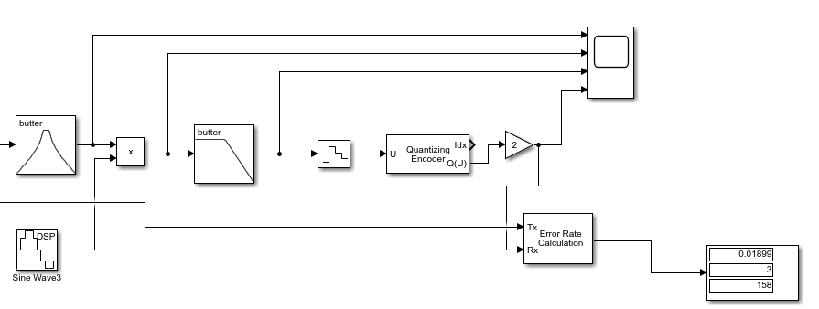
Synchronous demodulation (Simulink):
Modulated signal goes through the Butterworth band-pass filter to suppress out-of-band interference from the channel.
Modulated signal is multiplied with Sine-Wave (synchronous carrier) to restore the baseband signal.
Modulated signal passes through Butterworth low-pass filter to suppress high-order harmonics generated by the multiplier.
Output Signal is discretized using Zero-Order-Hold block. Which holds its input for certain period
Finally, Output is binarized using Quantized-Encoder and to adjust the amplitude signal is multiplied with 2.

Slide 20
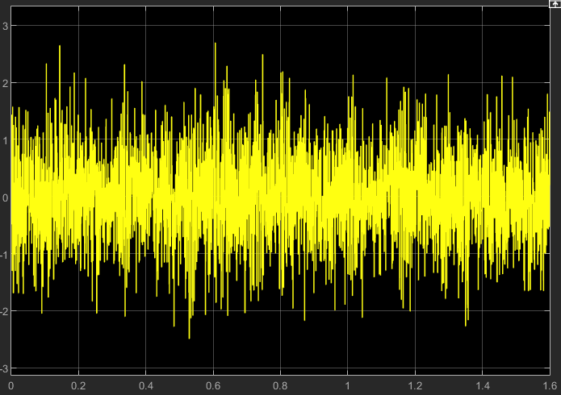
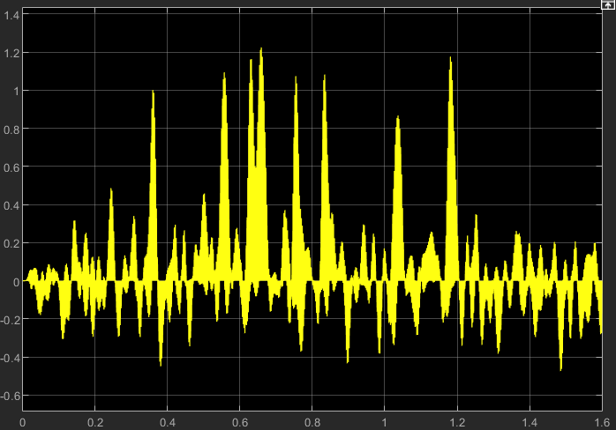
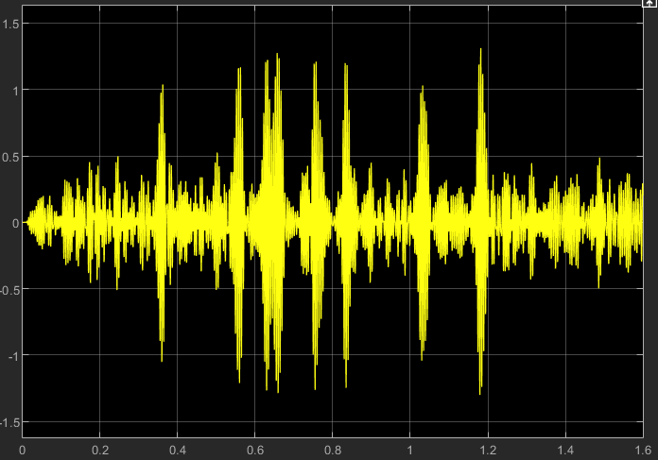
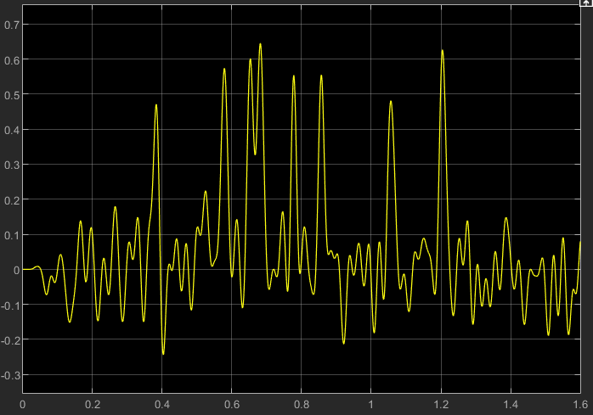
Result:
Modulated Signal:
After Multiplier:
After Band-Pass:
After Low-Pass:

Slide 21
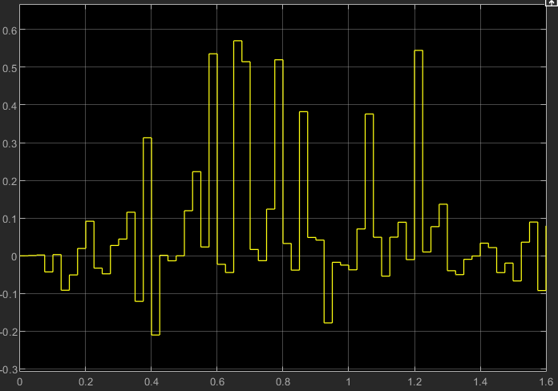
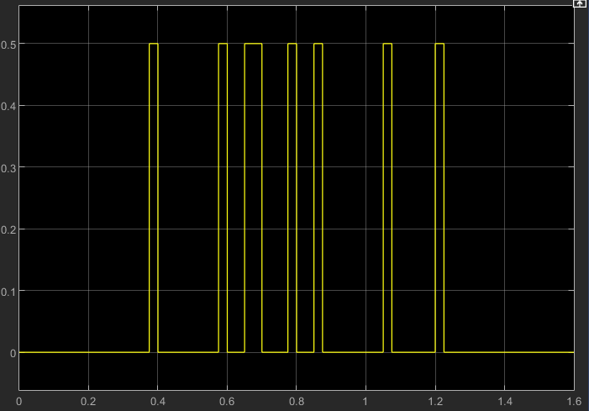
Result:
After Discretizer:
After Binarizer:

Slide 22
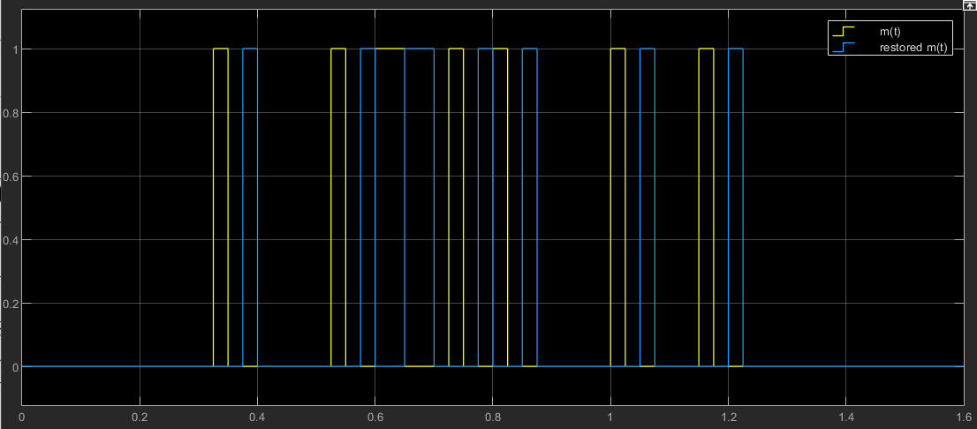
Result:
Input Vs Output:

