Slide 1
Stepper-motor Control using Simulink and Microcontroller
Presented by
Group -1
1706066-Awsafur Rahman
1706067-Abdul Mukit Majumdar
1706068-Nabila Tasnim
1706069-Joyita Halder
1706093-Anika tabassum

Slide 2
Objective
To control a stepper motor with a PWM signal where you input the angle, direction and speed to the motor controller.
To control it at a particular angle
To rotate it at a particular direction
To obtain a particular speed

Slide 3

Introduction:
Hybrid stepper motor-construction
Fig. 1 Construction of hybrid stepper motor
Hybrid steeper motor has small steep, typically 1.8°

Slide 4

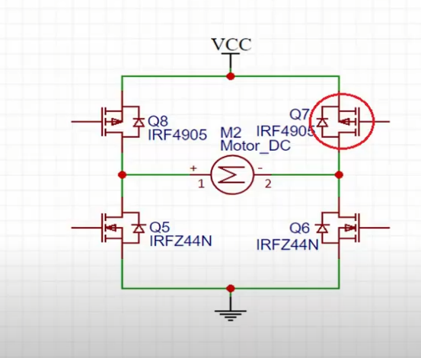
Special switching device in simulink
Full-Bridge MMC
The Full-Bridge MMC block implements a full-bridge modular multilevel converter. The converter consists of multiple series-connected power modules. Each power module consists of one H-bridge and one capacitor on the DC side.

Slide 5
Simulink Model Of Hybrid Stepper Motor
Fig.2 Simulink model of hybrid stepper motor

Slide 6
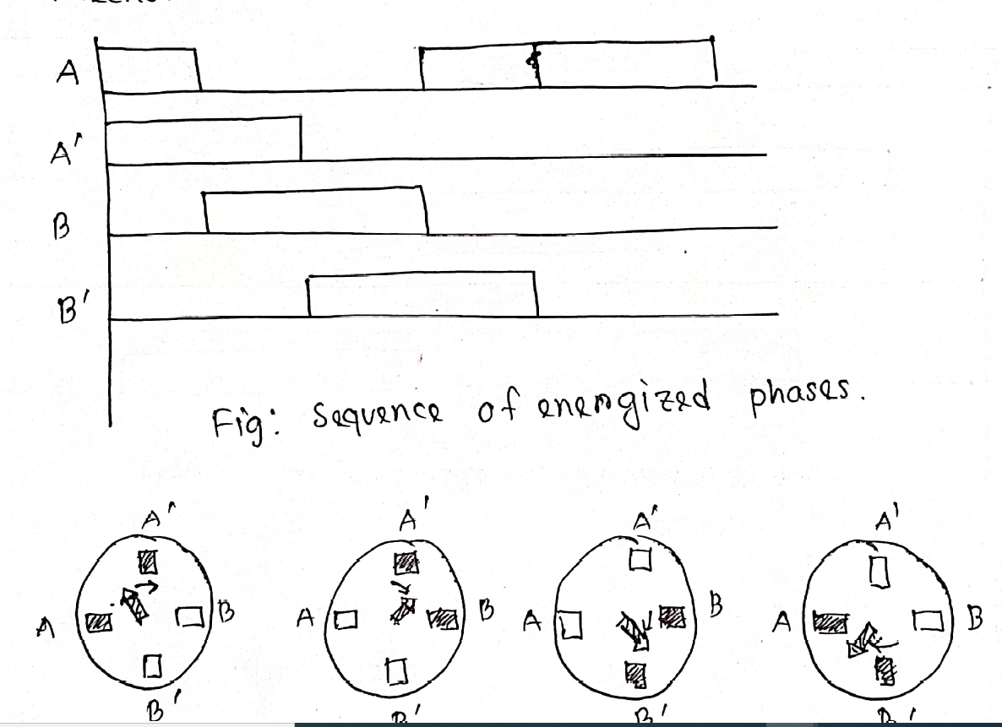
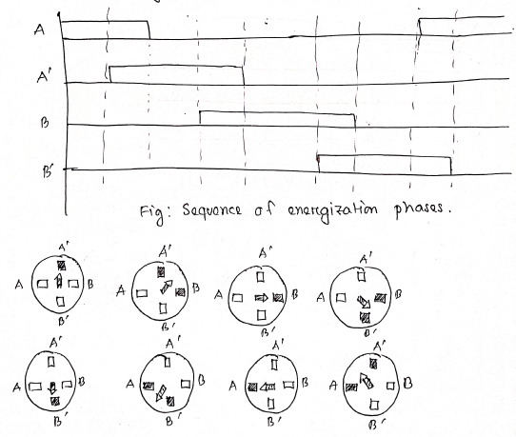
Methodology:
Inputs are taken as angle , step mode (full step/half step),speed (RPM)
and direction (clockwise/anticlockwise)
Fig :full step mode Fig :Half step mode
Then the Simulink model has been constructed

Slide 7
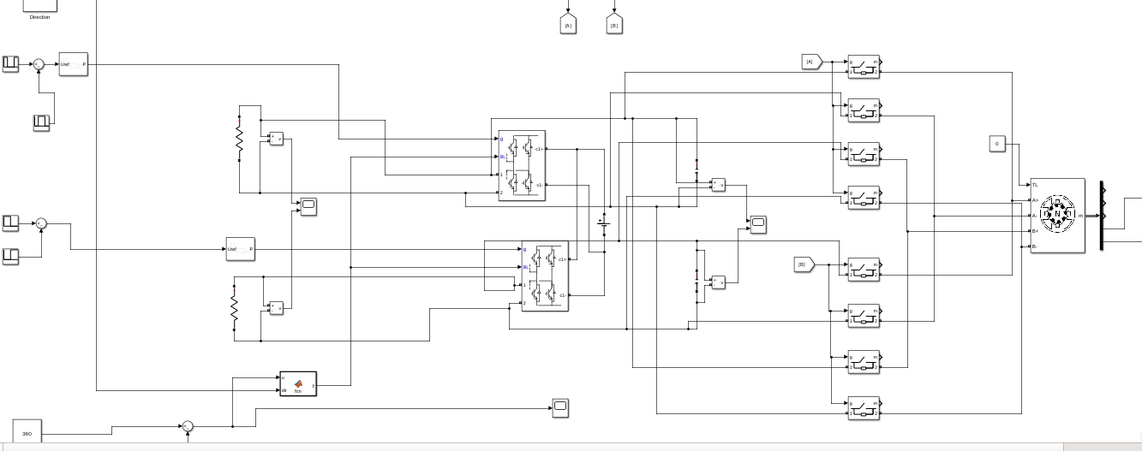
Simulink model description:

Slide 8
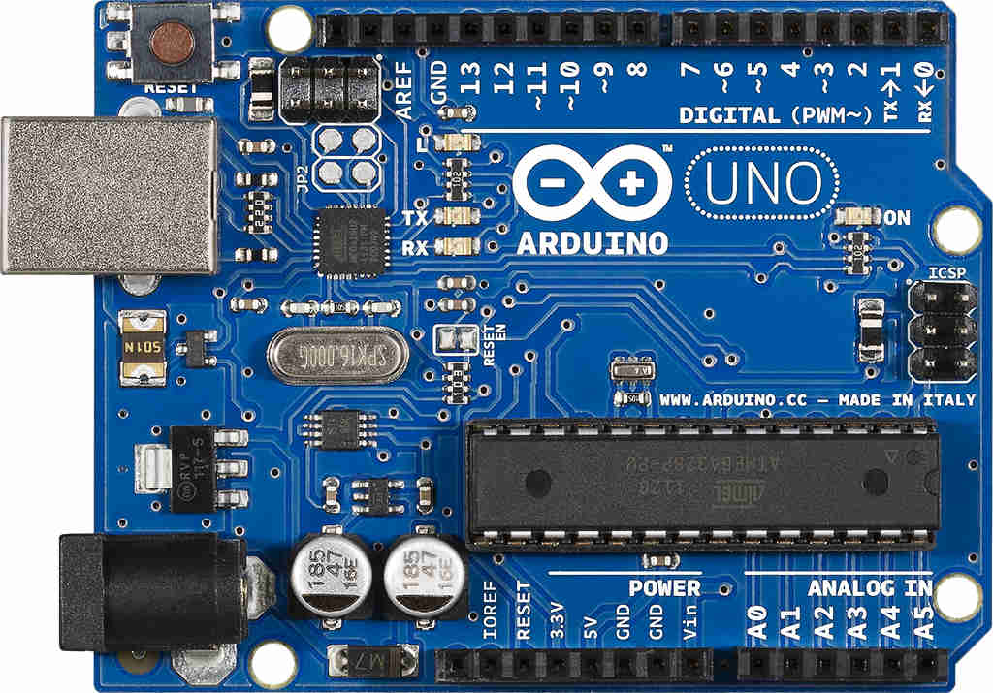
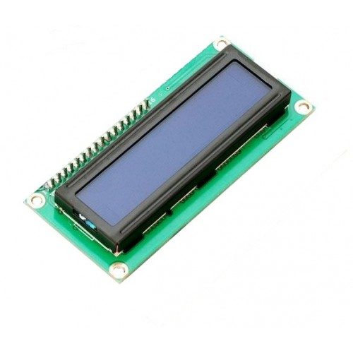
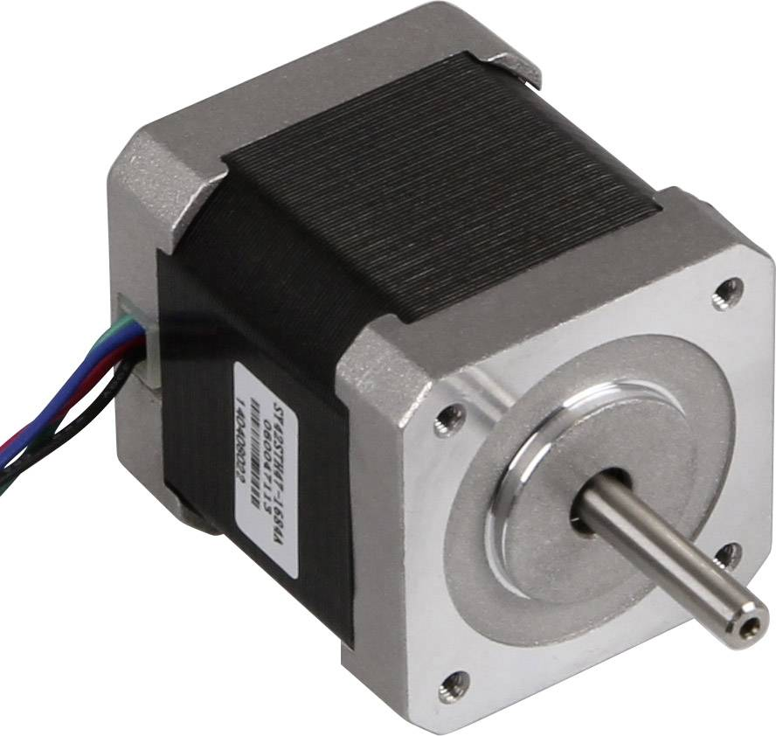
Our hardware components

Slide 9
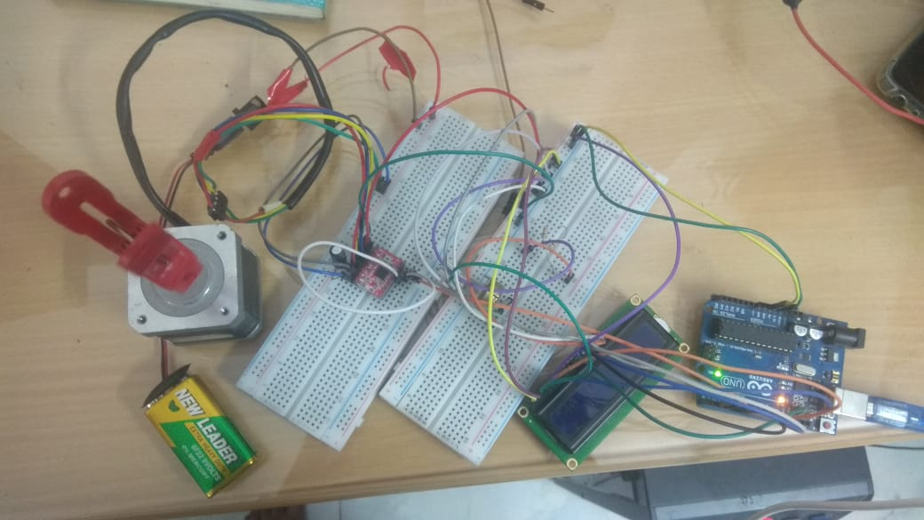
Hardware model description:

Slide 10
Outputs:
For Full step mode the outputs were observed at 5 rad/sec RPM and 100 degree step angle. We know, RPM = (step angle)/360*frequency*60
F=(6*RPM)/1.8; for full step
F=(6*RPM)/0.9; for Half step
Formulas for calculating frequencies from RPM
Have taken the mean value of the speed

Slide 11
Unstability:
Unstability occurs when we run the motor at more than 100 rpm
By upgrading the motor ratings like friction constant, Load rating, linkage flux and coil inductance
Solution:

Slide 12
Future plan:
Improve stability of the Stepper motor
Implement different types of stepper motor such as Permanent Magnet and Variable reluctance.
Implement different stepping mechanisms such as Quarter and Microstepping stepping.

Slide 13
Conclusion
Implemented a system to control stepper motor with a PWM signal in both Hardware and Software.
System can be used to control Speed, Direction and Angle of the stepper motor.
Discussed Stability, Maximum Stable Speed and Solution to improve stability of stepper motor.

